Slide 1
Helping Kids Publish Books For your Collection

Slide 2
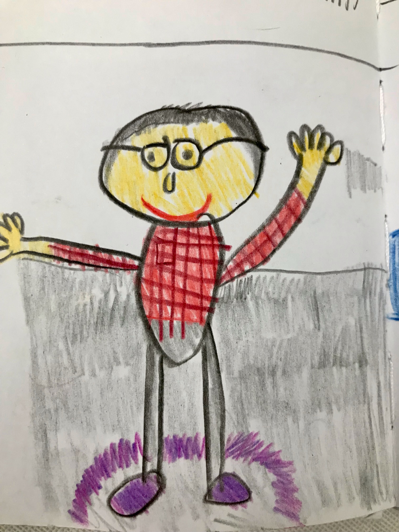
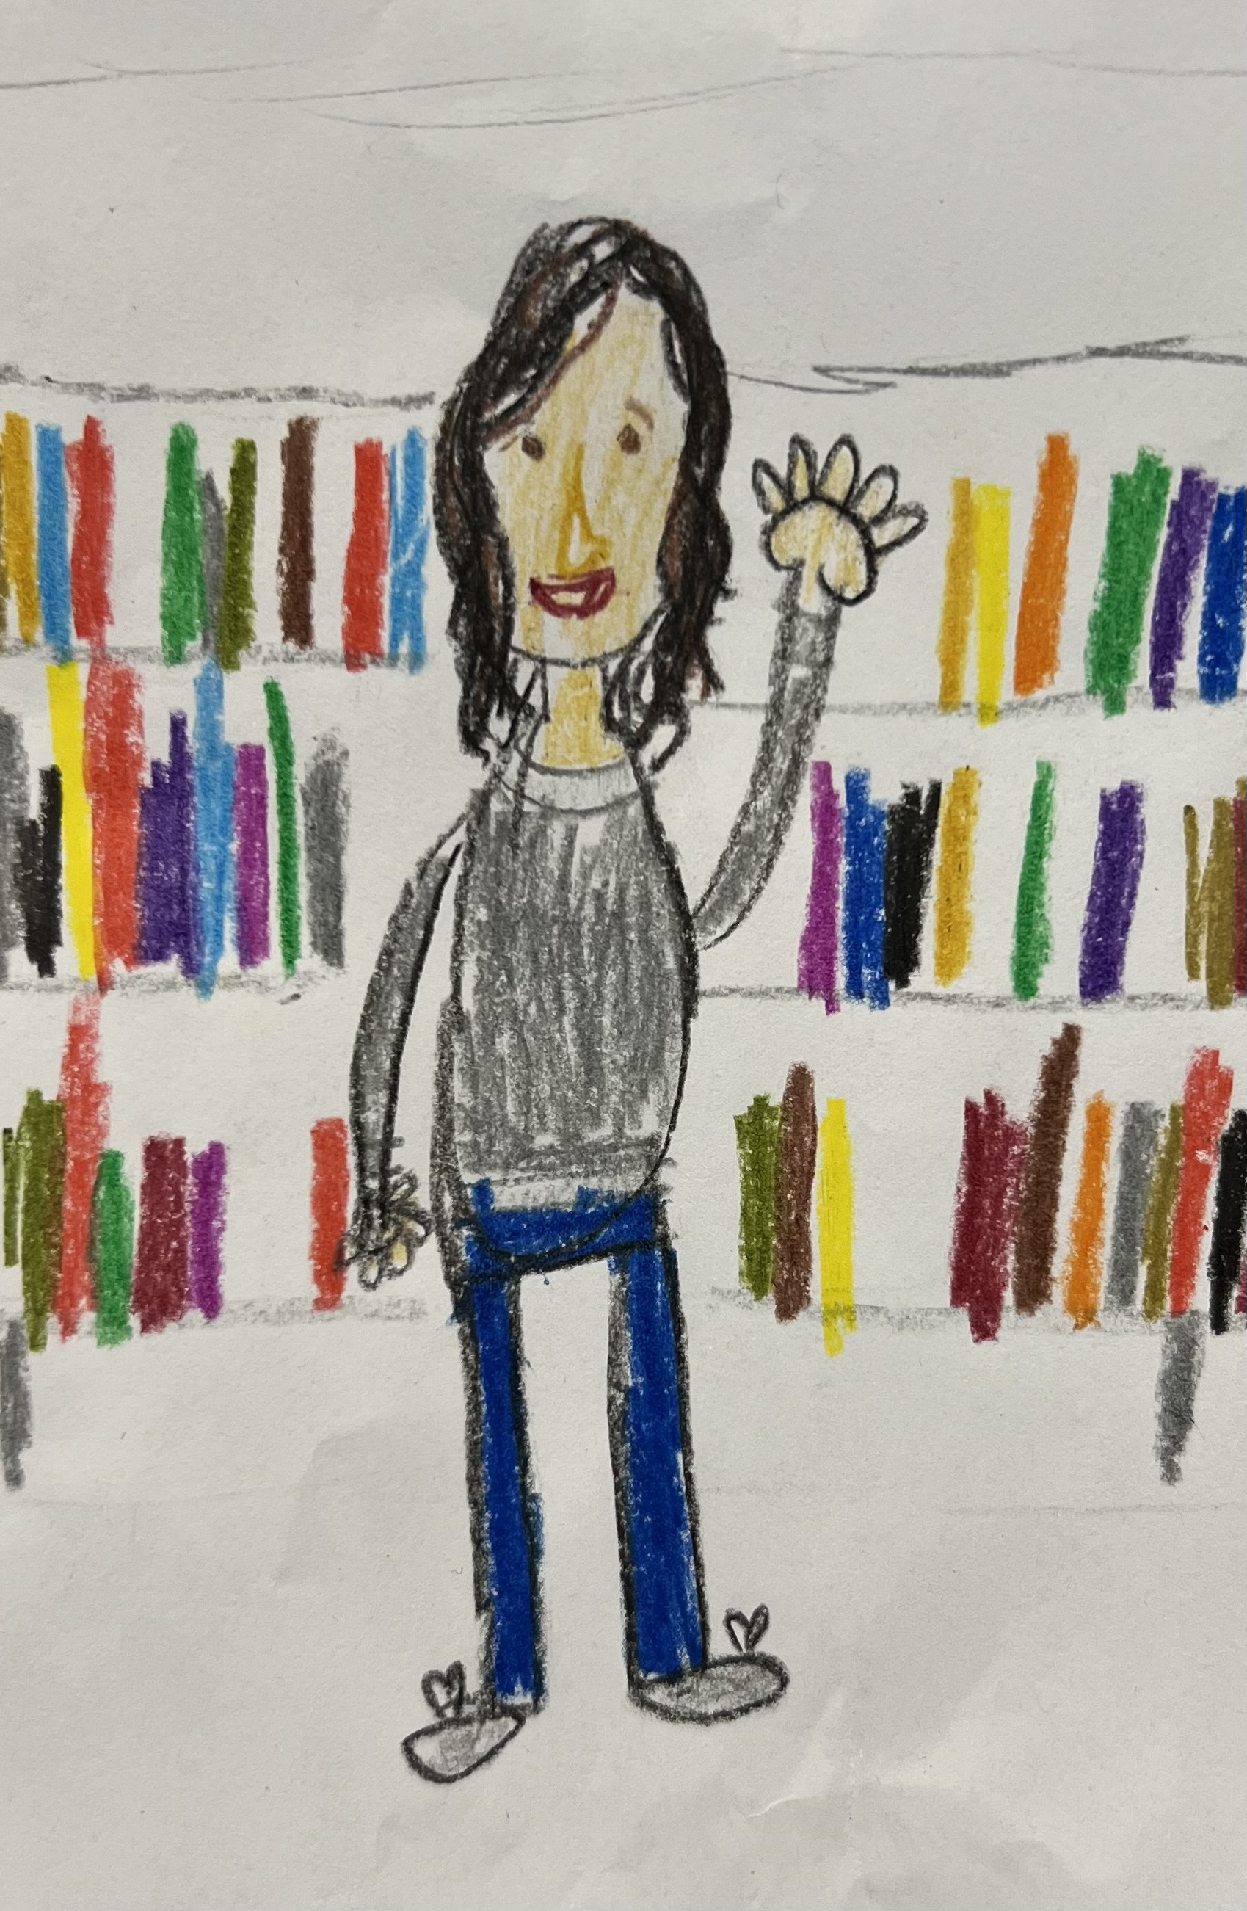
Meet Rob and Adrienne
Rob is the Manager of the Herrick North Branch Library
Adrienne is the Youth Librarian of the Herrick North Branch Library

Slide 3
Outcomes
Participants will engage in learning around an in-depth, series-style, collaborative program for kids that took place at the Herrick North Branch library in Holland, MI.
30 min
Participants will collaborate around how they might adapt this style of program to their own patrons, regardless of budget or staffing constraints.
30 min

Slide 4
How the Story Project Was Born

Slide 5
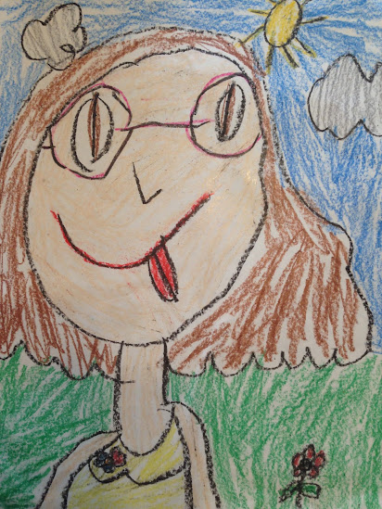
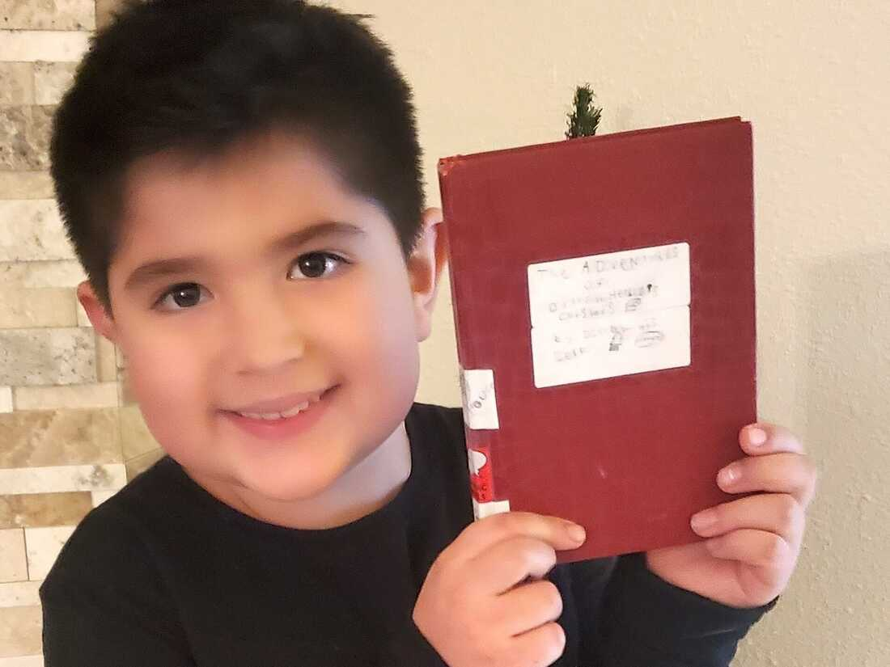
Little Dillon
and Little Lucy
The Helbig Family. (2022). At just 8 years old, Dillon Helbig of Boise, Idaho, is a self-publishing sensation. This 8-year-old's book is a hit at his library. He offers advice for aspiring authors. Photograph, NPR. Retrieved March 24, 2023, from https://www.npr.org/2022/02/05/1078478581/this-8-year-old-is-boise-idahos-hottest-new-author.

Slide 6
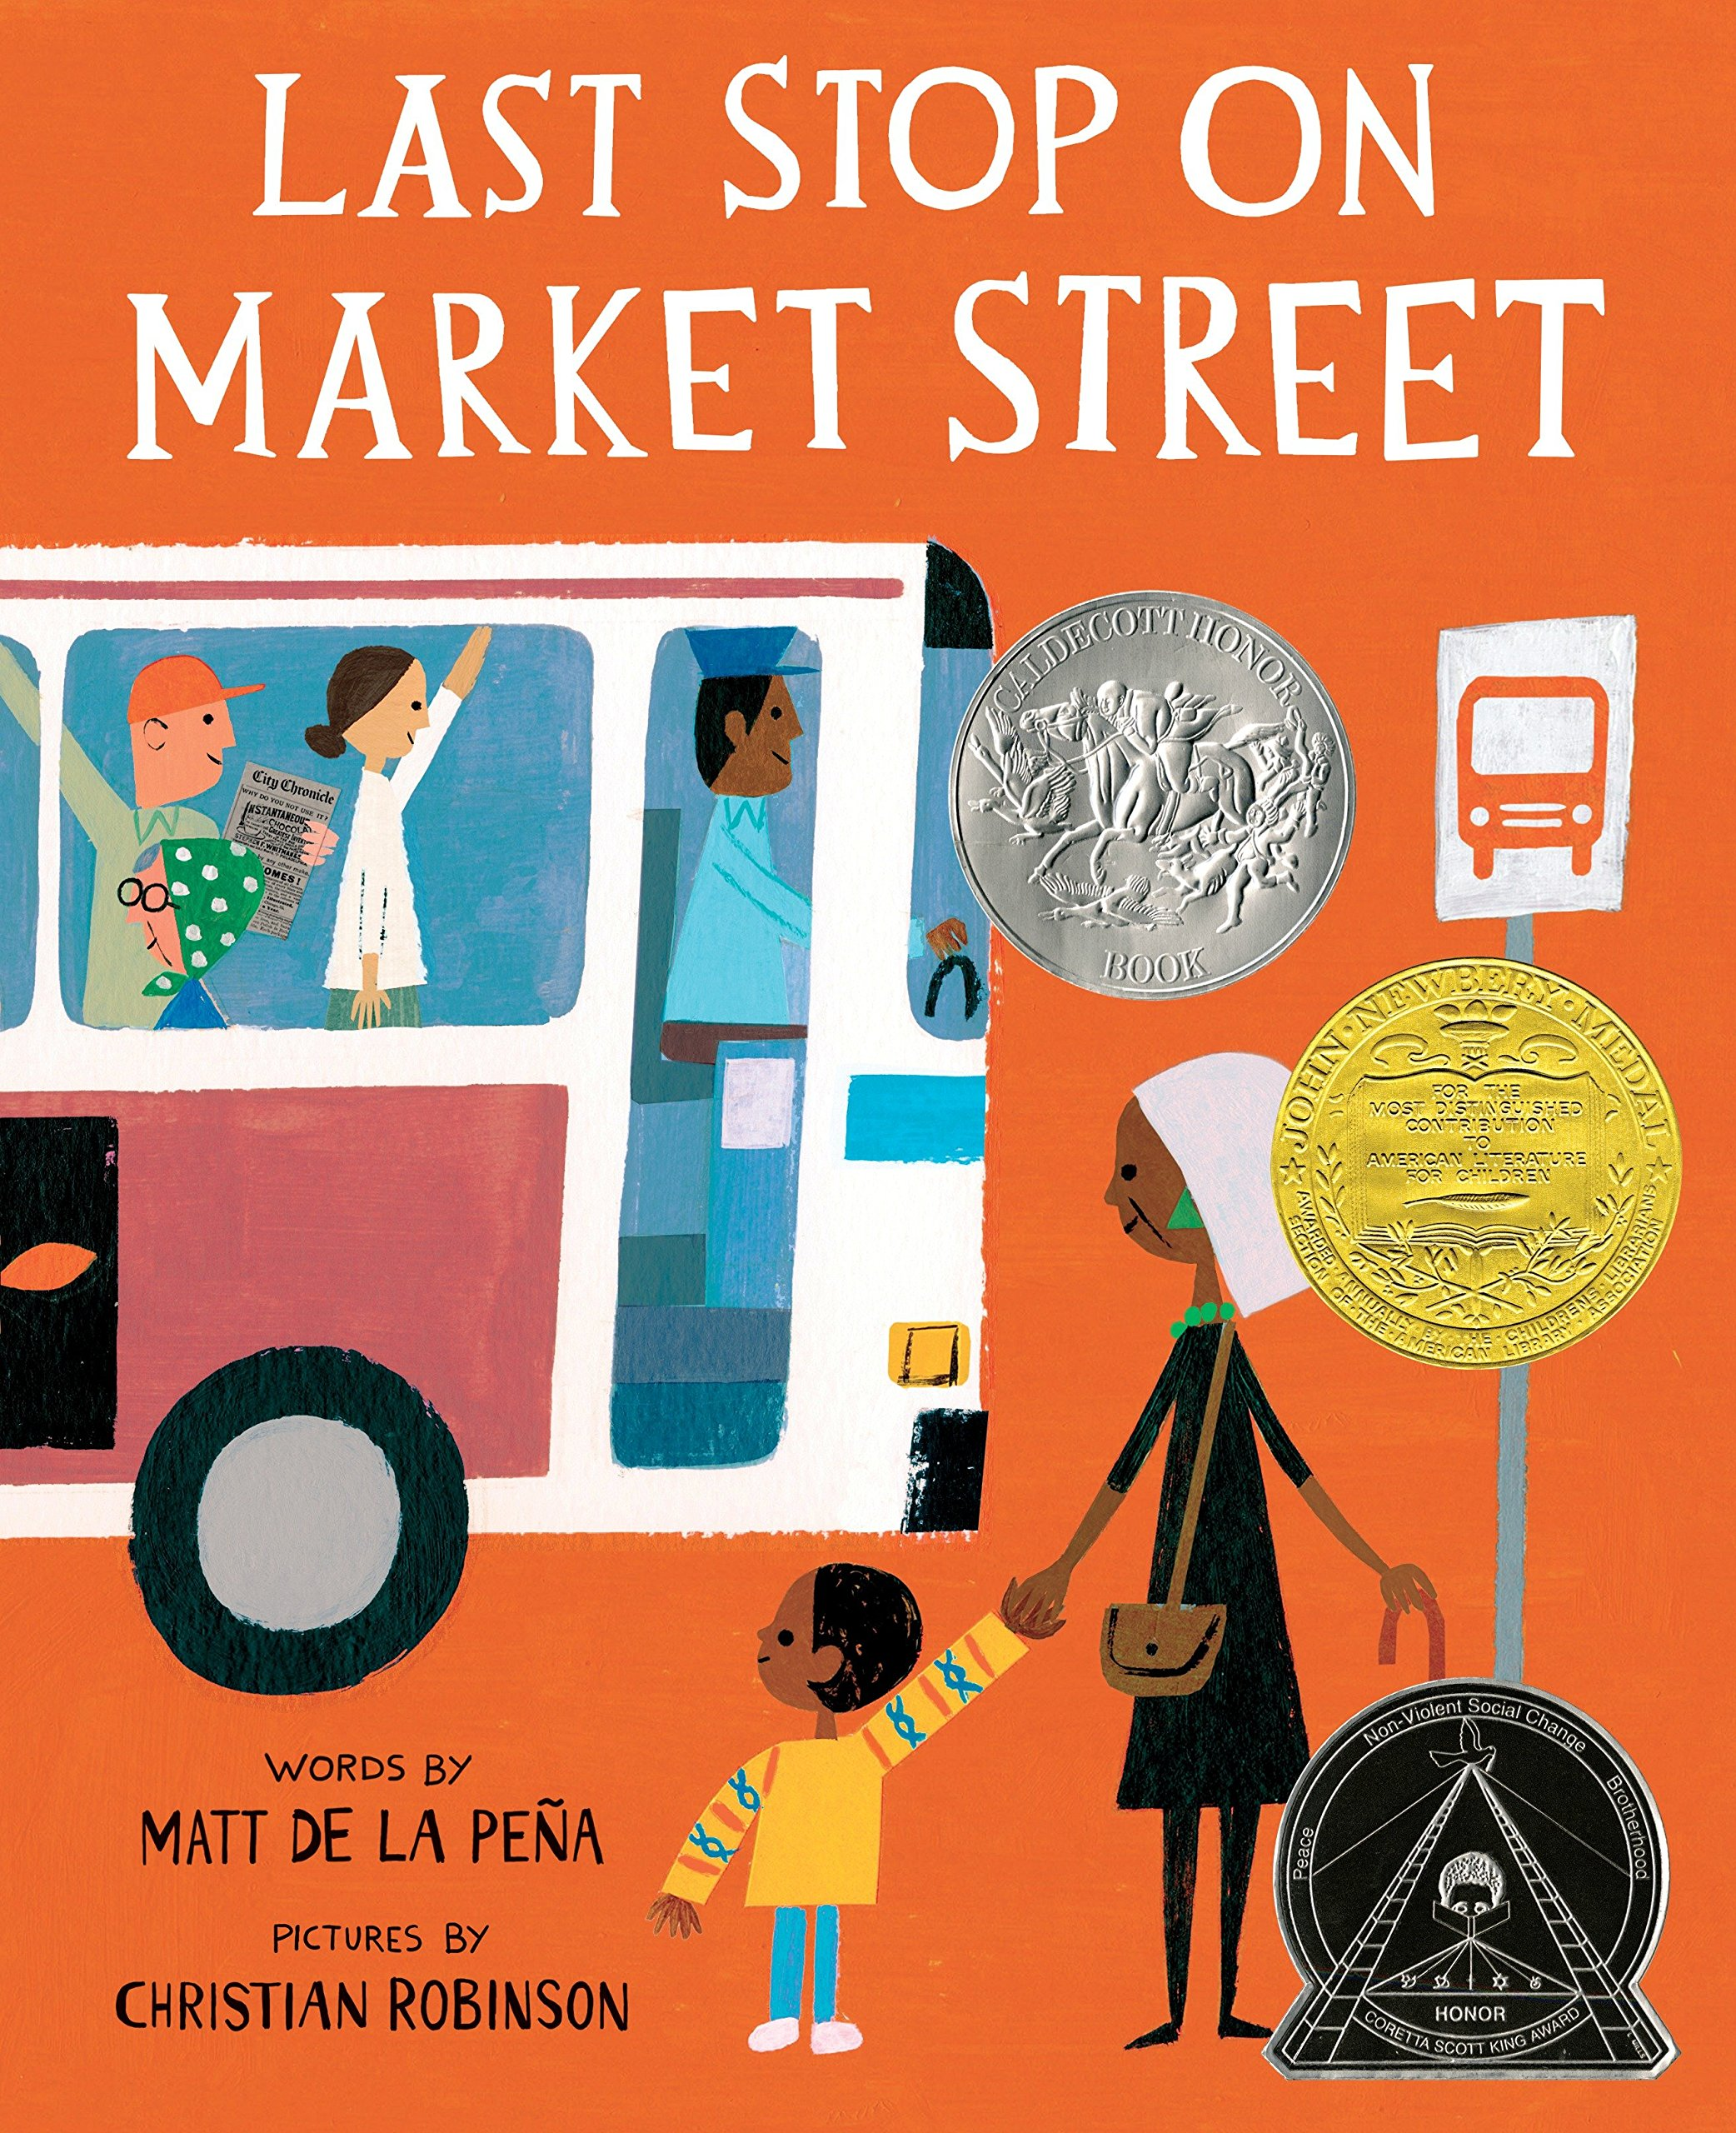
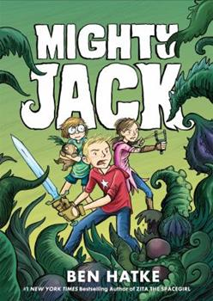
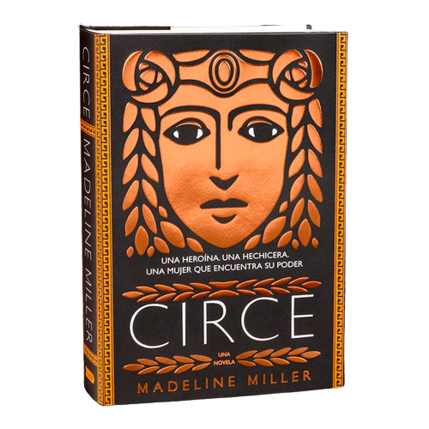
Little Read
Middle Read
Big Read
Little Read

Slide 7
Sessions

Slide 8
The First Four Weeks
1
2
3
4
Introduction
Characters
Plot
Illustrations

Slide 9
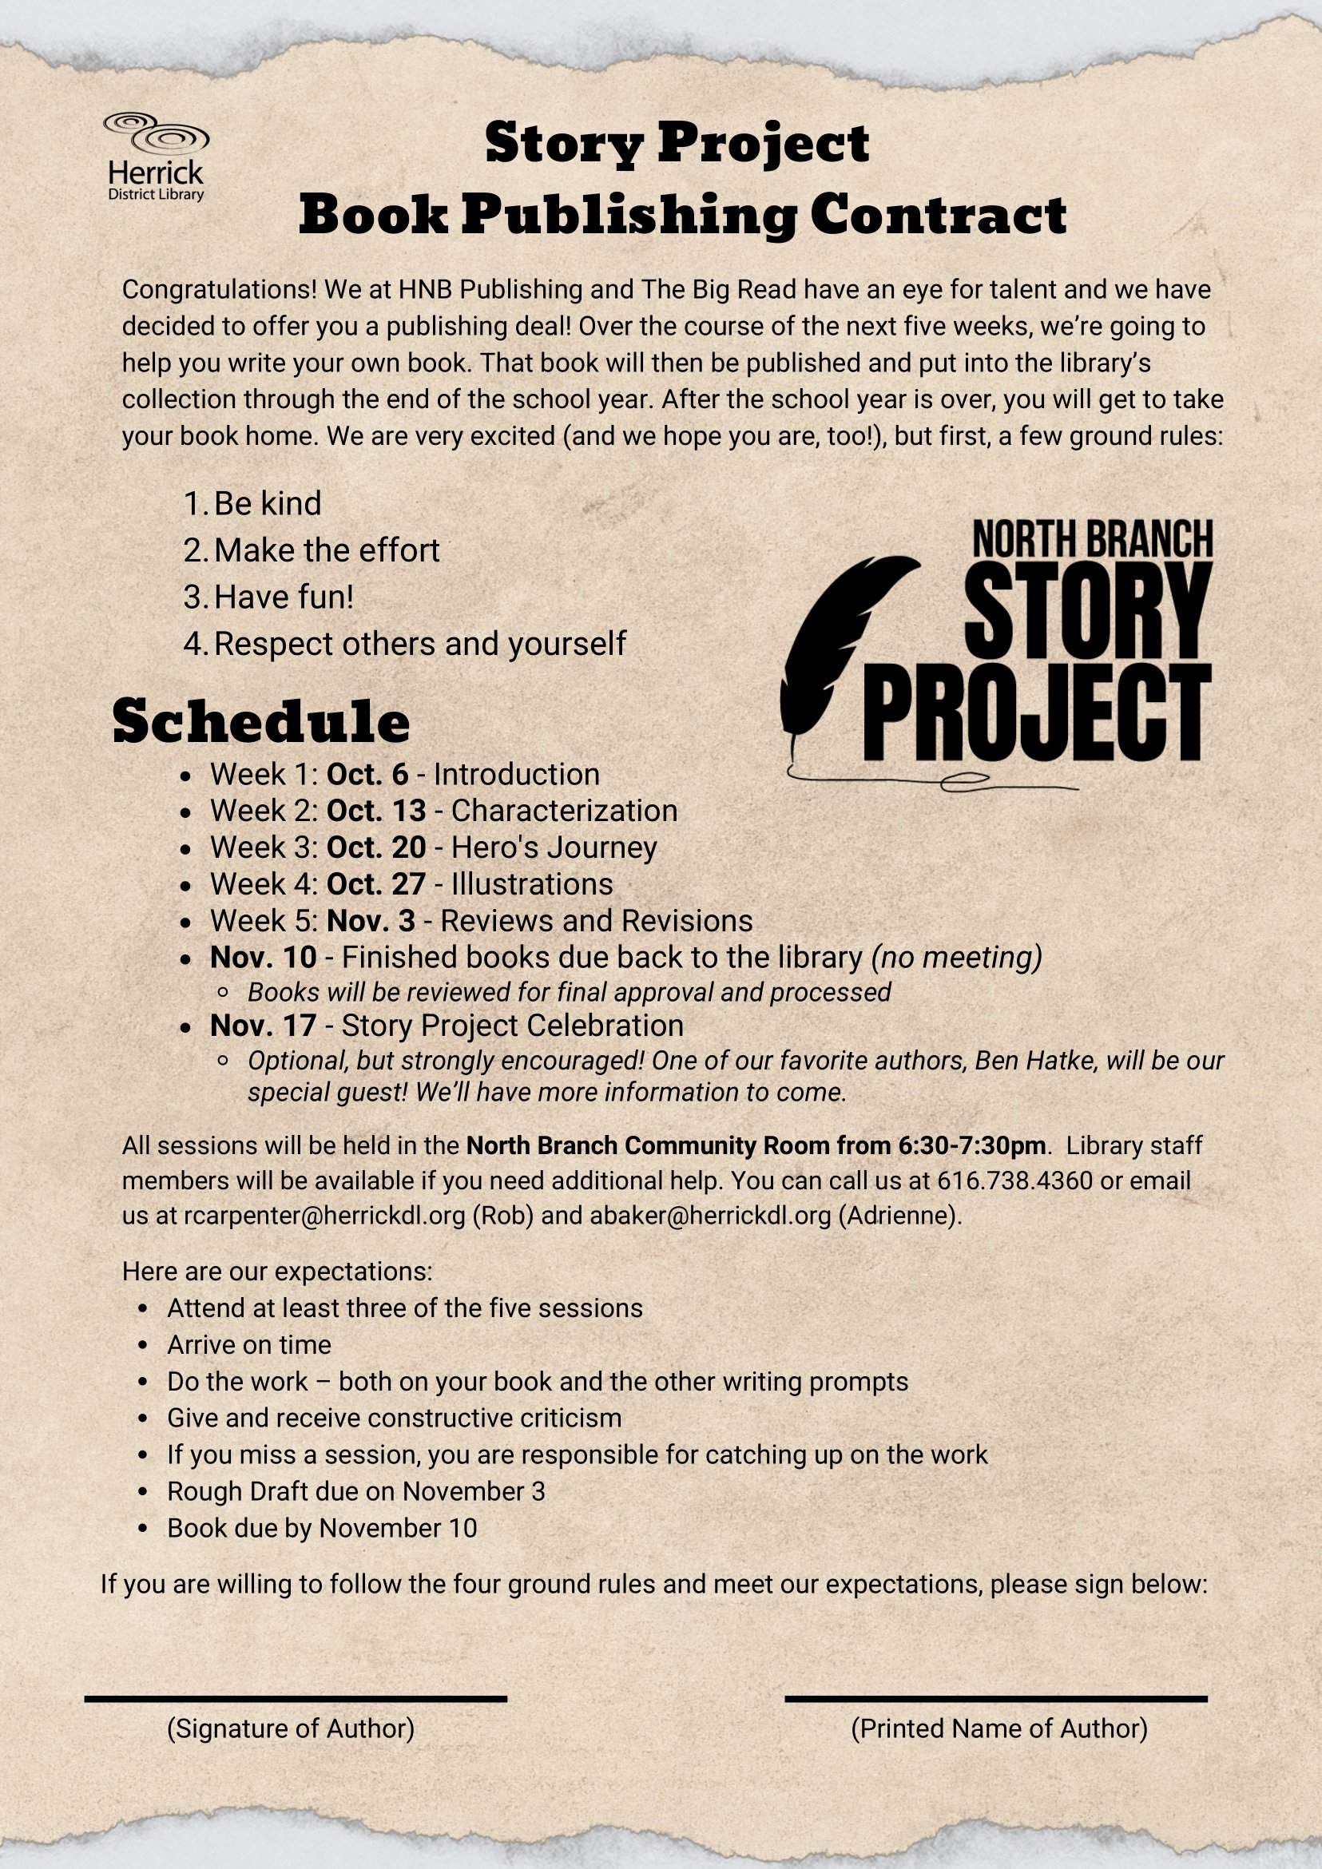
Week 1: Introduction
Getting To Know You!
Writing Exercise
Contract (Instruction)
Homework

Slide 10
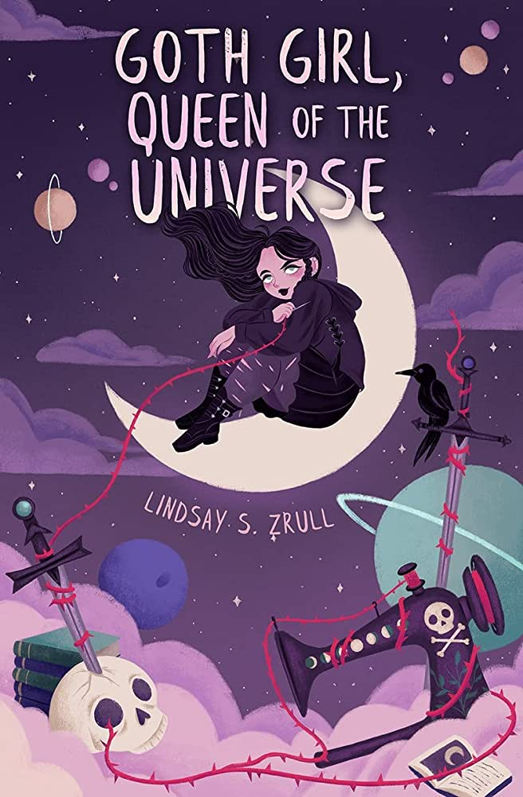
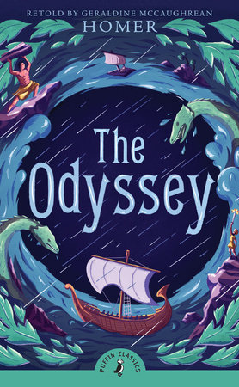
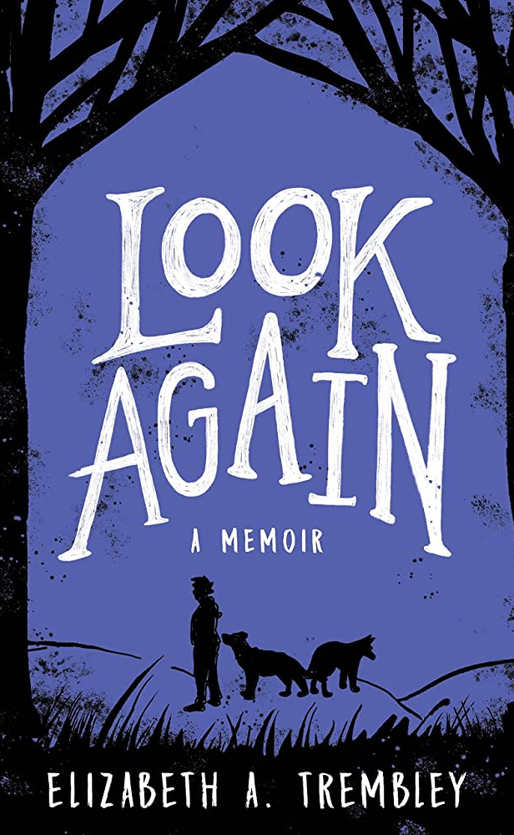
Special Guests!

Slide 12
Writer's
Workshop!
02.
03.
Peer Review
Independent Work Time
3 kiddos per group w/ Karen
Scheduled after Peer Review so that the kiddos could make changes to their stories before the Professional Review
01.
04.
05.
Brainstorming Questions For Ben
"Professional" Review
T-Shirts!!!!!
No such thing as a silly question!
Kids had a 1-on-1 session with Lindsay, Liz (CDR Librarian), or Natalie (Assistant Director)
Screen printing w/ Adrienne!

Slide 14
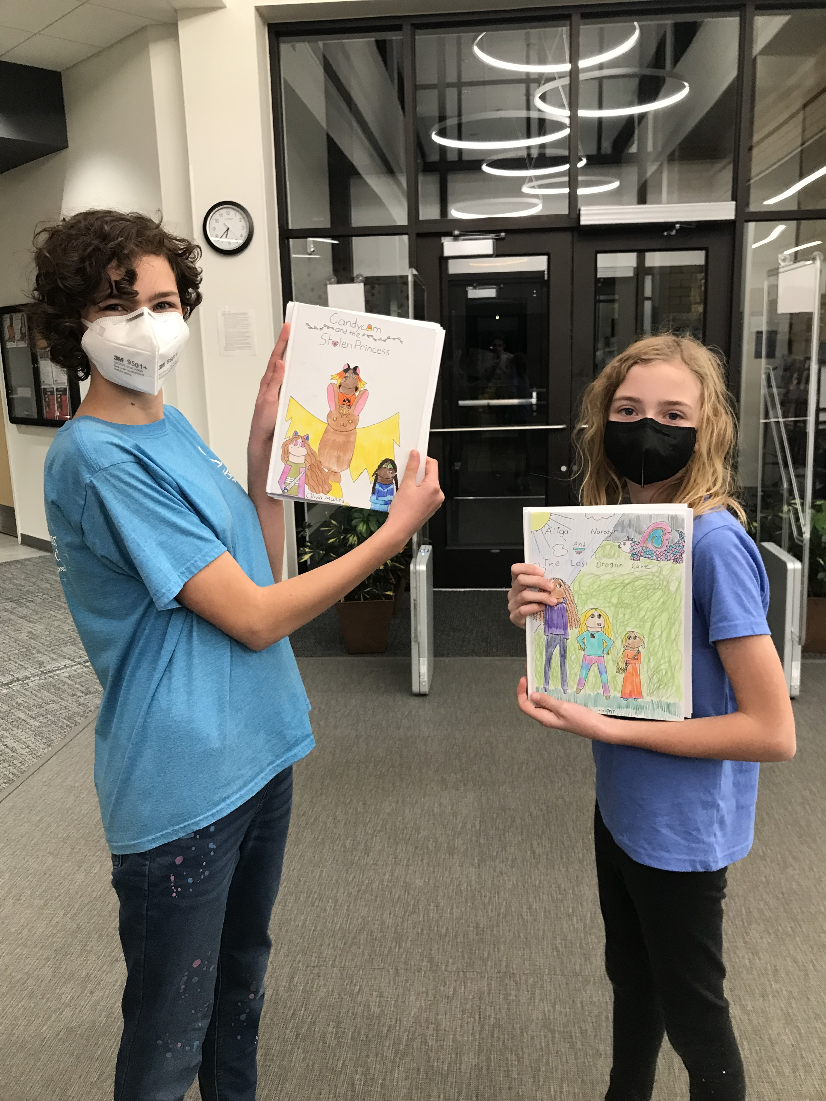
Week 6: Final Revisions
No official class
Open hours at the library where staff were available to work one on one with kiddos

Slide 15
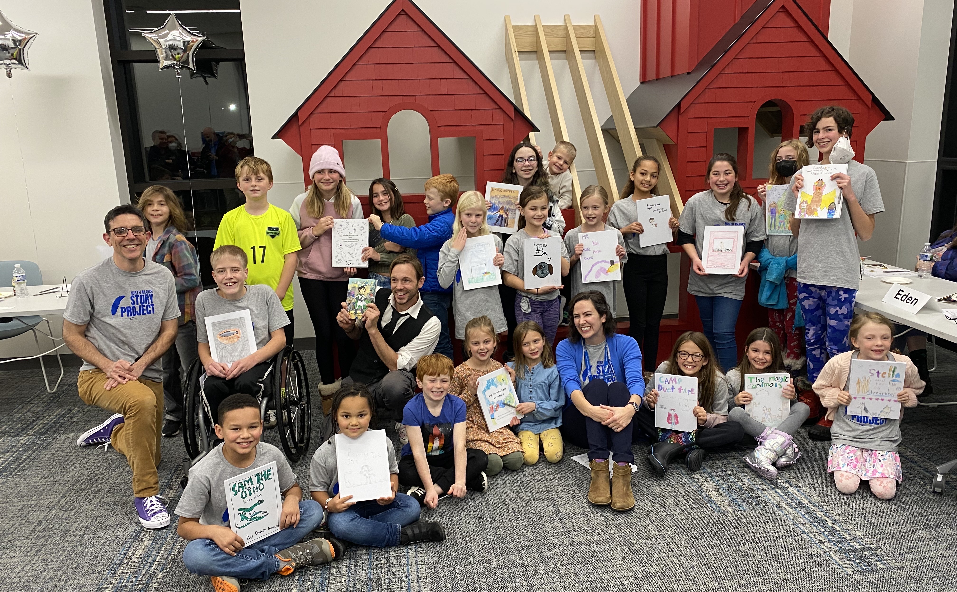
Week 7: Celebration!

Slide 16
Classroom Involvement

Slide 17
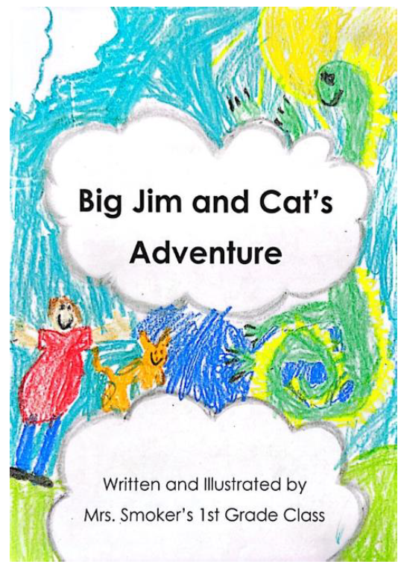
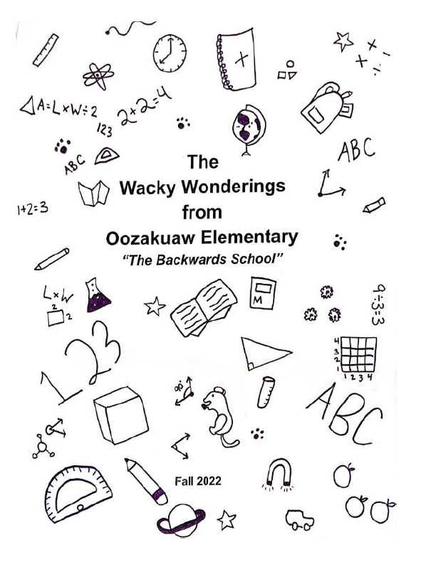
First Grade Classroom
Upper Elementary Montessori Classroom

Slide 18
Reflection

Slide 19
Our Favorite Parts
Kids
Ben
Community Interest
Ownership

Slide 20
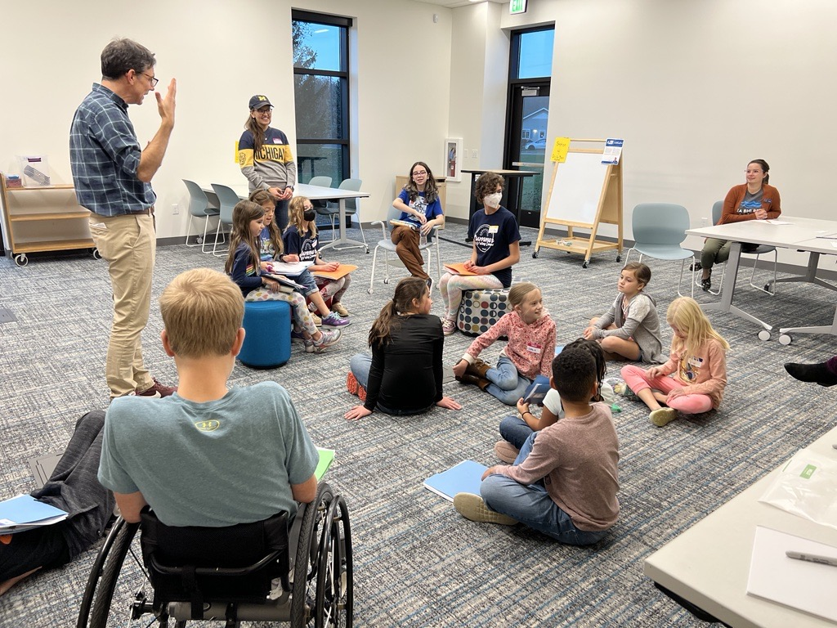
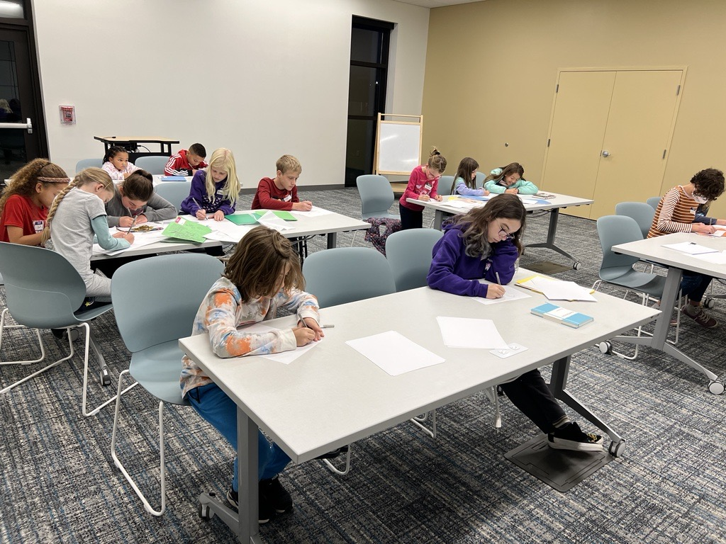
The Kids!

Slide 21
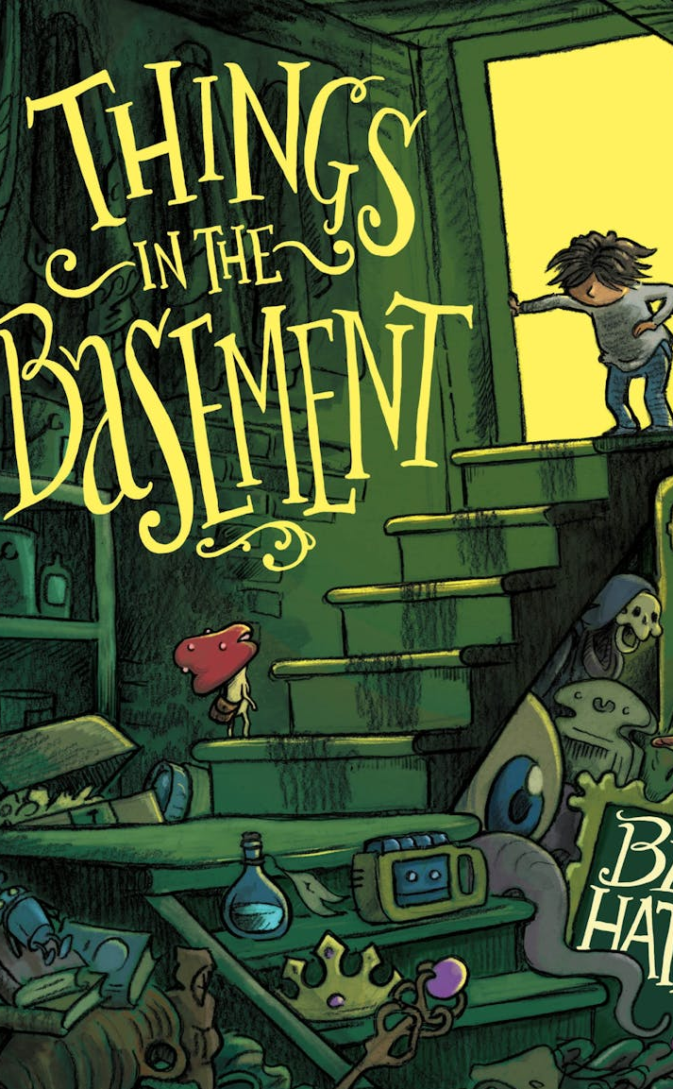
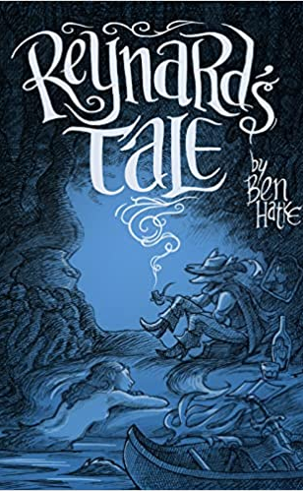
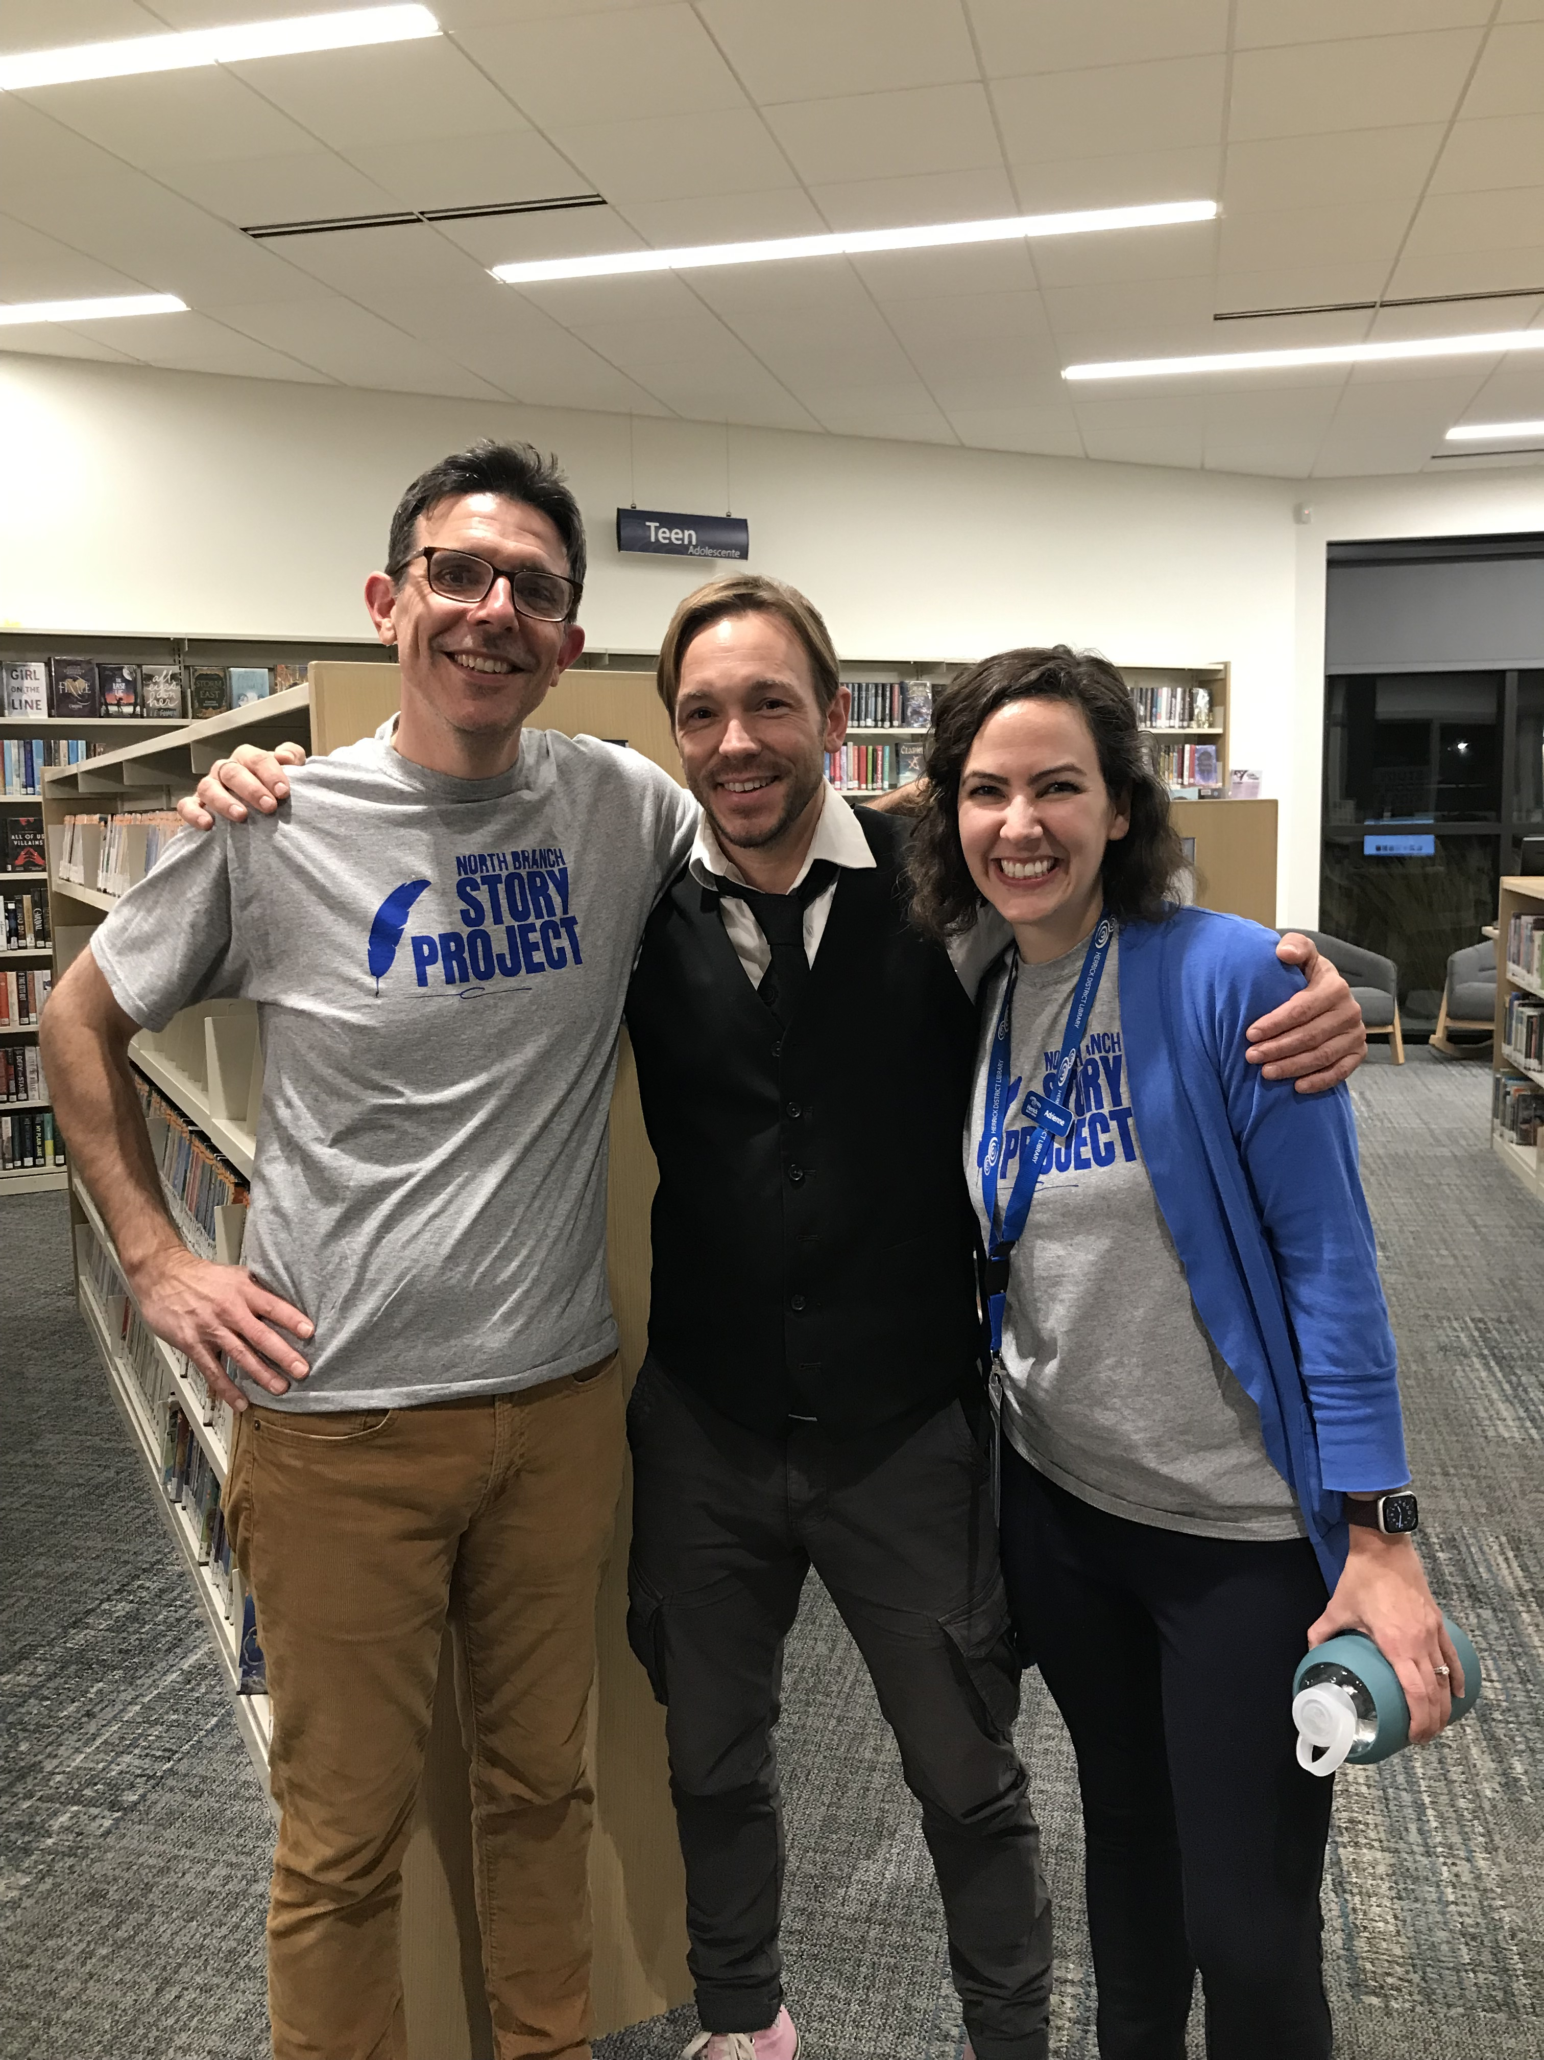
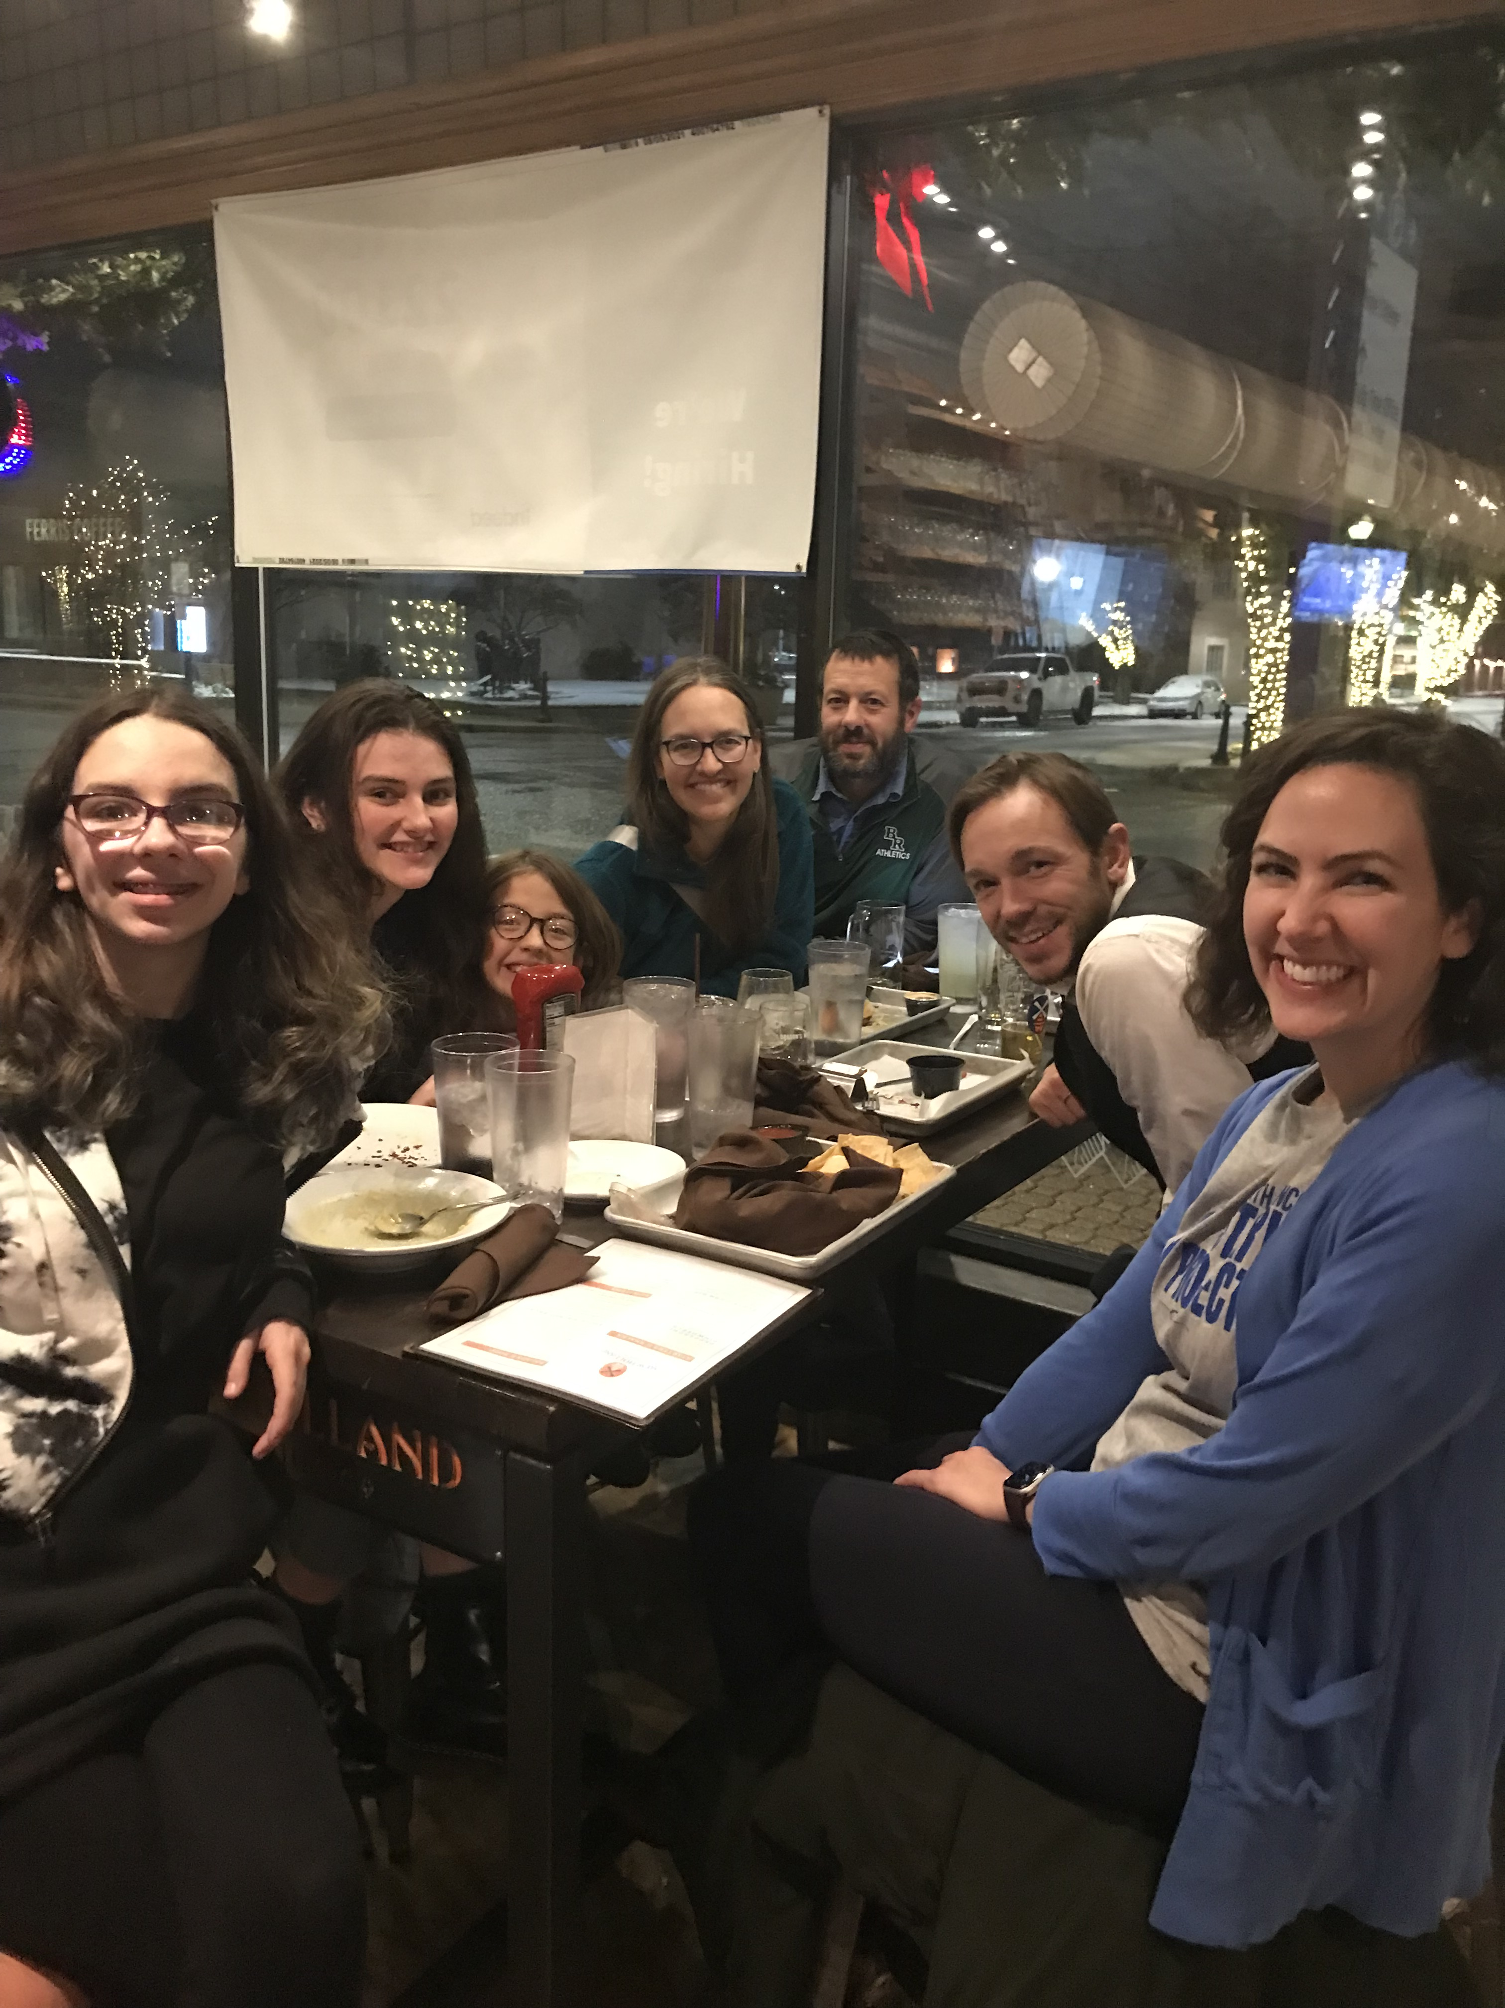
The Ben!

Slide 22
Next Time!

Slide 23
What would we do different?
Increase writing time
Time management
No “big name” author
More focus on inner-workings of library
Focus the target age
Formatting books
B&N Press
SO MUCH TIME
Enticing a different crowd of kids
Teen volunteers

Slide 24
Details

Slide 25
Program Details
Registration
Time
Commitment
Limit of 20 kids, but 15 registered
We collaborated with two classrooms
One hour session for five weeks
Open work hours at the library to finish books
One hour meeting with each presenter
Formatting books for B&N publishing took around 20min/book
One hour final celebration
One hour prep before each session
Kids had to attend at least five of our one-hour evening sessions to publish a book
Cost
Each B&N Press book cost around $10 (hardcover, full color)
Blank books were around $5/book
So. Much. Staff. Time.

Slide 26
Small Groups
11:30-11:50

Slide 27
Consider these questions:
How might this style of program work in your setting?
What other spins could you put on a series-style program?
Creating art, music, theater, STEM, etc.
What age group might you target?
What theme could inspire or focus your version of the program?
Hero’s Journey, Graphic Novels, Genre-specific, etc.
What community connections could you leverage to develop a robust program series?

Slide 28
What inspiration came through your conversation?

Slide 29
Testimonials
Eden (Author)
MC (Parent)
Ben! (Ben)
Kelsey (Teacher)
I liked getting my book published at the end because my book actually got to be in a library! My friends at school think they are famous because I dedicated the book to them. Now they can check out my book and take it home. My classmates want to write a book and get it published like me! Ben Hatke looked at my book, and I liked that because he was a real author. Now I’m a real author too!
(My daughter) is so proud of what she created! She even went as her main character, “Stella,” for “Favorite Book Character Day” at school. So many of her classmates have been going to the library looking to check out her book. It has encouraged families to attend the library who don’t normally go because their child is begging to go get Eden’s book! The impact and reach of this project is beyond what Eden and I expected. I love typing my own child’s name into the catalog search and having her book come up!
My visit to Holland goes on my shortlist of the most welcoming and positive programs to which I've been invited. Rob (who is definitely one of the coolest human beings I've ever met) was an excellent host! And I know I could search high and low and never find a children's librarian like Adrienne.
My students LOVED it! They are so proud of their book. They felt very connected to the library during the process and got to know you very well too and I think that's amazing to make that connection for them so young...We had so much fun doing this project and I would love to be involved next year too. Thank you so much for inviting my class to participate!

Slide 30
Thanks !
Adrienne: abaker@herrickdl.org
Rob: rcarpenter@herrickdl.org
616.738.4360

