Slide 1

MLA Spring Institute 2022
03/11/2022

Slide 2

Agenda
Meet MI Humanities
Your Presenters
Programs
Grants
MI Humanities Portal

Slide 3
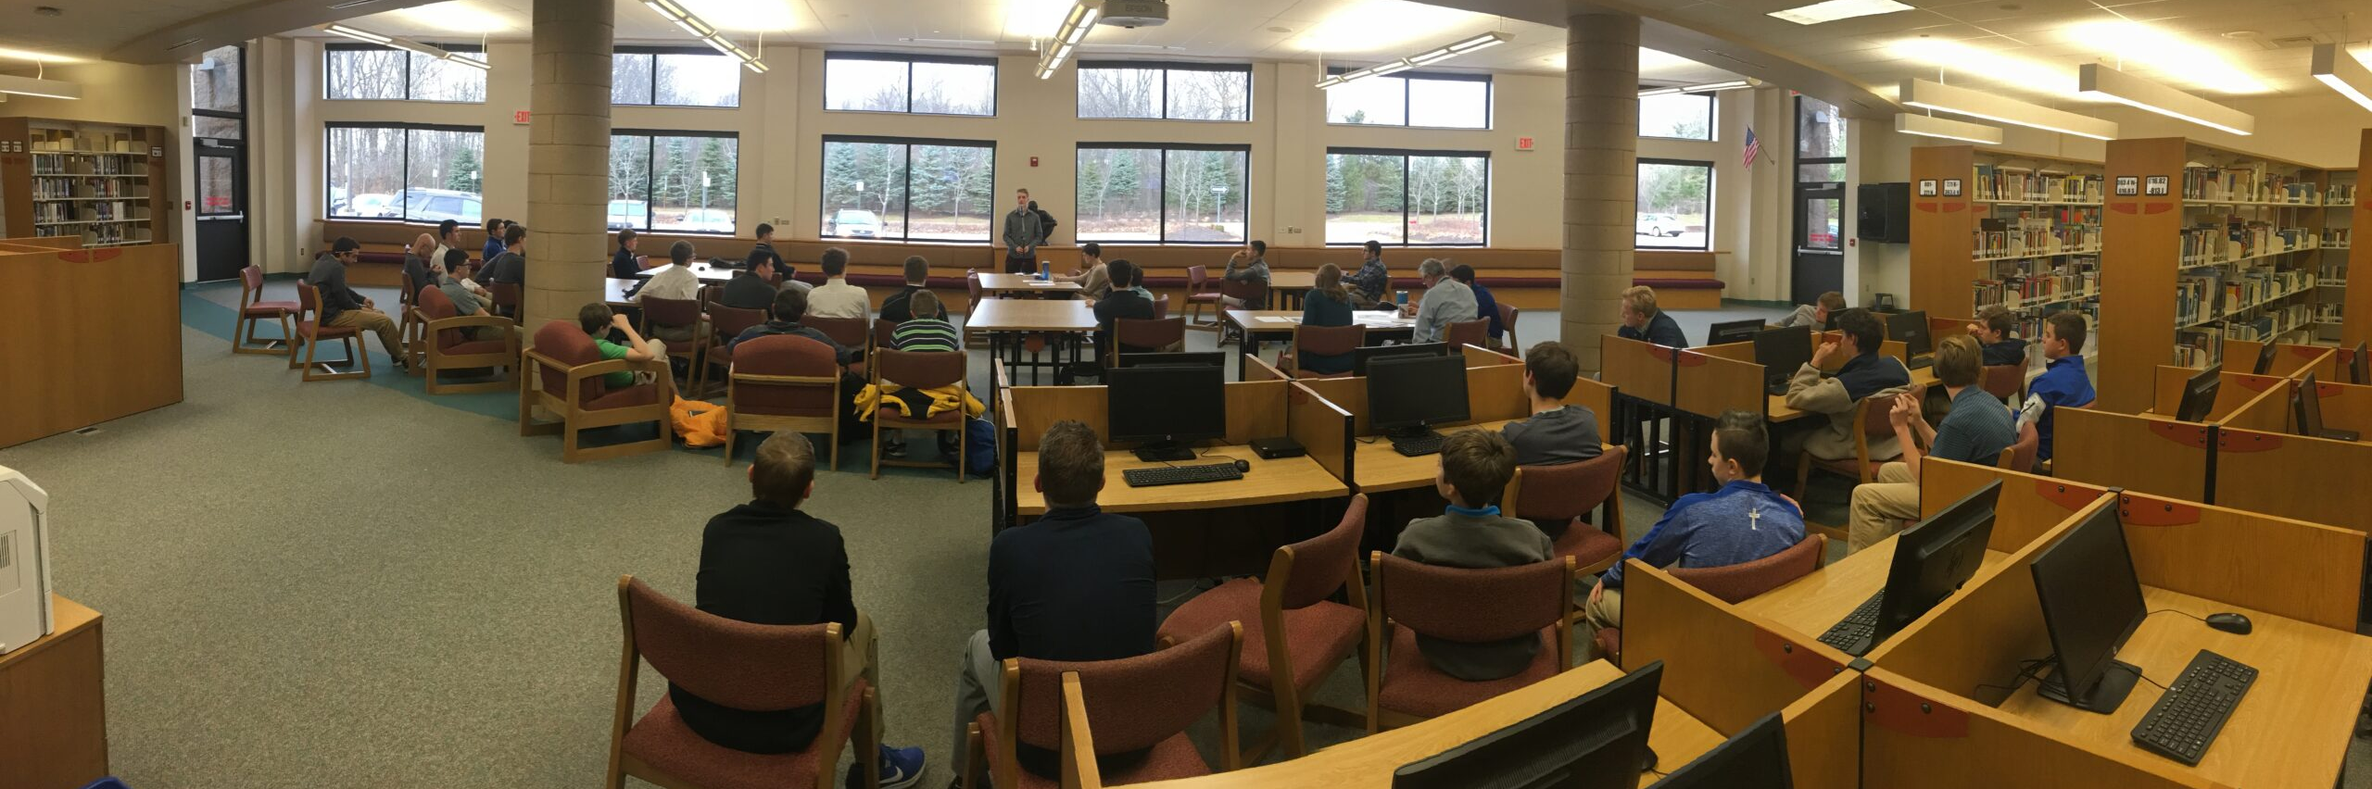
History
Michigan Humanities is a state affiliate of the National Endowment for the Humanities and began operation in 1974. There are 56 humanities councils.​

Slide 4
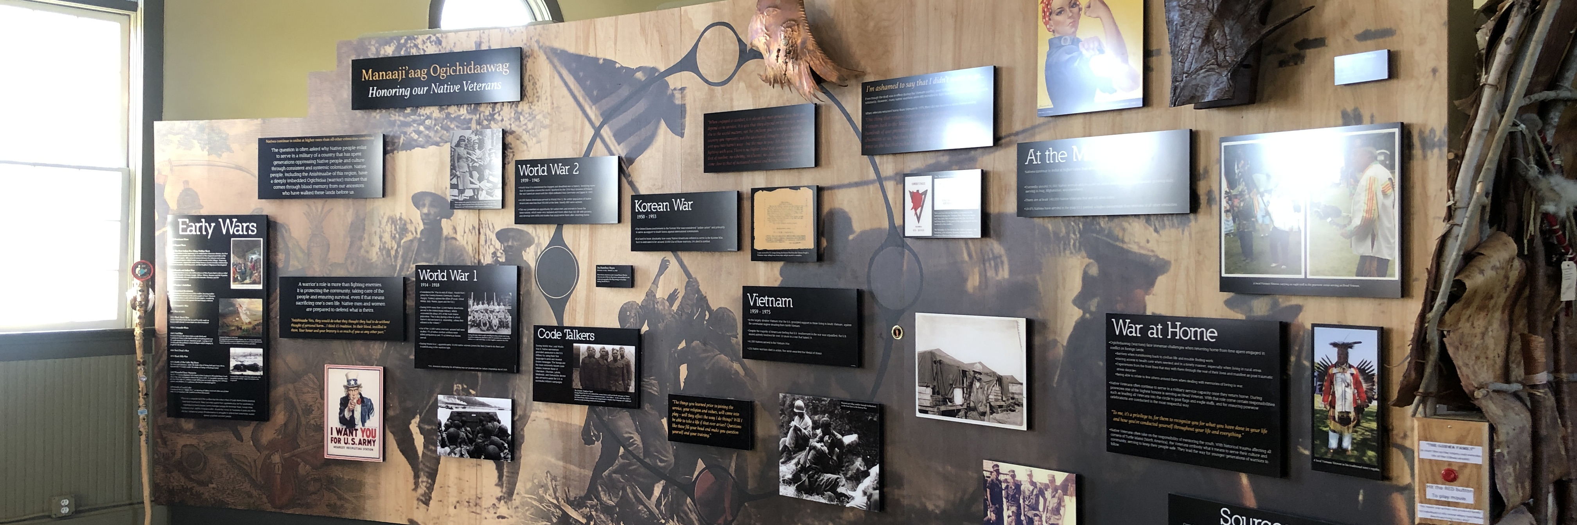
Mission
Our mission is bringing people together through stories, histories, cultures, and conversations.

Slide 5
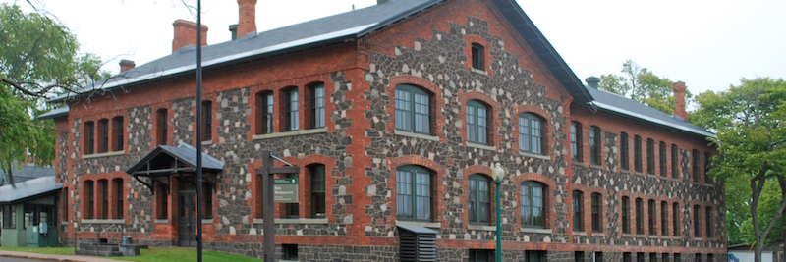
Vision
Our vision is for a more thoughtful, connected, engaged, and informed Michigan.

Slide 6
Values
Inclusion, Diversity, and Equity
Discovery and Understanding
Meaningful Experiences
Authentic Conversation
Respectful Collaboration

Slide 7
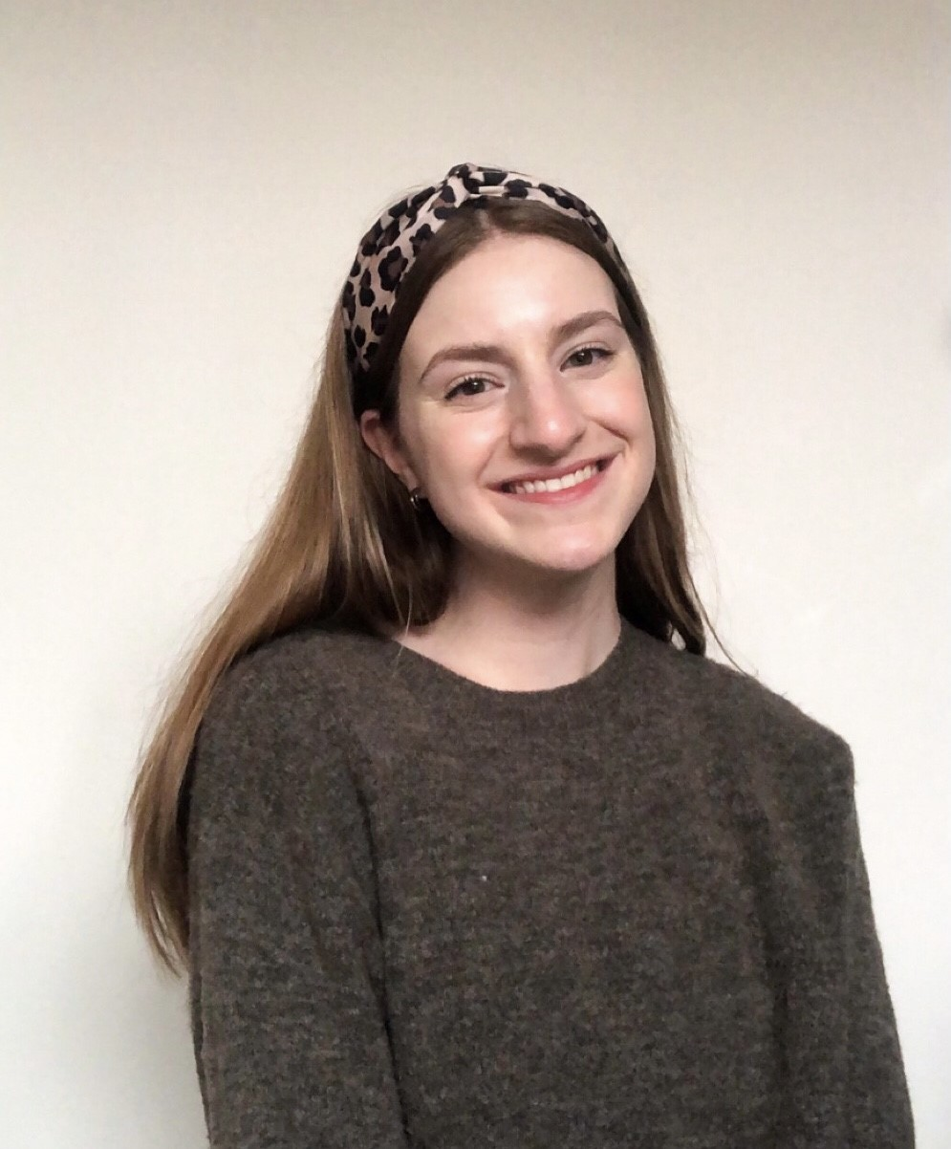
Meet the presenter
Estee Schlenner
Estee is the Programs and Communications Coordinator at Michigan Humanities. She oversees Poetry Out Loud and the Arts & Humanities Touring Grant program. Estee has a B.A. in English from Michigan State University.

Slide 8
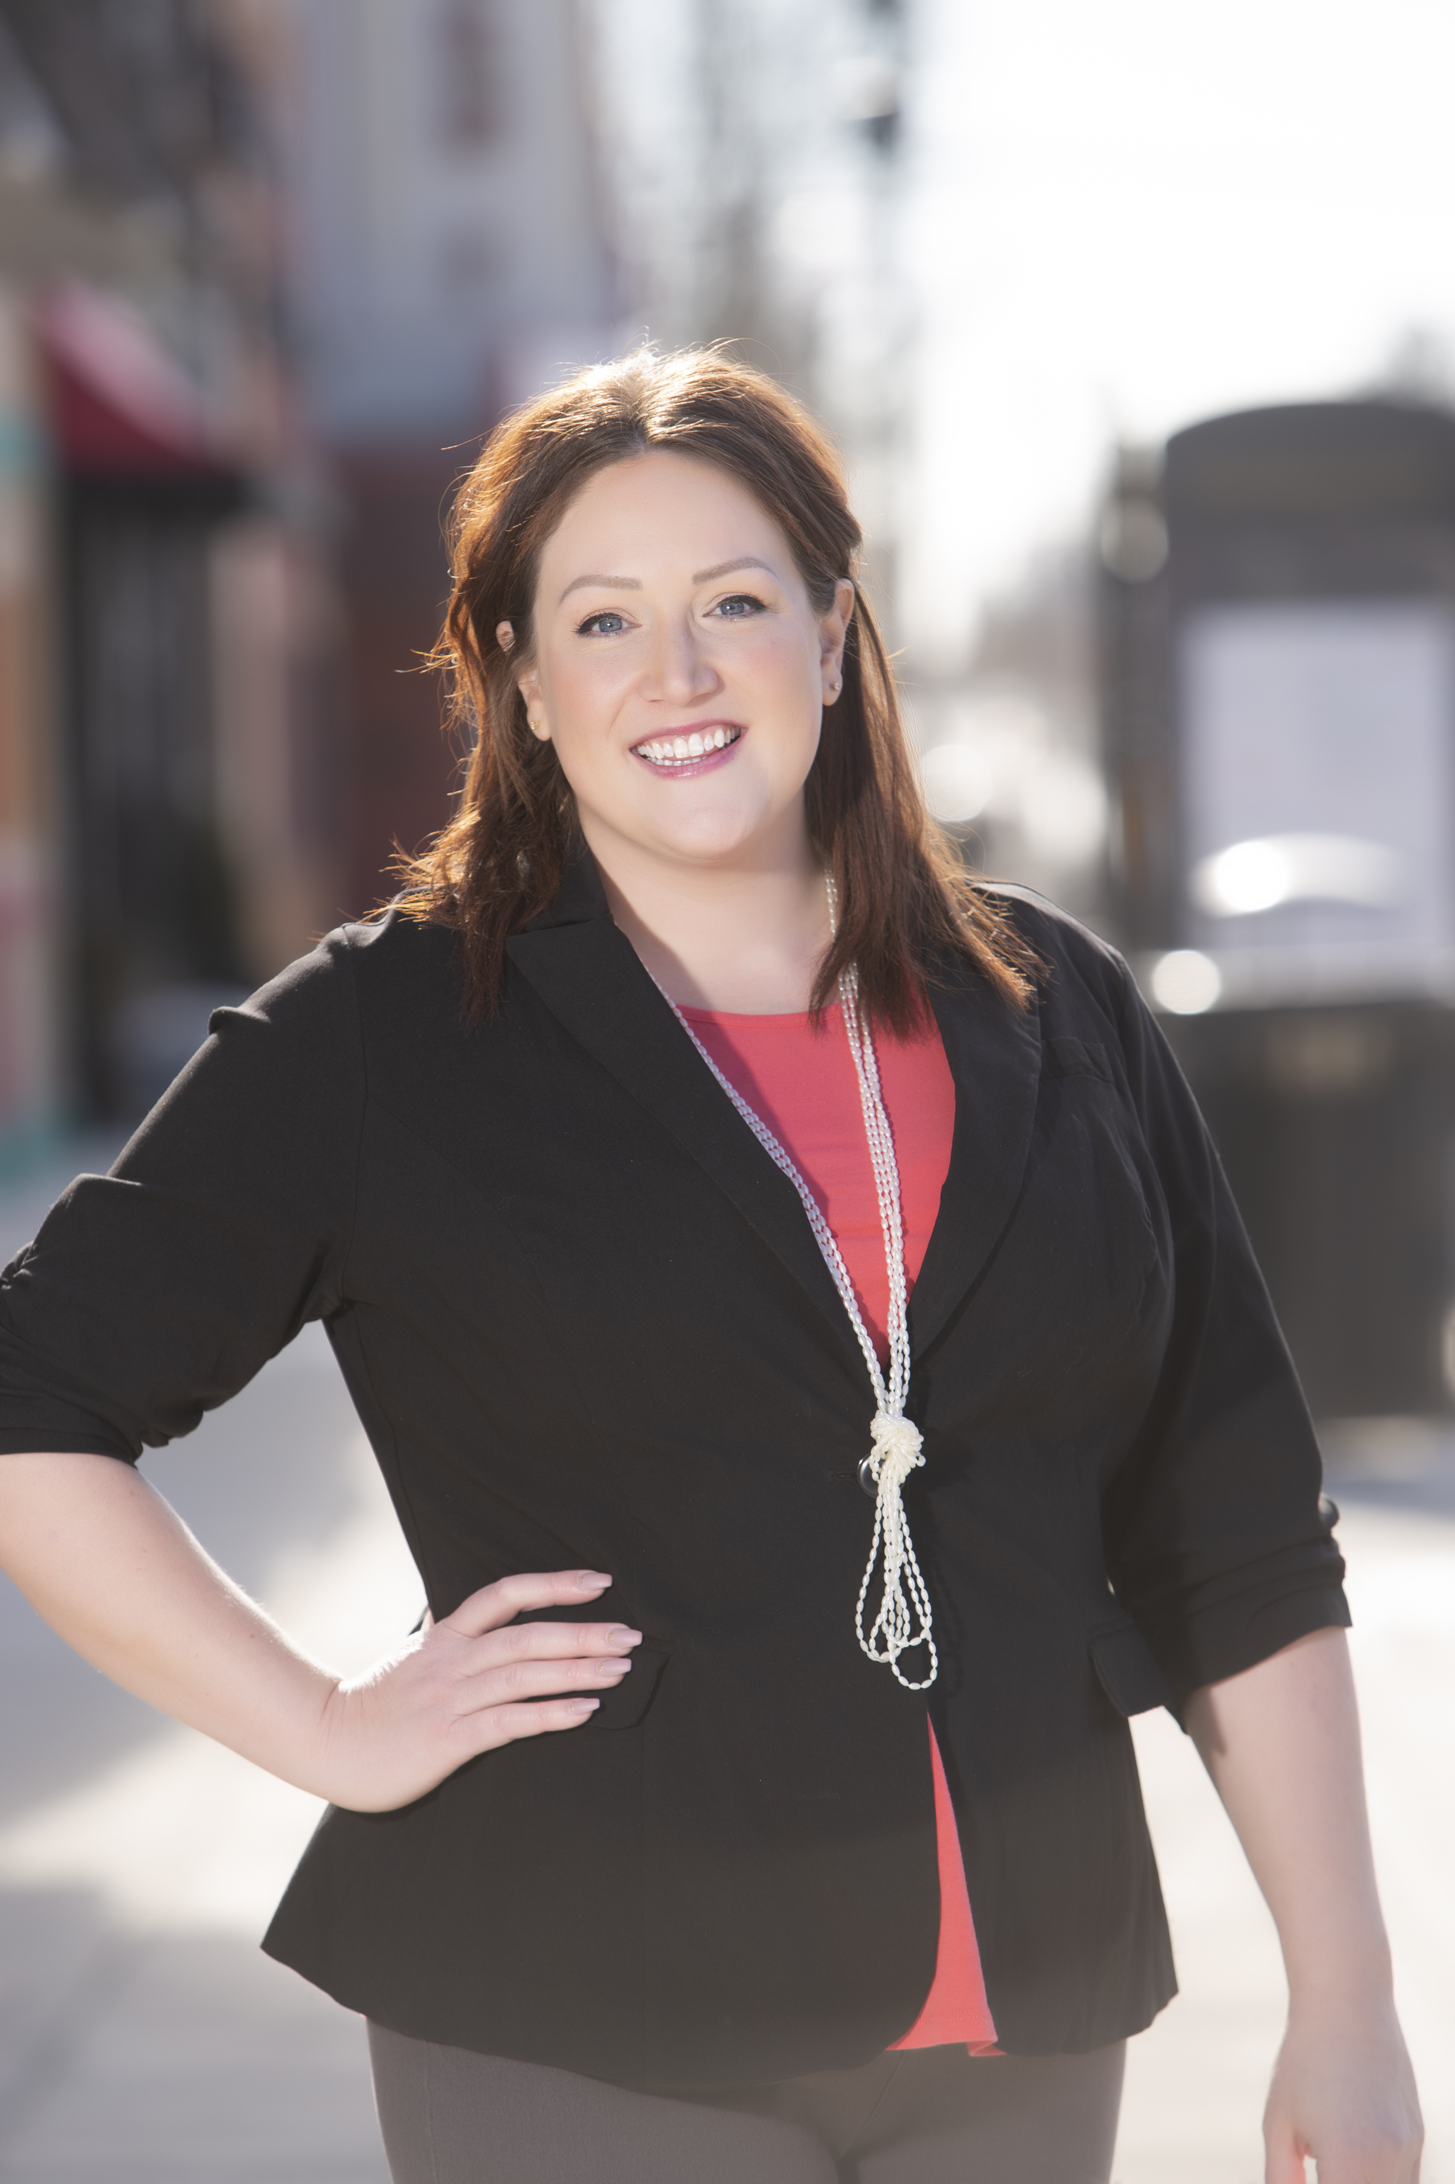
Meet the presenter
Ashley Ross
Ashley is the Director of Programs at Michigan Humanities. She oversees statewide programs throughout the state including the Great Michigan Read and the Smithsonian’s Museum on Main Street. Ashley has a M.A. in Anthropology with a concentration in Museum Studies.

Slide 9


Great Michigan Read
Creates a statewide discussion around the humanities themes of selected fiction or non-fiction books that focus on Michigan.

Slide 10

Great Michigan Read
7 regional selection committees select the title bi-annually
Author Tour opportunities
Open to Michigan non-profit organizations, libraries, schools, book clubs, and more!
Partners receive free books, reader’s guides, teacher’s guides, bookmarks, and supplemental materials, audio/e-books
Action Grants up to $750 are available for additional GMR programming needs

Slide 11

Museum on Main Street
Museum on Main Street brings high-quality Smithsonian traveling exhibitions to Main Street museums, historical societies, and other small-town cultural venues across the country.
Host venues are selected through a competitive application and awarded to communities as a cohort that will work and train together over the next year, leading up to opening day at the first venue.

Slide 12
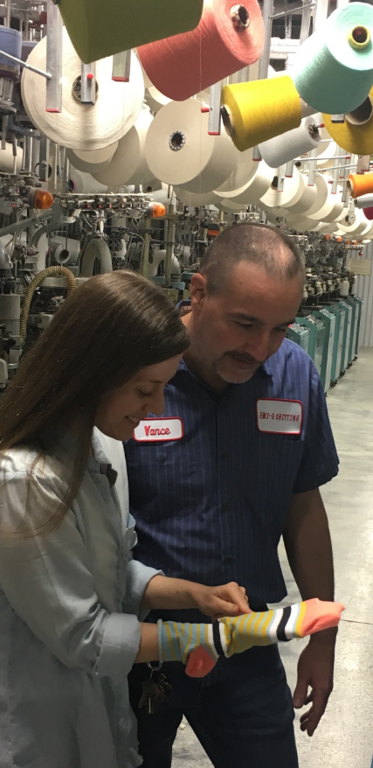
Spark! Places of Innovation
Spark! Places of Innovation will highlight innovation in rural America from the perspective of the people who lived it!

Slide 13

Arts & Humanities Touring Grants
Provide funding opportunities to Michigan
non-profit organizations to host arts and humanities programming that feature artists and presenters from both the humanities and performing/visual arts fields.

Slide 14
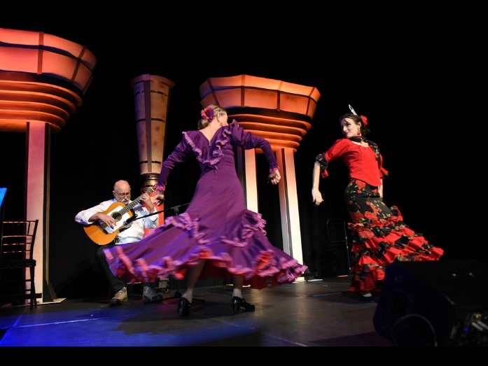
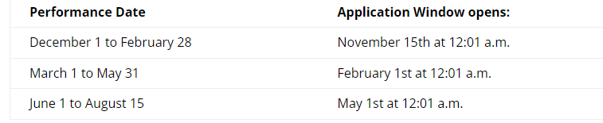
Craig Mapp​
Arts & Humanities Touring Grants
​
40% reimbursement for out-of-state artists, 60% reimbursement for in-state artists, and 75% reimbursement for under-represented in-state artists.
Request for a grant may not exceed $3,000 per application, and an organization may not submit more than 4 grant applications or request more than $4,000 during the program period.
Funding windows:

Slide 15

Bridging Michigan Grants
Bridging Michigan grants provide Michigan nonprofits with up to $2,500 that can be used to spark in-depth thinking and conversation around the persistent social, economic, and cultural issues of systemic inequity that divide our communities. ​

Slide 16
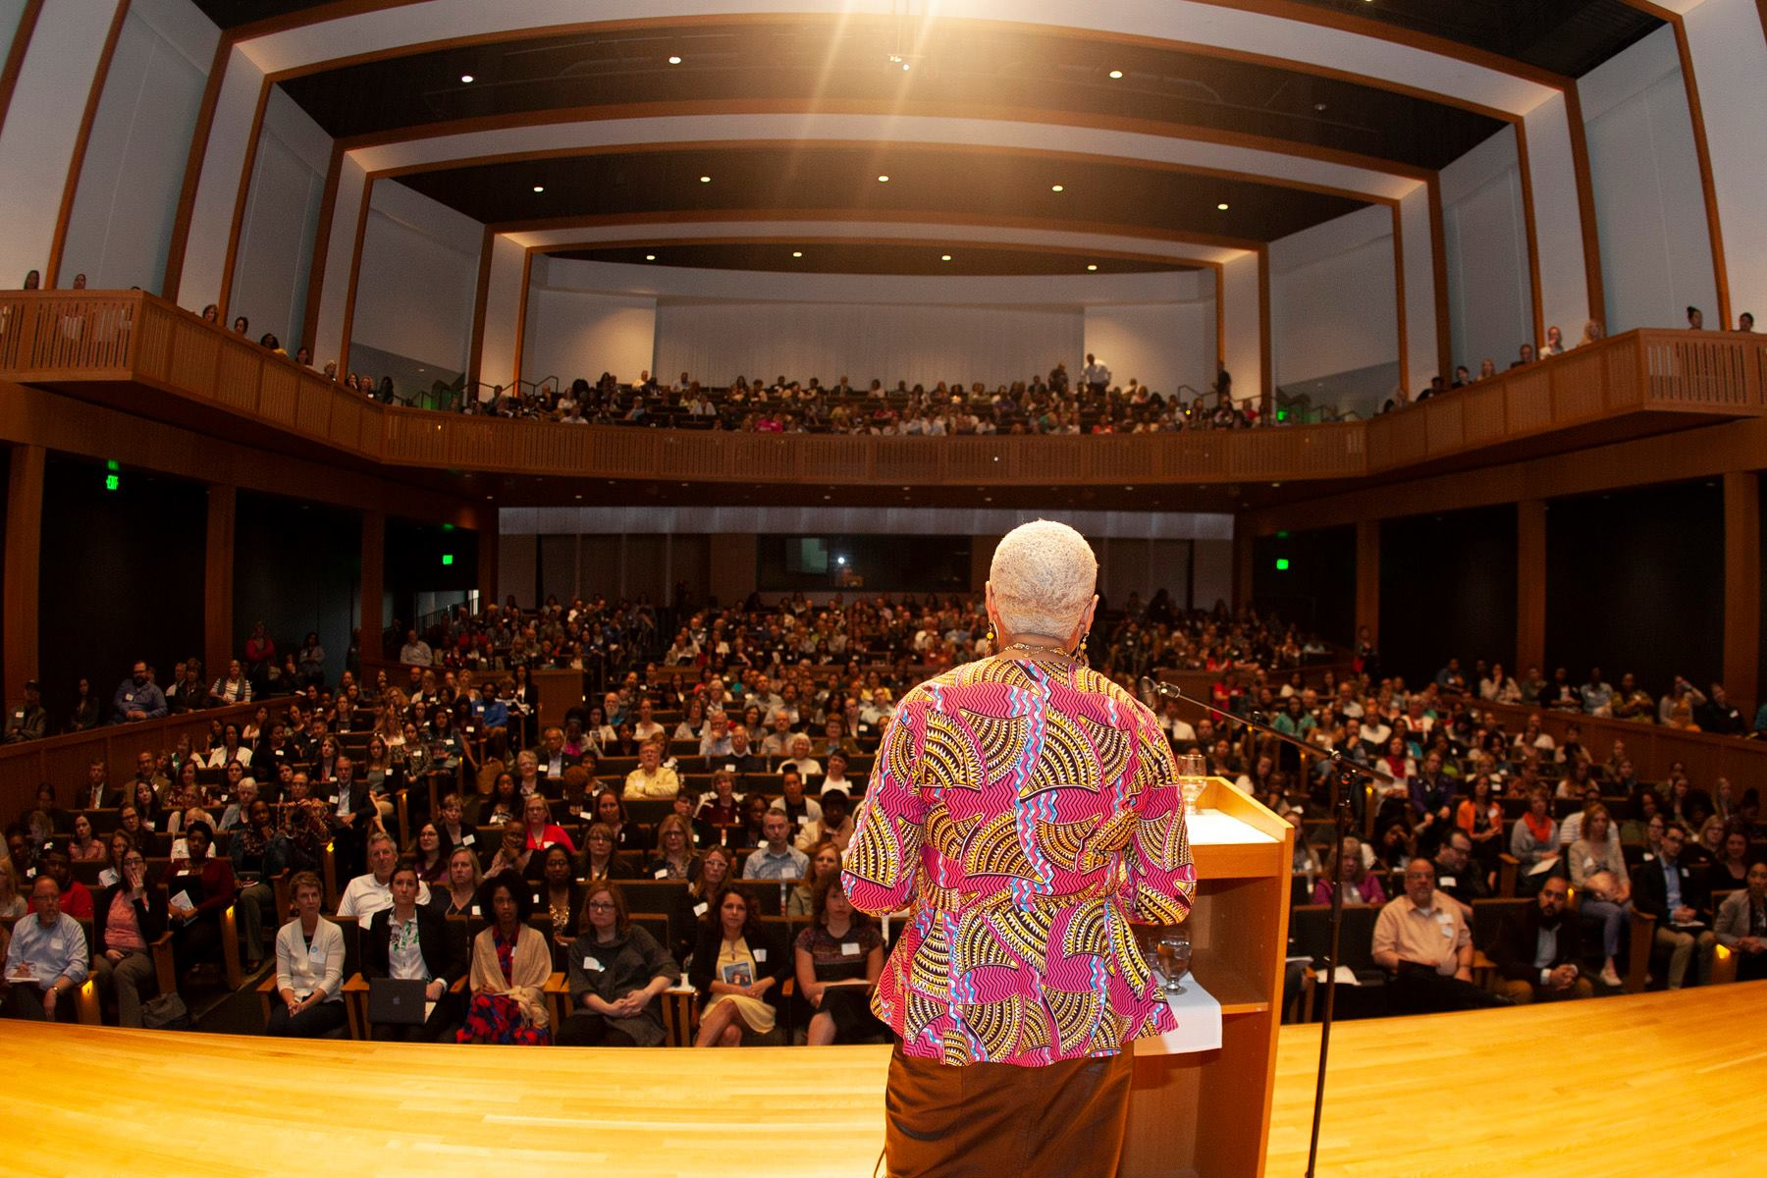
Bridging Michigan Grants​
Diverse projects from across Michigan, addressing different themes and using a variety of public humanities formats, including reflective conversations, reading series, film screenings with discussions, web projects, walking tours, public lectures and panels, and the creation of exhibits are invited to apply.

Slide 17




Responsibilities
The Michigan Humanities name and logo must appear on the following:
All printed materials
All broadcast materials
All electronic materials (including websites and social media channels)
Event signage
As a grant or program partner, you must provide credit of funding/partnership to the Michigan Humanities. This is stated in your agreement with MI Humanities.

Slide 18
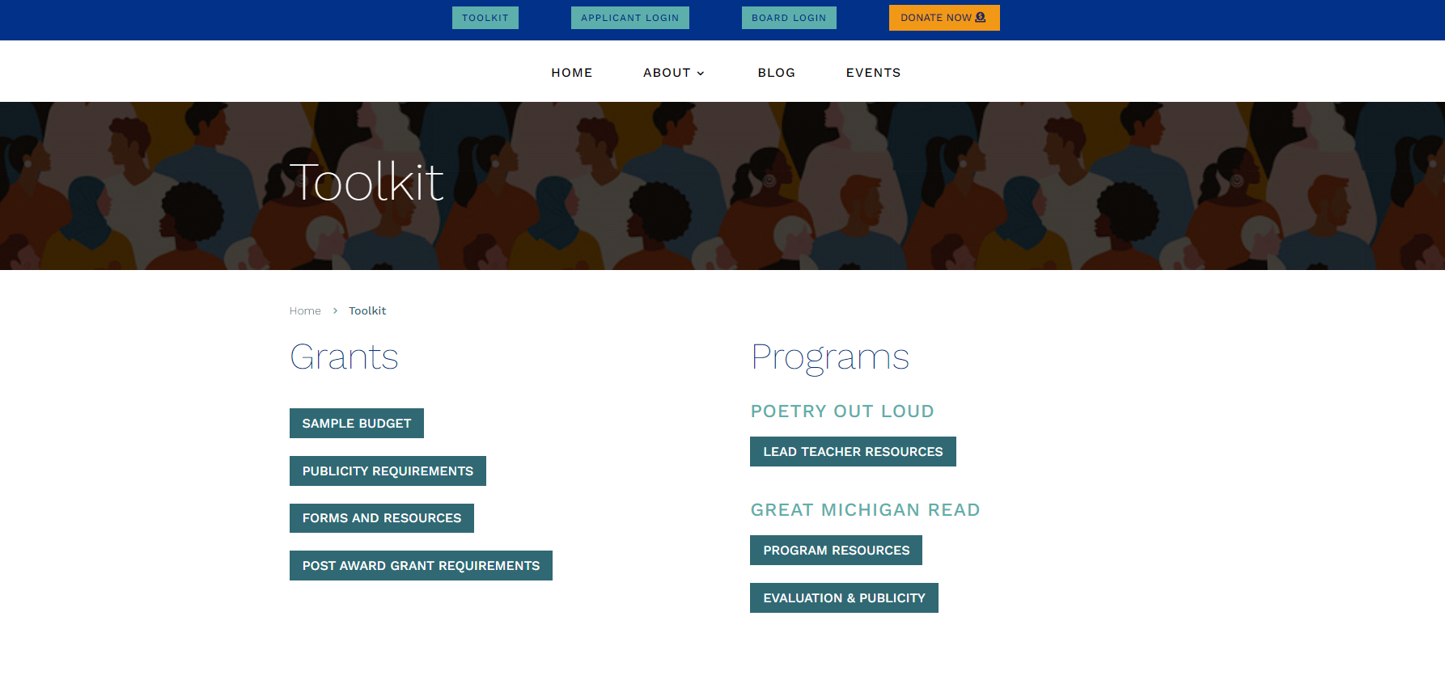

Slide 19
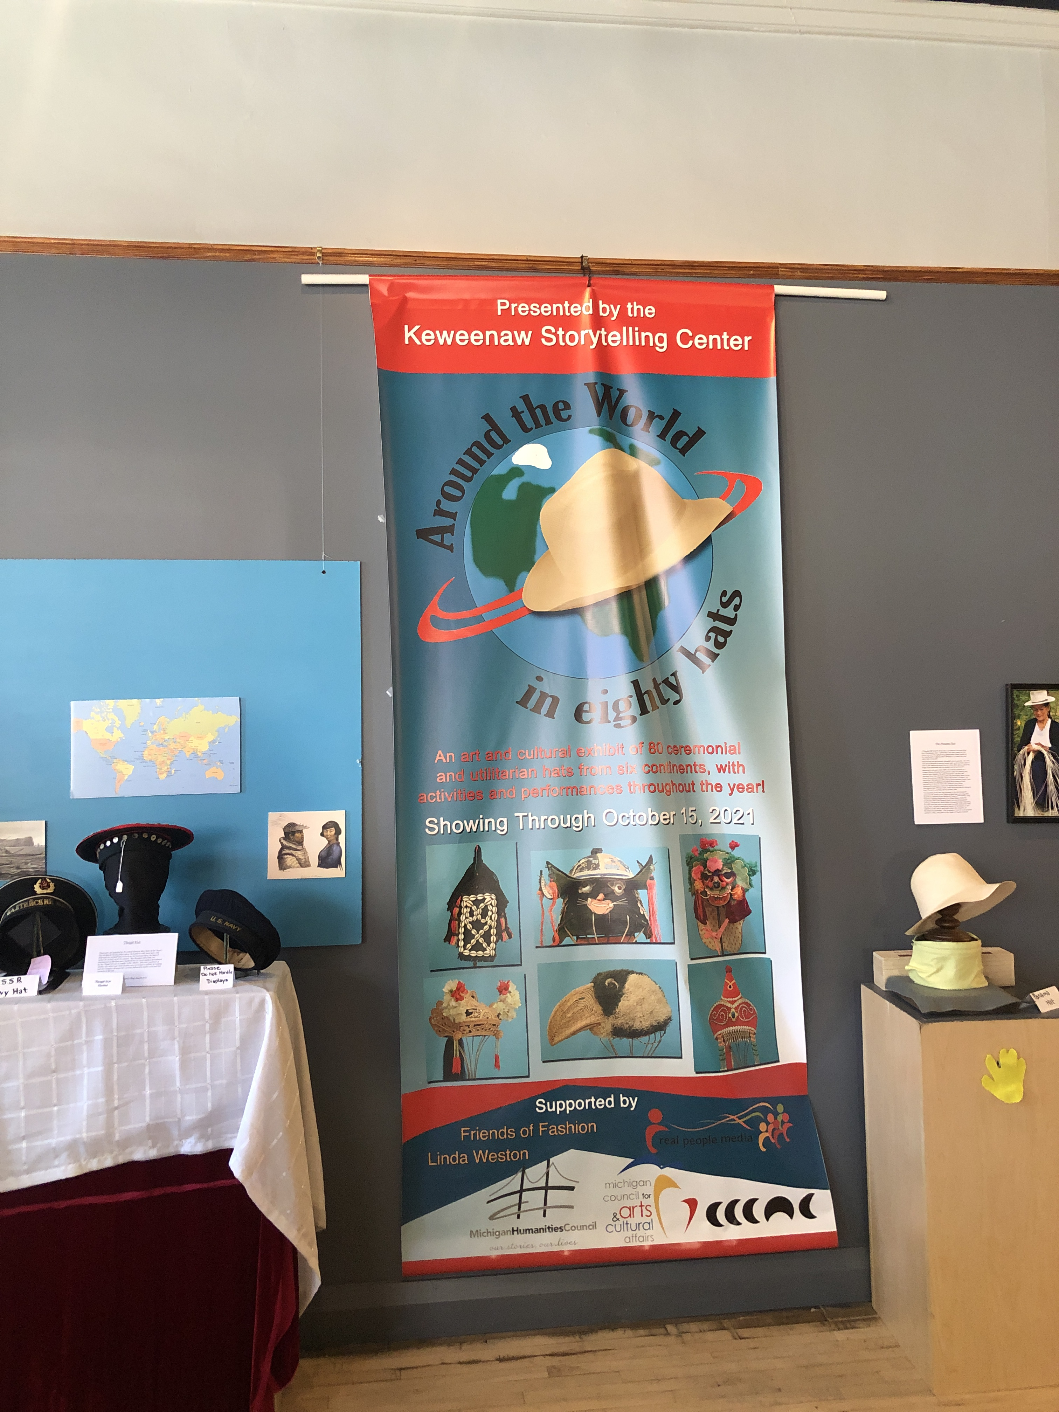
Wording
The following note must also accompany all logos and be printed on all publicity materials. It must also be stated in speaking engagements and discussions with media:
“This project is funded in part by Michigan Humanities, an affiliate of the National Endowment for the Humanities.”

Slide 20
Notification of Project Activities
What do partners need to record?
Date, time, and location of project event(s)
Examples of publicity the grant funded project/event has received
Photos or videos that Michigan Humanities can share on its website or social media outlets
To ensure a strong partnership, it is vital that you keep Michigan Humanities updated on grant activity. This is stated in your agreement with Michigan Humanities.

Slide 21
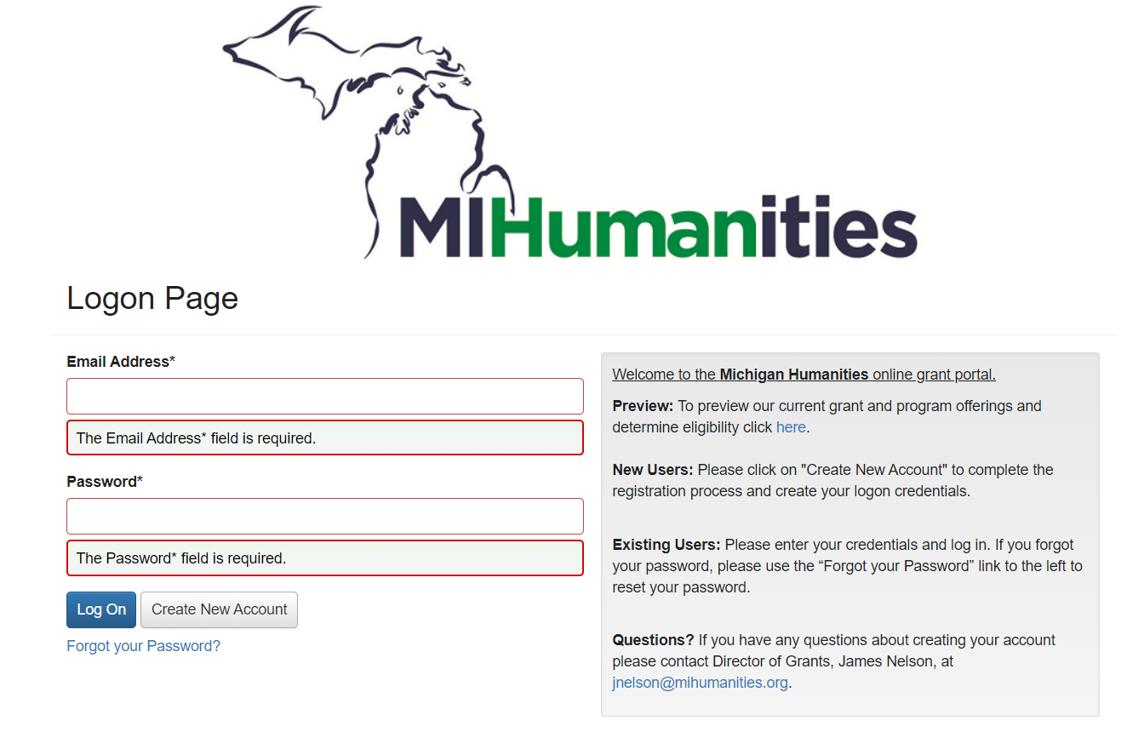
Grants Portal
https://www.grantinterface.com/Home/Logon?urlkey=mihumanities

Slide 22
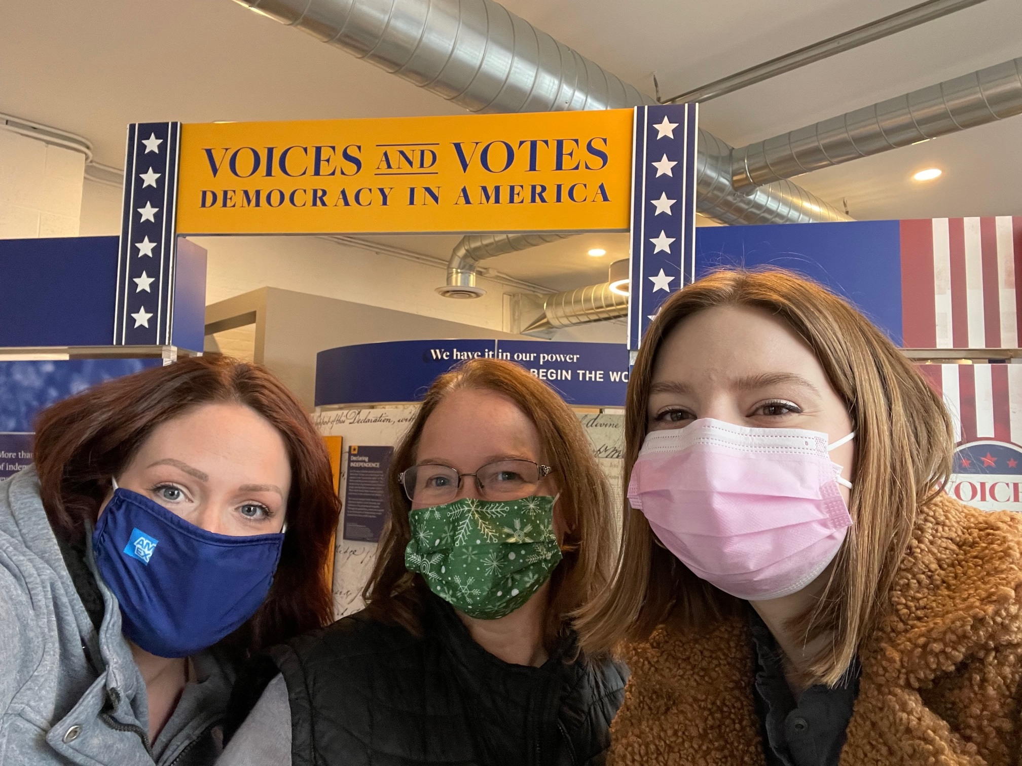
For more information
Contact Us!
Estee Schlenner, Programs and Communications Coordinator
Arts & Humanities Touring Grants, Bridging Michigan Grants
eschlenner@mihumanities.org
-------
Ashley Ross, Director of Programs
Great Michigan Read, Museum on Main Street
aross@mihumanities.org

