Slide 1

The
Freedom to Read
Who Decides What You Can Read?

Slide 2
What is MI Right to Read?
Initiative of the Michigan Library Association (MLA)
  Advocacy, education and engagement on behalf of all Michigan libraries
  Lead by MLA’s Intellectual Freedom Task Force
Intellectual freedom is core value of librarianship
Right to read is a First Amendment right
Education and access to information are foundational to democracy

Slide 3

How Are Library Materials Selected?

Slide 4
Library Policies
No library has room for every book
Collection Development policies provide guidance and state goals for collection
Request for Reconsideration procedures allow users to request removal of an item
Policies are approved by the governing board

Slide 5
What is a Board?
School and library policies are generally set by a governing board
  The board has the legal responsibility for library operations
  Day-to-day library functions are delegated to staff
A board is made up of community members who may be appointed or elected, depending on the type of organization
Often board members must reside in the organization’s service area

Slide 6
Responsibilities
A library board:
  Appoints and manages the director or administrator
  Adopts written policies and rules that govern operation and use of the library
  Studies community needs and approve a strategic plan
  Approves the budget, examines expenditures, and amends the budget as needed
  Participates in continuing education and provides orientation for new trustees
  Adopts a collection development policy
  Addresses formal patron comments and complaints
  Advocates for the library in the community
The director/administrator:
  Hires and evaluates library staff
  Proposes policies and carries out approved policies
  Manages day-to-day operations of the library
  Delegates library functions to staff members
  Prepares and submits a budget request and maintains complete and accurate financial records
  Participates in continuing education and encourages staff to do the same
  Selects and orders books and other library materials or delegates this task to staff members
  Advocates for the library in the community

Slide 7
Common Criteria for Selection
Demonstrated and anticipated needs of library users
  Local interest
Reputation, authority, and literary skills of the author
Timeliness of topic
Positive reviews in reputable professional journals such as School Library Journal
Existing holdings in subject area
Budget and physical space
Availability through interlibrary loan

Slide 8
Controversial Materials
Representation of a diversity of views and expression is a major goal of library collections
Materials are not restricted due to frankness of language or content
Parents and legal guardians are responsible for what their children are reading
Materials may be routinely removed due to physical damage, outdated content, and lack of checkouts, not controversy

Slide 9
First Amendment
Congress shall make no law respecting an establishment of religion, or prohibiting the free exercise thereof; or abridging the freedom of speech, or of the press; or the right of the people peaceably to assemble, and to petition the Government for a redress of grievances.
Protects against government attempts to suppress speech and publishing
Courts have held that the “right to receive information” is essential to freedom of speech
Unprotected speech includes obscenity, child pornography, defamatory speech, false advertising, true threats, and fighting words

Slide 10
Censorship at the Library

Slide 11
What is Censorship?
Limiting access to information
Can happen:
  During the selection process
  Through removal from the collection
  By restricting access to materials within the collection
Choosing not to purchase, choosing to remove, or choosing to restrict access to a title because of personal opposition to the content or the belief it is inflammatory is censoring that title.

Slide 12
How are Books Banned?
Formal challenges
  Procedure set by library policy
  Increasingly performative, organized at a national level
  Targeted lists of books circulated
  Coaching and advising provided
“Shadow banning” or “soft censorship”
  ALA estimates 90% of book challenges go unreported

Slide 13
Forms of Censorship
Relocating
  Moving an item from its current location to a different one
  Putting an item in an inappropriate area makes it less accessible to the intended audience
  Fundamentally removes privacy
  Example: a children’s book is moved to the adult nonfiction; a book is kept behind a desk and must be requested
Removing
  An item is completely removed from the library
  The message is that this material and its themes are dangerous and should not be accessible to the public
  Example: a young adult book is removed from the collection because of a patron’s interpretation of its message

Slide 14
“Soft” Censorship
The library side
  Restricting circulation to specific groups of patrons
  Moving or removing items that have not received a formal challenge or before the reconsideration process is complete
  Placing an item in the collection in a way that makes it more difficult to find
  Not promoting or displaying a book due to potential controversy
The patron side
  Hiding an item in the collection, such as behind a shelf or in the wrong section
  Checking out items specifically to restrict others’ access
  Deliberately damaging an item
  Stealing

Slide 15
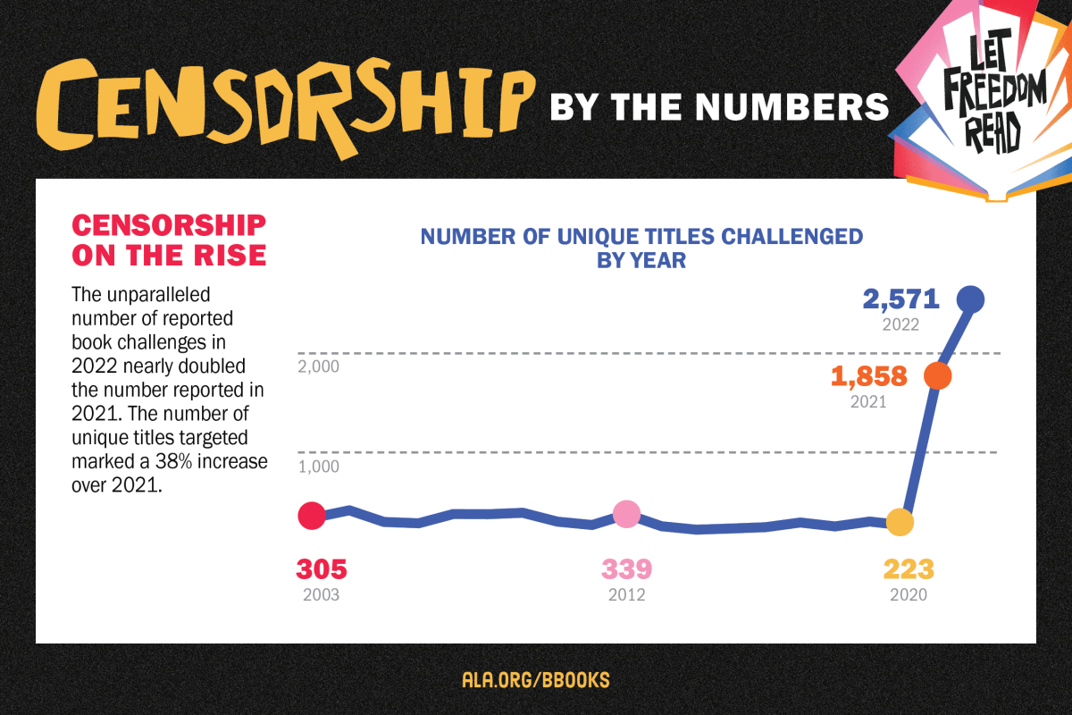
Censorship is on the Rise
More censorship attempts documented by the American Library Association in 2021 than any year since tracking began
ALA estimates 80-90% of challenges go unreported

Slide 16
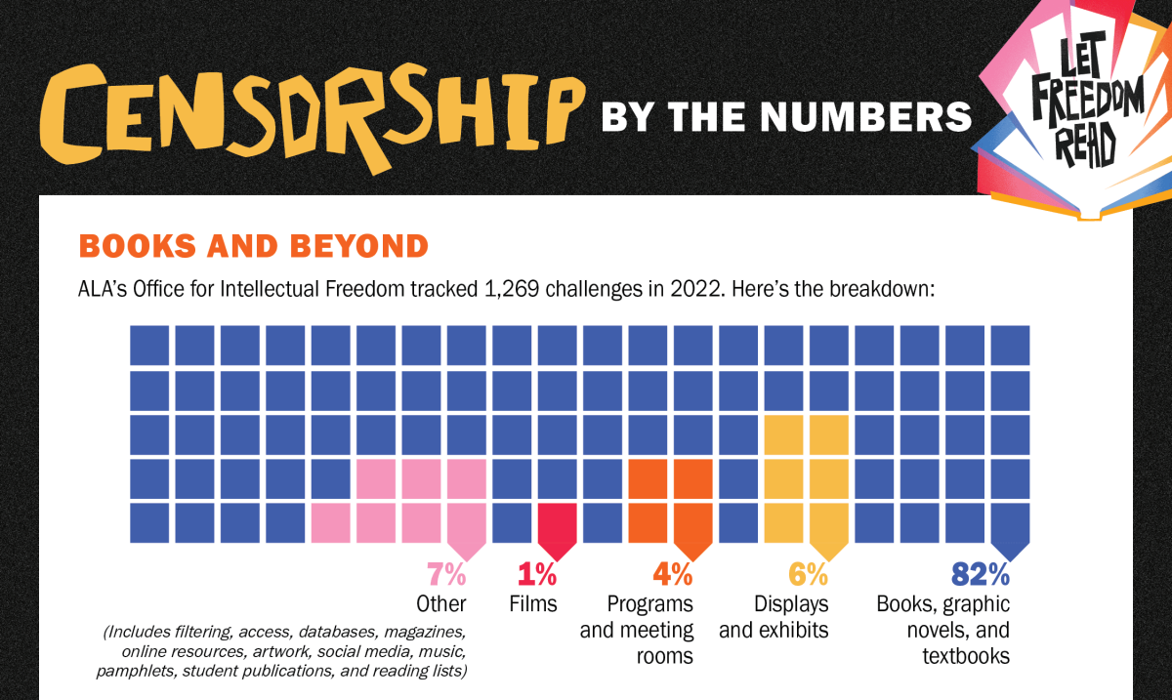
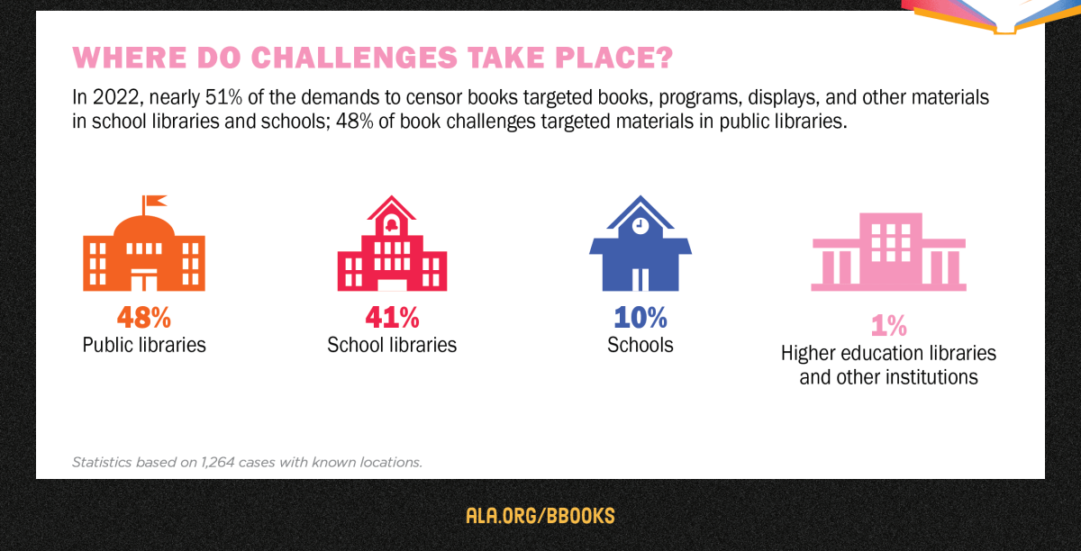
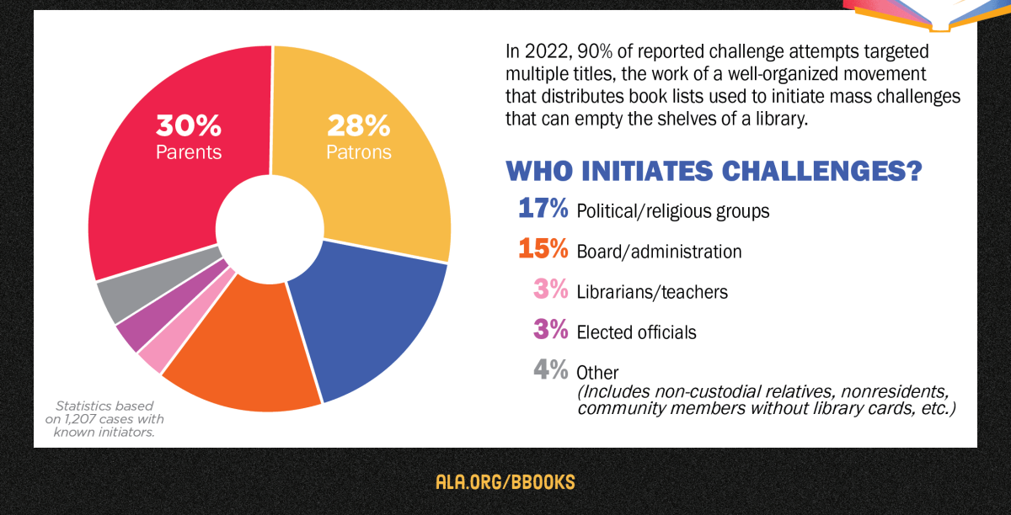

Slide 17
Banning Books is Bad for Communities
Prevents individuals, especially young people, from accessing critical information
Takes away opportunities for young people to see themselves reflected in literature
Lost opportunities to build mutual understanding
Freedom to read is a Constitutional right

Slide 18
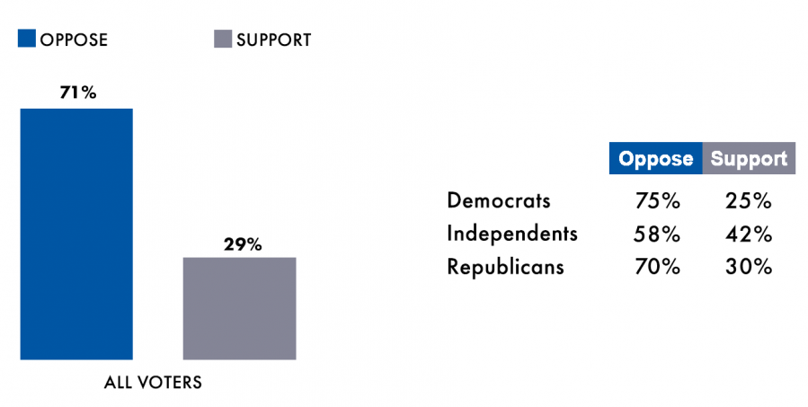
Most Americans Oppose Book banning
71% of voters oppose efforts to remove books from public libraries
67% of voters oppose efforts to remove books from school libraries
Full poll results and key findings available via the American Library Association. (Link)

Slide 19
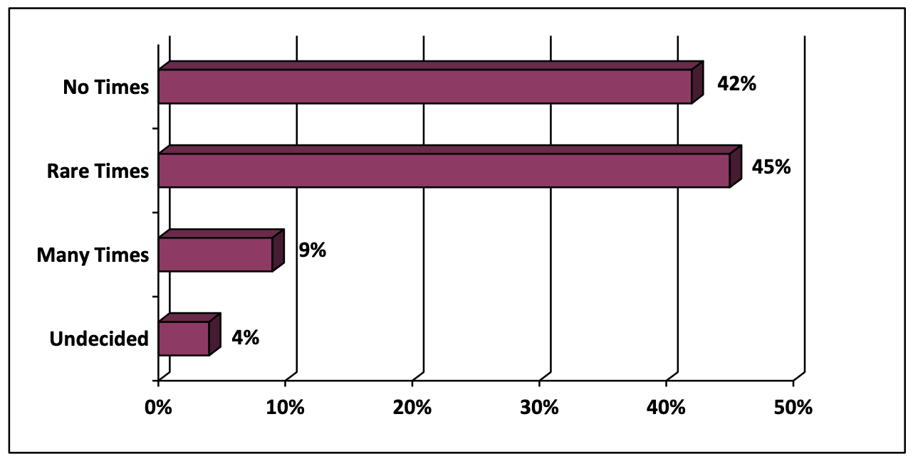
Most Michiganders Oppose Book banning
When should books be banned?
87% of Michigan voters said there are no times or rare times when books should be banned, including:
  97% of Democrats
  93% of Independents
  76% of Republicans
Poll commissioned by the Michigan Library Association and conducted by EPIC-MRA. (Link)

Slide 20
Impact on diversity, equity, inclusion, and access
Less content is purchased when “controversial” topics are avoided
Goes against the purpose of collection development, which is to produce a well-rounded collection that is meant to be used
Providing a resource to someone who needs it is always the goal

Slide 21
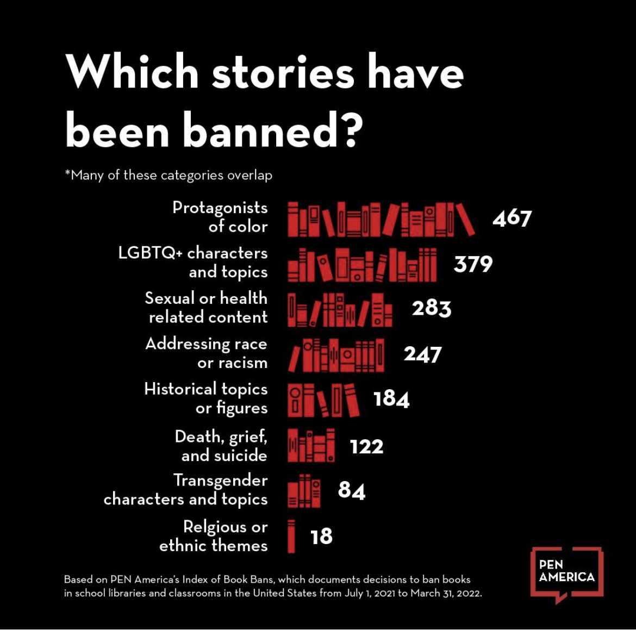

Slide 22
How Are Challenges Handled?
A Request for Reconsideration or similar form and accompanying procedure should be approved by the library or school board
Reconsideration Committee formed to review challenged material
  Includes librarians, administration, educators, board members, or other stakeholders
Challenged materials should remain accessible during reconsideration process
Appeal procedure is included in policy

Slide 23
Thank You
Contact MI Right to Read at https://www.mirighttoread.com/contact-us
Learn more and join the coalition at https://www.mirighttoread.com/take-action

