Slide 1
Creating Digital Access and Preservation Consortia: Lessons from UPLINK
Annika Peterson
Digital Project Manager
Central Upper Peninsula & Northern Michigan University Archives
Notes:
-Give you an overview of the challenges that brought UPLINK into being, its history, and where we are with the project today
-Talk about the mechanics of the consortium in case any of you are thinking about starting formal consortia or informal partnerships for digital projects
-including governance model, how we approach collaboration, and the hardware/software/platforms we use for our digitization, digital access, and digital preservation

Slide 2
Upper Peninsula Digital Network
Mission Statement: The mission of the Upper Peninsula Digital Network, or UPLINK, is to manage and sustain a low-cost, secure, and geographically distributed digital preservation and access service for locally created digital primary source material documenting the history of the Upper Peninsula of Michigan.
Notes:
-ask how many had heard of UPLINK before the event
-acronym, mission statement

Slide 3
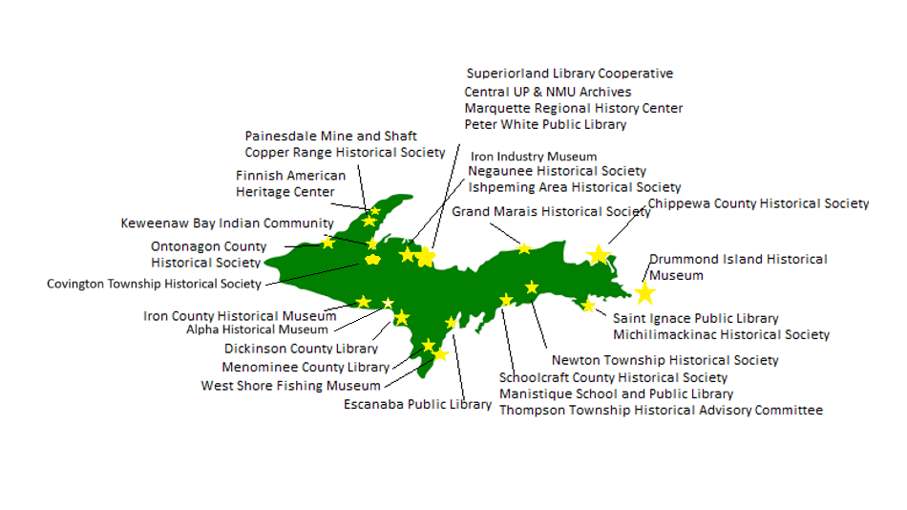
Notes:
-any org with primary sources documenting UP history can join. Must be in the UP or very close neighbor.
-includes historical societies, archives, museums, libraries. We did not expect the level of interest we got from public libraries! Especially interested in newspaper digitization, city directories, and offering community digitization.
-timeline: 2019—Marcus Robyns gets internal NMU grant to do survey of heritage organizations and figure out if there’s interest in a digital consortium; NHPRC planning grant leads to committee from three universities, PWPL, and MRHC to write up governance documents and procedures from the consortium; NHPRC implementation grant from May 2021 to May 2023 allows actual creation of the consortium. I am hired May 2021 and groups start formally joining that summer. Website goes live December 2021. MHC grant summer 2022 allows for community workshops and digitization projects. 2024 – migration to new website, launch new summer institute for K-12 teachers to learn about and make use of UPLINK.

Slide 4
Services We Offer to Members
A page on the UPLINK website with promotional material, lists of collections, inventories, and finding aids
Digitization and metadata training and advice
Free loans of digitization equipment and access to equipment at NMU, MTU, and LSSU
Digital storage and basic digital preservation
For an additional fee, we will digitize and create metadata for organizations and upload collections to the website
Notes:
-Each group pays annual fee on a sliding scale, $25-$100 based on budget
-Formats we can digitize: oversize books/maps, cassettes, reel to reels, records, VHS, 16 mm film*, microfilm
-batch microfilm scanners now semi-affordable – around $7,000 – this is our big new service, and it’s quite popular
-example of how consortia help cut costs -- $60 for vendor to digitize reel without splicing into issues and naming; we’re charging $20 (some labor subsidized by NMU, and it’s a lot slower turn-around, but able to scan higher-quality images than before and do splicing/naming as we go)
-audio transcription AI software is only $10/month and extremely accurate

Slide 5
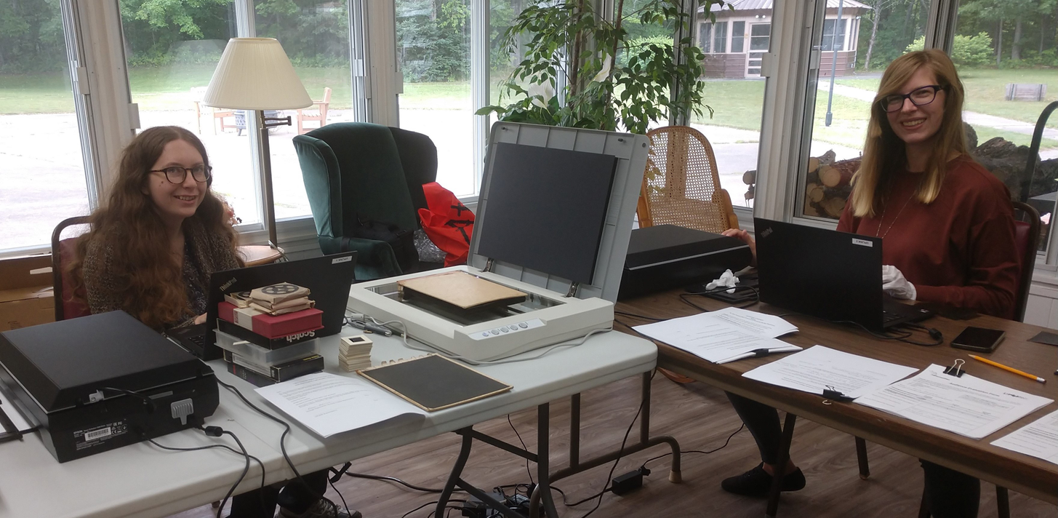
Community digitization efforts
Grant from the MHC
Events in Sault Sainte Marie, Ontonagon, and Stephenson (Menominee County)
Increased awareness of UPLINK, received individual donations from community members, scanned materials for our member organizations, three new organizations joined
Led indirectly to our free digitization kit loan program

Slide 6
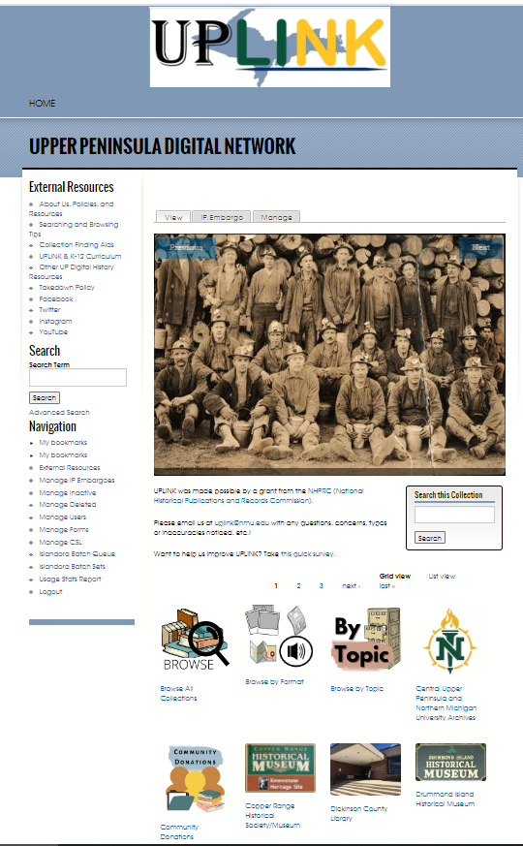
27 member organizations, 163 collections, 85,915 items
Newspapers
Photographs
Oral histories
Mining records
Government records
Manuscript collections
Soon: K-12 lesson plans based on our collections
Notes:
-website currently being migrated to new version of our platform/new vendor
-we haven’t been able to make changes to the website since the spring
-in November, you’ll see a totally different website, including three new organization pages and 32 new collections
-majority of collections are newspapers—even more so now that we’re doing our own microfilm scanning!

Slide 7
Why a consortium approach?
Most UP heritage organizations have tiny budgets, are often run by volunteers.
  UPLINK pools resources; more expensive digitization equipment and platforms can be shared.
Groups want to share their collections, but don’t want to give them to larger, distant archives.
  UPLINK lets them keep their heritage in their local communities while making them available globally.
Researchers and library patrons increasingly expect online access to collections. If it’s not online, they don’t contact the organization to ask.
  A digital collections platform handles digitized newspapers and local history collections better than a library catalog.

Slide 8
results
For members: more people coming in, using collections, and donating
For researchers: collections in one place; no need to travel; learn about small organizations; full-text search of typed text
For NMU: increased visibility and good press for the archives; has improved our status with administrators; more materials for our students to work with; better digitization and search capacity for us as well; more reference requests than before; more digital and physical donations and funds
1,623,814 views (as of September 24)
Notes:
-Online presence for the organization; Getting collection descriptions and the collections themselves online; More people are aware of the organization = more people coming in the doors, using the collections, and donating
-collects everything into one place; -don’t need to physically travel; makes them aware of organizations that they might not have known existed; full-text search—newspaper collections in particular are very popular; allows you to find evidence that you wouldn’t otherwise
-increased visibility and good press for the archives; explains to the administration why we matter; provides more materials for students to work with without traveling; we got better digitization equipment out of it and better searching capabilities
-sadly, no advanced stats to know how many unique visits; from where; etc. Should get that soon.

Slide 9
Collaboration considerations
Don’t over plan.
  Do pilot projects and THEN write procedures and workflows, not the other way around.
  In collaborative situations, having a set of standards and a checklist for each project is more useful than a workflow.
Ask the community what they need and adjust accordingly.
  You will serve your members better.
  More groups will want to join.
  You will get more done.
Notes:
-These are aimed more at larger consortia than smaller partnerships.
-We wrote bylaws, workflows before we had a platform or had done any pilot projects. Bad idea.
-Had to re-write it all once we knew how the platform worked.
-Had to de-confuse organizations about how to prepare collections as we made it much simpler.
-Will talk about later, but governance model also hasn’t worked as it was intended to.
-Again, bylaws and plans for UPLINK were written on the basis of a handful of organizations. After launch, as groups joined, we realized their needs were different than anticipated.
-Some groups had no computer capacity, but more than expected already had scanners and had been doing their own digitization. What they needed was a way to host the content online that wasn’t Google Drive.
-Much greater interest in doing own digitization and metadata than we thought, which has meant we can get more done.
-We should have asked first, written bylaws and plans later.

Slide 10
Collaboration considerations, continued
Leverage existing skill sets and resources to get more done collectively.
In our case:
  Universities provide equipment, professional staff, infrastructure
  Members provide local institutional and historical knowledge
  Groups with willing volunteers, no money get training and consulting from us to do their own projects
  Group with money, no volunteers pay us to do projects for them
  I work one-on-one with groups to figure out what works best for them
Notes:
-This one is relevant to any size of collaboration.
-Sweet spot of standardization (necessary for database to work well) vs. customization (necessary to make the consortium useful for different types of groups with different types of goals)
-I can speak to our specific metadata and digitization choices if anyone is interested, but I’m not going to go into detail here.

Slide 11
Collaboration considerations, continued
We try to balance group and individual needs.
  Standard controlled vocabulary
  Description fields allow for variety
Don’t let the perfect be the enemy of the good!
  Be willing to digitize unprocessed collections
  Be willing to take “legacy” digitization projects
Notes:
-The original UPLINK planning documents made several assumptions: Groups would have traditional manuscript collections, they would be required to fully and formally process those collections before putting them online, the “service hubs” would be doing most of the digitization and metadata, and groups would largely want to digitize all of a collection and put it online. All of this got thrown out once we started actually doing projects because:
-Many members don’t have traditional manuscript collections with clear provenance. They have a lot of individual items whose origin is often lost. Most have at least organized this information into artificial collections; others just have piles of stuff with no inventory.
-Other groups are highly organized, but they aren’t archives—they are museums, public libraries, etc. that use other forms of arrangement and description to access their collections. Understandably, they don’t want to re-organize collections just to make them look familiar to archivists.
-Many groups do want to do their own digitization and metadata.
-Many groups want to digitize one or two items from each of their collections to encourage people to come into their organizations in-person.
-I decided that if we wanted groups to actually start contributing collections to UPLINK, we couldn’t let the perfect be the enemy of the good. Our new method is this:
-Organizations do not need to send items in traditional collection groupings, but they do need to give me a basic inventory of what they’re sending for both security and so that I know what I’m looking at.
-If they gave me no idea of how they want the items broken up into collections, I group the items (digitally, not physically) in a way that makes sense to me. Sometimes I have to create very artificial groupings, but at least everything is placed in a collection.
-I ask groups for the contextual information they have about a collection: provenance, any original order, etc—and then I write the finding aid. Groups can ask for edits after the finding aid is complete, but I have veto power to keep things consistent across groups.
-If they are writing their own item-level metadata, then I give them a template and a few sample entries. I have found that even after training, most ignore the rules, so I end up having to check all the metadata anyway. It’s faster than sending it back and asking them to fix it.
-If they are doing their own digitization and it’s a new project, we suggest dpi and file naming standards and provide training. But, if it already exists at a lower dpi or only as a JPG, we take it as is.
-In terms of metadata standards, finding a balance between individual and group needs is tricky in any collective venture, and it’s one that we’re still figuring out. In order for the database to work, there has to be a degree of standardization: one finding aid format (EAD; DACS), one item-level metadata standard (MODS), controlled vocabulary (LCSH for subject headings, AAT for format). However, there is also flexibility in the metadata: length of descriptions, local identifiers, etc. If a group asks me to add a field, I add it.

Slide 12
Funding
NMU Faculty Research Grant, $7,000 (2019) – paid for survey of potential members
NHPRC Planning Grant, $20,000 (2019) – paid for writing bylaws, governance docs, deciding on technology/platforms
NHPRC Implementation Grant, $100,000 (2020) – paid for book scanner, initial website creation, my position for two years
Michigan Council for the Humanities, $8,000 - Community Digitization Program, 2021
Library Technology Services Act (LSTA) Grant, $25,000 – Summer Institute for K-12 teachers
Ongoing costs paid by member annual fees (covers hard drive/server costs) and NMU (covers staff and student labor costs, major expenses like platform migration)
Notes:
-approach that worked for us is starting with smaller grants, ramping up to larger ones
-If you’re trying to start a smaller collaboration, I think the same approach could work. Get a small grant for a pilot digitization project or community digitization event, show that they work, and then ramp up to larger digitization projects or launching a consortium.

Slide 13
Technical skills and equipment
Hardware: inexpensive options exist and are often sufficient
Software: free photo/audio editing software
Platform: Islandora –open-source, but needs significant IT skills and time to run
Digital preservation: hard drives and checksums are fine to start!
Notes:
Starting small is better than doing nothing at all!
-Software: you can get by with standard, free photo/audio software like Audacity. You don’t need Adobe! (We have it though.) OpenRefine to clean up any data sets is incredible if you have to standardize any sort of metadata.
-Hardware: you don’t need an extremely high-end scanner! No real point in going over 600 dpi for most purposes.
-We do use a BookEye scanner, purchased via grant.
-Also already mentioned batch microfilm scanner—cheaper than you think now! $7,000. If you share with a couple libraries, it pays for itself after 300 reels of microfilm.
-AV: can be expensive. Again, pooling resources helps. We have the benefit of university AV graveyard, so we get a lot of free equipment. Less expensive than you think! Can purchase individual conversion equipment relatively cheaply if you’re working with only one format. (Often under $100)
-See if you can partner with a university! Might be able to use equipment for free or pick the brains of their IT department.
-Platforms: we use Islandora, currently shifting to 9. Chose it because of clear item display, full-text search, open-source. Can run yourself; we use a vendor (used to be Lyrasis, now DGI) because we don’t have enough IT in-house to run it. About $7,000 a year for us; migration is pricy if coming from another system.
-Considered Content DM, but seems to be dying. Aspace (which NMU uses for finding aids) doesn’t allow full-text search for items and display is wonky. Omeka seemed aimed at online exhibits, not a digital collections database.
-Digital preservation: a couple of hard drives with some checksums is better than nothing! We use “checksum” by corz, run them twice a year or when transferring files. Major goal for us is geographical separation of all files. Joined the new MDPN—talk to Chelsea Denault if you’re interested—which will store our most valuable digital collections. Rest will probably go to Wasabi or Amazon Glacier.

Slide 14
Governance model
Board of directors with three permanent university members (NMU, MTU, LSSU) and five elected members from heritage organizations.
The board is elected at an annual meeting of the membership. Each group has one vote. The membership can also vote to change the bylaws.
Similar organizations: Recollection Wisconsin, Oakland County Historical Resources
Notes:
-structure of the consortium—per the bylaws: governing board, (aspirational) committees, members vote. In practice, this has yet to materialize—no one wants to serve on committees or come to an annual meeting to discuss anything. Group was conceived by a few orgs who thought of course other groups would want to be involved. They want to join, but have little interest in a real consortium run by members. Frankly, I think all the bylaws need to be re-written because they are largely ignored.
-So, all day-to-day management run by DPM (me) out of NMU Archives. Right now, that includes a lot of decision-making that rightfully should be with the committees. I have four student assistants working around ten hours a week each (sadly). We also have one part-time staff member at the NMU archives, Samantha Pynnonen, who helps with events and occasionally UPLINK work even though it’s not in her job description.
-Recollection Wisconsin—same basic goals and initiatives; governing board is only their major orgs with subcommittees of general membership. Offer digitization training, but don’t offer digitization and metadata services themselves, so barriers still a bit higher for smaller groups.
-Oakland County Historical Resources—again, each group must learn to do their own digitization and upload collections to the website; org just provides the database and the server. Membership levels based on how much you pay; more money means voting privileges.
-UPLINK is trying (and maybe failing?) to be a little bit more grassroots. It is succeeding in being more flexible.

Slide 15
Questions?
Check out our website at uplink.nmu.edu!
Annika Peterson
(906) 227-1225
annipete@nmu.edu

