Slide 1



Grosse Pointe Public Library Presents:
DigiLit
Series
DigiLIT -
Designing Engaging Digital Literacy Programs at Your Library
Alexis Smith - Emerging Technologies Librarian
Notes:
Just to warn you, you might end up asking yourself a quarter through this presentation, "How many times can one person say the word 'digital' in one hour?" and to that I'll say, at least 27.

Slide 2
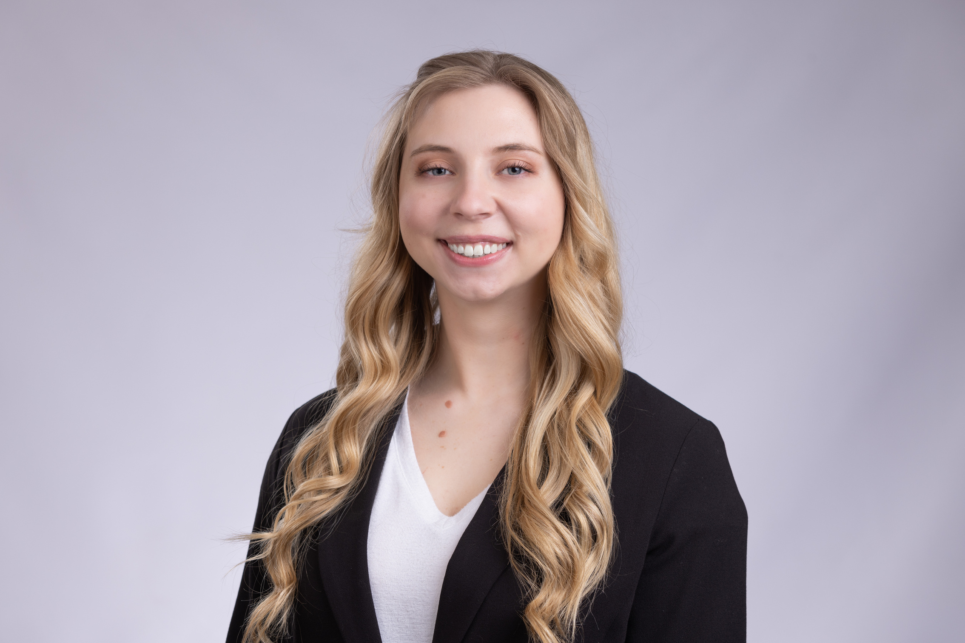
Who?
Emerging Technologies Librarian at Grosse Pointe Public Library - Ewald Branch
Alexis Smith
(She/Her/Hers)
Notes:
Mention that I'm a CIS white female and why that matters and is directly linked to digital literacy. (I have had certain privileges growing up and certain access to technology that others haven't).

Slide 3
What?
DigiLit is a series of classes where each week focuses on a different technology topic. I try to detail what each session will look like so patrons are never surprised, and I recommend they bring the following to EVERY class:
DigiLit
Series
  Library barcode number
  Any relevant passwords (Apple ID, email, etc)
  Their own device.
Notes:
I don't require registration.

Slide 4
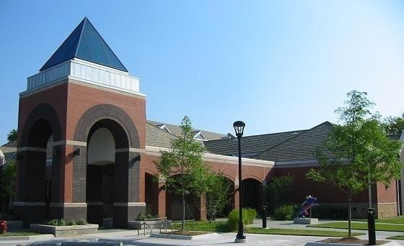
Where?
Grosse Pointe Public Library
Ewald Branch
  Services over 11,124 patrons in the Grosse Pointe Park area
    Total patrons = over 42 thousand
  18% are 65 years or older
  99.2% of all households have a computer / smart device
  97.3% of households have internet access
Ewald Branch - Grosse Pointe Park

Slide 5


Why?
  Tech Savvy Tuesdays were a hit
  Patrons requested more tech related programs
    Specifically device training
  Digital literacy matters!!
Notes:
Started out as Tech Savvy Tuesdays
Look at survey from Mary Short and cite it.
Digital Literacy matters!

Slide 6

Digital Literacy
“The ability to use information and communication technologies to find, evaluate, create, and communicate information, requiring both cognitive and technical skills”
Notes:
Mention the spectrum

Slide 7
How it works:

Slide 8
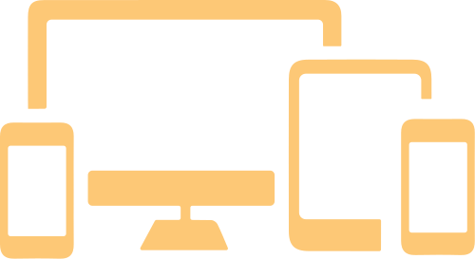

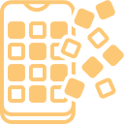
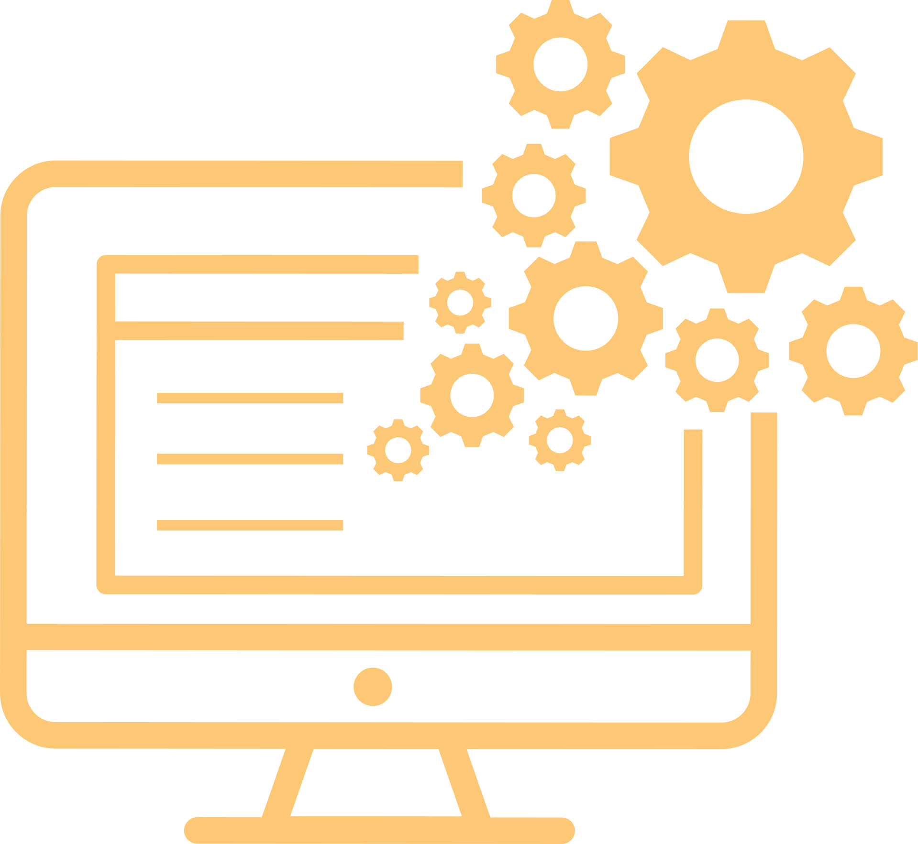
First Week - Devices
Second Week - Internet Basics
Third Week - Appy Hour
Fourth Week - Tech Help Drop-In
Notes:
Patrons are encouraged to bring in their own, specific devices (phones, tablets, and laptops only, no desktops or printers...yes, this has happened before) for detailed instruction.
Using Google, YouTube, and credible sources to their advantage, where to find it on their device.
LIBRARY APPS!!!! I go over app basics (what menu buttons look like, what play/pause buttons mean, but I only use library apps for example).
Where patrons can receive one-on-one help for whatever tech questions they have. We have teen volunteers come in as well to assist.

Slide 9




Class time
  Lecture style
  Live presentation
  Stream apps on tv screen
  One-on-one instruction as needed / on drop-in day
    I instruct patrons, I will not do it for them
  Guest speakers
Notes:
Meet the patrons where they are at.
Unfortunately, I do use up most of the hour as a lecture, but I encourage and stop for questions as often as possible because I don’t want to just divulge information that isn’t relevant.
But it didn't start out this way...
I learned the hard way not to do things FOR the patrons, but instead instruct them.

Slide 10

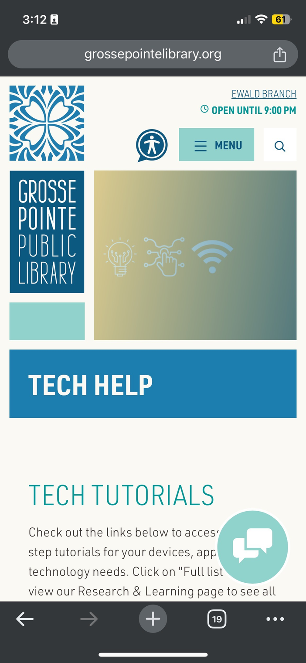
Additional Tools:
  Tech Help Page
    Tutorials
    Links to device-help pages
    Gathering of tech info
    FAQs
  One on one tech appointments
  Tools such as hotspots & Chromebooks
  OWL Devices (for staff use)

Slide 11

The Library Services & Technology Act (LSTA) Grant
Equitable Access & Digital Inclusion
[2023/2024]
Upon receiving the LSTA grant from the Library of Michigan, Grosse Pointe Public Library has purchased 30 new hotspots (for a total of 50 for our patrons), 30 Chromebooks to populate our programming carts and a new OWL meeting device so each branch has their own to use for programs. DigiLit provides a space for patrons to learn how to operate hotspots and chromebooks for their own use.
Funding is provided in part by the Institute of Museum and Library Services through the Library of Michigan.
Notes:
LSTA project

Slide 12
How we got here:

Slide 13
Evolution:
From:
Themes, themes, themes
To:
More focused content
  Content focused
    Genealogy day
    Database day
    Language day
  LONG (1 1/2 to 2 hours)
  Lengthy PowerPoint lectures
  One person show
  Online resources only
  In-person only
  Patron focused
    Devices
    Internet
    Appy Hour
  Concise screen time (1 hour)
  Organized & intentional content
  Volunteers welcome
  Physical devices included
  Inclusive access
Notes:
Each theme is generalized so that when the patrons walk in its tailored to their specific needs - their devices etc...
How and why it had to evolve.

Slide 14

Evolution leads to...
  More recurring attendance
  Manageable expectations
    AKA - we are NOT tech experts, but resource experts
  More confidence in patrons
  Less burnout for librarians
  Increased “Tech Help” page engagement
Notes:
Patrons have a better understanding of the library's role. We are not going to be able to fix it for you, but we can give you the tools to figure it out.

Slide 15





What’s next?
What patrons are saying:
I love the one-on-one help.
I feel like I now have the confidence to practice at home on my own because of this class.
Have more of these classes!!!
The detailed walk-throughs were a life saver.
I learn something new every class, even if it’s a repeat.
Notes:
Statistics

Slide 16

The future of DigiLit:
  More times / days offered
  Design own DigiLit online courses
    Via NicheAcademy or DigitalLearn
  Train one librarian at each branch to be
able to offer their own DigiLit sessions
  Refined lesson planning
  Partnering with local resources (Senior centers, geek squads, etc...)

Slide 17
Resources
Notes:
How can you get your own digilit started at your library?

Slide 18

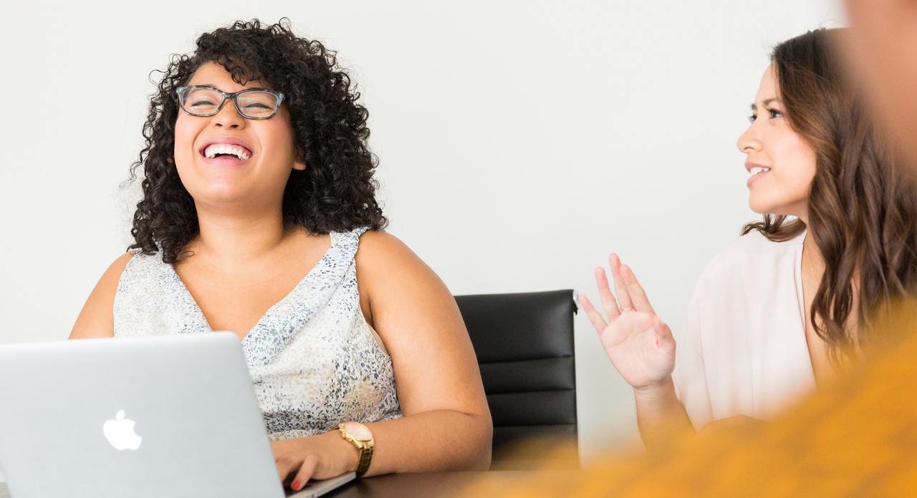
Digital Inclusion Toolkit
New York State
Library
New York State Library - https://www.nysl.nysed.gov
2022 Digital Inclusion Toolkit
--> Search “Digital Inclusion”
--> Click on 2022 PDF
Includes
  Tools to assess the digital divide / needs in your community
  Great compilation of tools and worksheets at the end of the document
  Links and actionable practices to audit your current digital inclusion offerings
New York State Library Digital Inclusion Toolkit

Slide 19

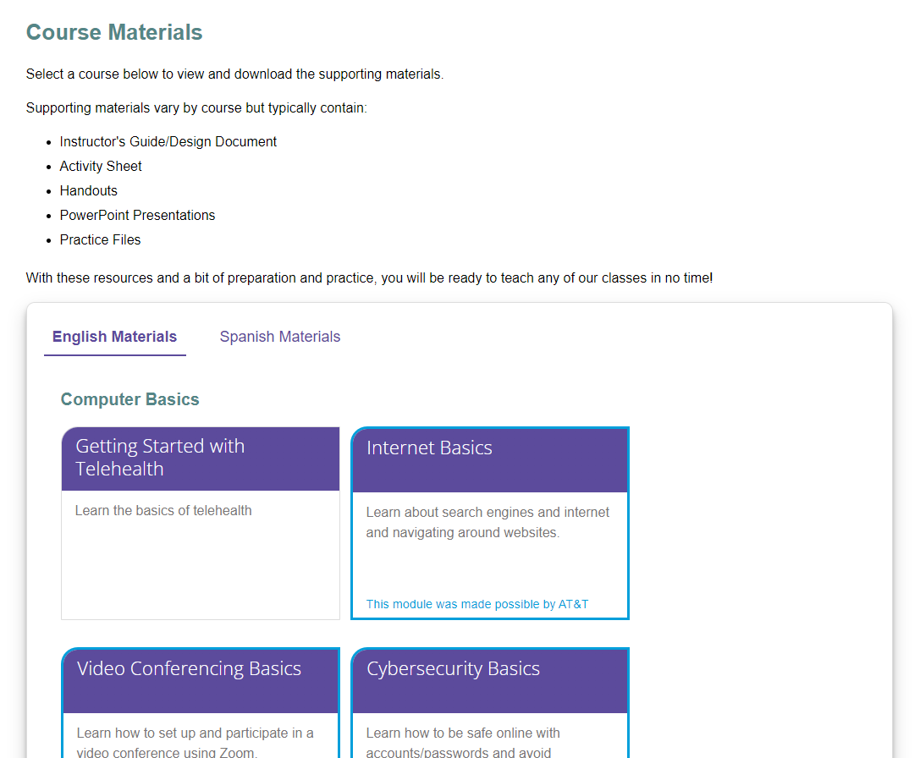
PLA DigitalLearn Training
  Multiple digital literacy courses
  Can customize / create your own modules for free
  English & Spanish available
  Simple layout
  Easy to link

Slide 20

Digital Literacy Workbook
https://www.ala.org/pla/initiatives/digitallead/digital-lit-instruction-playbook
  Links articles and resources for instructors to further their own learning
  Troubleshooting tech tips
  Tips and tricks for teaching adult learners
Notes:
can google digital lit instruction playbook to get the page

Slide 21

Digital Skills LibGuides
https://4cls.libguides.com/adultservices/digitalskills
  Includes self paced courses for library staff
  Has a whole page of resources for Older Adults
    Some specific to Four County / New York
  Provides examples of other library digital literacy programs

Slide 22
Questions?
Notes:
Questions?

Slide 23
Sources
"DigitalLead: Rural Libraries Creating New Possibilities", American Library Association, April 7, 2020
https://www.ala.org/pla/initiatives/digitallead/digital-lit-instruction-playbook (Accessed October 8, 2024), Document ID: f1c6f44a-3c95-44c4-96ec-cbaefa5ec34f
“Libguides: Adult Services: Digital Skills.” Digital Skills - Adult Services - LibGuides at Four County
Library System, Four County Library System, 6 Sept. 2024, 4cls.libguides.com/adultservices/digitalskills.
“Tech Help.” Grosse Pointe Public Library, 2024, grossepointelibrary.org/technology-help.
“Tools and Resources for Trainers.” DigitalLearn Training, Public Library Association (PLA),
training.digitallearn.org/. Accessed 2024.

Slide 24
Sources Continued...
U.S. Census Bureau Quickfacts: United States,
www.census.gov/quickfacts/fact/table/US/PST045223. Accessed 2024.
What Is Digital Literacy?, ALA - American Library Association, 2011,
alair.ala.org/server/api/core/bitstreams/6a42b84d-dbaf-4871-b2da-d60b51b21aef/content.
2020 Adult Services Survey. Grosse Pointe Public Library, 2020
2022 Digital Inclusion Toolkit - NYS Library, New York State Library, 2022,
www.nysl.nysed.gov/libdev/Digital-Inclusion-Toolkit.pdf.

Slide 25

Thank you!
Alexis Smith
(She/Her/Hers)
Feel free to contact me anytime!
(313) 640 - 4775 (ext. 1215)
asmith@grossepointelibrary.org

