Slide 1
How to Comply with Michigan's Wage and Hour Laws
Michael R. Blum
Foster Swift Collins & Smith, PC
(248) 785-4722
mblum@fosterswift.com
Michigan Library Association (MLA) Annual Conference
October 18, 2023
Notes:
Good Afternoon.
I hope you are enjoying the MLA annual conference so far. As many of you probably know, it was originally anticipated that new sick leave and minimum wage laws may become effective February 19, 2023, which resulted in a lot of preparatory work. In fact, many of you may have already prepared draft sick leave policies in anticipation of implementing them in February.
But, the Court of Appeals overruled the Court of Claims decision that would have resulted in implementation of those new laws. And the Court of Appeals decision has now been appealed to the Michigan Supreme Court.
It remains unclear what the sick leave and minimum wage laws may end up being after the Supreme Court issues its decision. So today, we will be discussing both the laws currently in place and what changes the new laws will require, if they are implemented.

Slide 2
Current Michigan Wage Law
Improved Workforce Opportunity Act of 2018
  http://www.legislature.mi.gov/(S(giqvmxxdrj5m2obfmsrv1mio))/mileg.aspx?page=GetObject&objectname=mcl-Act-337-of-2018
  Sets minimum wage and overtime requirements
  Effective January 1, 2024, minimum wage is:
    $10.10
    85% rate for minors aged 16 and 17 is $8.78
    Tipped employee hourly rate of pay is $3.93
Notes:
Michigan’s minimum wage is set by the Improved Workplace Opportunity Act of 2018.
But, you cannot simply look at the bill that was passed in 2018 to determine what the current minimum wage, because it was affected by the high unemployment in Michigan during the pandemic.
We will discuss that in a little more detail later.
But for the moment, the minimum wage is [GO TO SLIDE].

Slide 3
Current Sick Leave Law
Paid Medical Leave Act (PMLA)
  https://www.legislature.mi.gov/documents/2017-2018/publicact/htm/2018-PA-0369.htm
  Covers employers that employ 50 or more individuals.
  Employees must accrue at least one hour of paid leave for every 30 hours of work, up to 40 hours annually.
    Employees may roll over up to 40 hours of accrued, unused paid leave.
    But if the employer front-loads at least 40 hours of paid leave, rollover is not required.
  Excludes for eligibility for paid sick time individuals exempt from overtime requirements under the FLSA.
Notes:
There is also a current sick leave law in Michigan.
The current law came in due to actions by the Michigan legislature in 2018, which is subject to the appeal to the Supreme Court.
We will also talk about that shortly.
But for the moment, Michigan’s sick leave law is called the Paid Medical Leave Act.
[GO TO SLIDE]

Slide 4
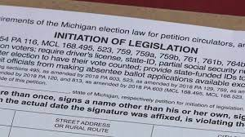
November 2018 Ballot Initiatives
Improved Workforce Opportunity Wage Act (IWOWA)
Earned Sick Time Act (ESTA)
  Both initiatives received enough signatures on to go on the November 2018 ballot.
  If passed by the voters, they would have become law and could have only been amended or repealed by the voters or by three-fourths of the legislature.
Notes:
Let’s begin by reviewing how this got started.
In 2018, two ballot initiatives were circulated to change the sick leave and minimum wage laws then in effect.
So, what is a ballot initiative?
Ballot initiatives are proposed laws that generally are put on the ballot for voter consideration. If the initiative receives enough votes, it becomes law.
24 states, including Michigan, allow for ballot initiatives.
In 2018, one of the ballot initiatives sought to increase minimum wage and eliminate the tip credit.
The other sought to require employers to provide employees with paid sick time.
[Go to slide.]

Slide 5

IWOWA Ballot Initiative
Raised the minimum wage to $12.00 per hour by 2022.
Provided for yearly increases thereafter based on inflation.
Eliminated the tip credit by 2024.
Notes:
Let’s first discuss the IWOWA initiative.
[Go to slide.]

Slide 6

Earned Sick Time Act (ESTA) Ballot Initiative
Provided Michigan employees with 72 hours of annual leave for specified reasons for absence.
For employers with 10 or more employees, the 72 hours of leave time must be paid.
For small employers with less than 10 employees, only the first 40 hours had to be paid, so the remaining 32 hours could be unpaid.
Notes:
The other ballot initiative, the ESTA, sought to significantly change and increase the amount of paid time off employees in Michigan would get for reasons specified in the initiative.
[Go to slide.]

Slide 7


Adopt and Amend
Prior to the election, the Michigan legislature adopted both ballot initiatives.
In the same legislative session, the Michigan legislature then amended both the IWOWA and the ESTA before they became effective.
Notes:
So, why aren’t are these new requirements currently the law in Michigan?
Well, a ballot initiatives generally is placed on the next general election ballot, provided enough signatures are obtained on the petition.
But Michigan has a unique procedural mechanism known as Adopt and Amend.
[Go to slide.]

Slide 8
IWOWA, as Amended
Stretched out the increases in the minimum wage to reach $12.00 per hour by 2030 rather than 2022.
Removed the provision for yearly increases based on inflation.
Removed the provision eliminating the tip credit.
Notes:
And the amendments significantly changed what would have been required if the ballot initiatives has been approved by the voters.
[Go to slide.]

Slide 9
ESTA, as Amended
Renamed the Paid Medical Leave Act (PMLA).
Applied only to employers with 50 or more employees.
Allowed for employers to frontload the leave to avoid carry-over.
Removed anti-retaliation provisions.
Removed the right to bring a private civil suit for violations.

Slide 10

Legal Challenges
Notes:
Once the amendments were implemented, a lot of individuals and organizations cried foul.

Slide 11

Legal Challenge – Court of Claims
In May 2021, Mothering Justice, an advocacy group, and other plaintiffs filed a lawsuit in the Michigan Court of Claims to invalidate the PMLA and amended IWOWA.
On July 19, 2022, the Court of Claims ruled in favor of Mothering Justice, holding that the Michigan legislature could not constitutionally adopt and amend a ballot initiative in the same legislative session.
Mothering Justice, et. al vs. Dana Nessel, 2022mWL 17548484 (Mich.Ct.Cl., July 19, 2022)
But the Court of Claims stayed enforcement of its ruling until February 19, 2023.
Notes:
Since the court’s stay was set to expire February 19, 2023, there was a lot of publicity and discussion over how employers, including libraries, had to prepare for the new laws to take effect that day.

Slide 12
Legal Challenge – Court of Appeals
The State of Michigan appealed the Court of Claims ruling to the Michigan Court of Appeals.
On January 26, 2023, the Michigan Court of Appeals overturned the Court of Claims ruling, finding that the legislature could constitutionally amend laws adopted beyond the initial 40-session day period for legislative action, even if the amendment was in the same legislative session.
COA 362271 MOTHERING JUSTICE V ATTORNEY GENERAL Opinion - Authored - Published 01/25/2023 (michigan.gov)
Notes:
But prior to expiration of the stay, the Court of Appeals reversed the Court of Claims.
The Court of Appeals disagreed with the lower court’s determination that adopting and then amending a petition initiative in the same legislative session was unconstitutional.
The Court of Appeals felt it necessary to stress that the underlying subject of the initiatives was irrelevant to its decision, because it was ruling solely on a constitutional grounds.
I found this statement in the Court of Appeals decisions interesting: “Whether the underlying subject matter is taxes, abortions, sentencing of criminals, you name whatever that social issue is, is not relevant to this matter.”
So, if you recall how quickly the Michigan legislature addressed the social issue of abortion after the Supreme Court overturned Rowe v. Wade, many thought the Michigan legislature, which is now controlled by the Democrats, would quickly pass new bills implementing the minimum wage increases and sick leave contained in the ballot initiatives.

Slide 13
Legal Challenge – Supreme Court
On February 10, 2023, Mothering Justice filed an Application for Appeal to the Supreme Court.
Michigan LEO statement:
  On January 26, 2023, the Michigan Court of Appeals reversed the Court of Claims’ July decision and ruled the amended versions of these statutes are valid and enforceable. This Court of Appeals decision means there is no change to the current minimum wage and paid medical leave laws, and the Wage & Hour Division will continue enforcing these standards as it has since their enactment.
  https://www.michigan.gov/leo/bureaus-agencies/ber/wage-and-hour/ruling-on-minimum-wage-and-paid-medical-leave
Supreme Court granted application to appeal on June 24, 2023.
Notes:
But, to date the legislature not has proposed any bills to do so.
Rather, Mothering Justice filed an appeal with the Michigan Supreme Court, which is pending.
[Go to slide.]
But, if the Supreme Court were to decline to overrule the Court of Appeals decision, the matter could still be addressed by the Michigan legislature.
So, it remains important to not only know what the current laws require, but how they could change depending on what the Supreme Court and/or the legislature does.

Slide 14
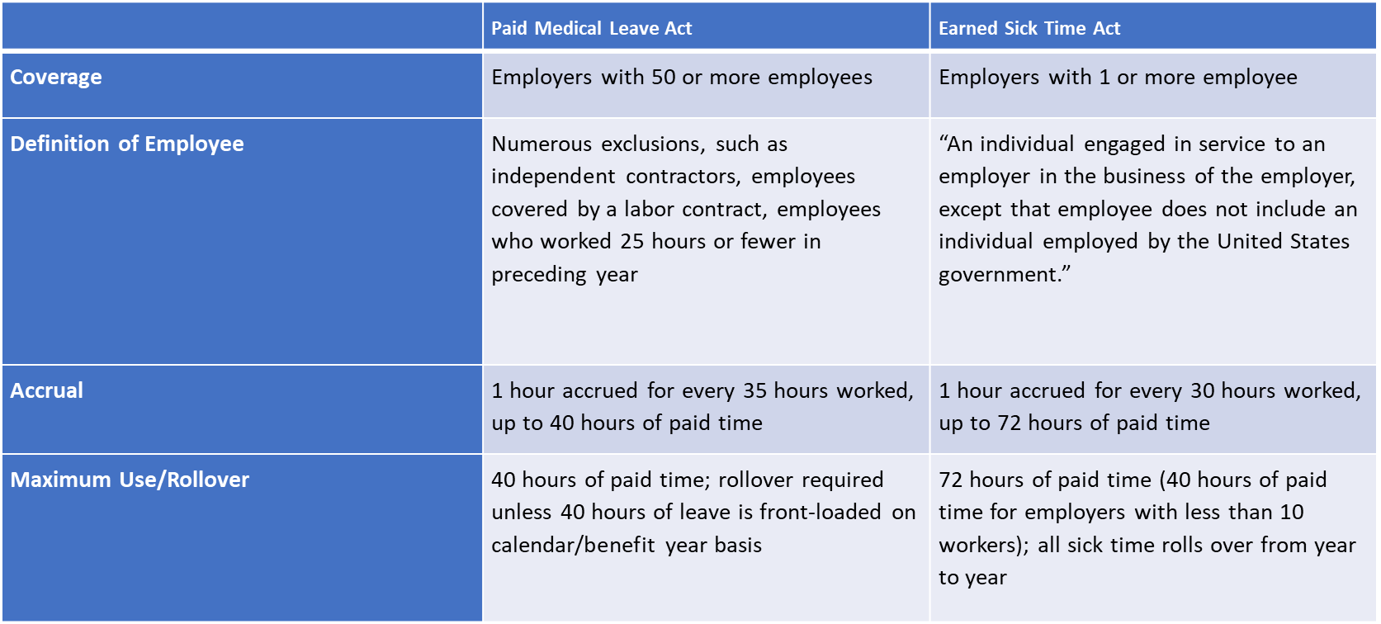
Difference Between the ESTA and PMLA
Notes:
Let’s look at the differences between Michigan current paid sick leave law and what would be required in the terms of the ballot initiative become law.
The biggest difference between the ESTA and PMLA is which libraries are covered.
Currently, only libraries with 50 or more employees are required provide paid sick leave. But, if the ESTA becomes law, every library in the State of Michigan will be required to provide 72 hours of leave time, and for those with at least 10 employees all 72 hours must be paid.
[Go to slide.]

Slide 15

What Libraries Should do Now
Determine whether the Library is a covered employer under the Paid Medical Leave Act, PA 338 of 2018, effective March 29, 2019.
Michigan Legislature - Act 338 of 2018
Ensure the Library is in compliance with the Improved Workforce Opportunity Wage Act, PA 337 of 2018, as amended and effective March 29, 2019.
Michigan Legislature - Act 337 of 2018
Notes:
So, with the law still in a status of flux, the question is what libraries should be doing now.
[Go so slide.]

Slide 16
PMLA – Covered Employers
Employer" means any person, firm, business, educational institution, nonprofit agency, corporation, limited liability company, government entity, or other entity that employs 50 or more individuals.
Term “employ” is not defined, but should be interpreted broadly, not narrowly.
  Count individuals employed on a part-time basis.
  But do not count individuals who are properly classified as independent contractors.
Notes:
As I already mentioned, the threshold issue is whether the library employs at least 50 employees.
But, there is more to it than that.
[Go so slide.]

Slide 17
PMLA – Eligible Employees
Eligible employee" means an individual engaged in service to an employer in the business of the employer and from whom an employer is required to withhold for federal income tax purposes.
Eligible employee does not include, among others, any of the following:
  An individual who is exempt from overtime requirements under Fair Labor Standards Act.
  An individual employed by an employer for 25 weeks or fewer in a calendar year for a job scheduled for 25 weeks or fewer.
  An individual who worked, on average, fewer than 25 hours per week during the immediately preceding calendar year.
Notes:
But, even if the library is a covered employer, not all of its employees are eligible to accrue paid sick time under the PMLA.
[Go so slide.]

Slide 18
PMLA - Accrual Requirements
Employees who work on average 25 or more hours per week must accrue 1 hours of paid leave for every 35 hours worked up to a maximum of 40 hours annually.
Alternatively, the employer can front-load employees with at least 40 hours of paid leave for PMLA-covered reasons.
Under the front load method, an employer does not have to let an employee carry over any unused paid leave to the next benefit year.
Employers who provide eligible employees with at least 40 hours of paid leave each benefit year will be presumed to be in compliance with the Act.
Notes:
If the library is a covered employer under the PMLA, you must also determine which method of accrual you want to follow.
There are two options.
[Go to slide.]

Slide 19
PMLA – Reasons for Taking Leave
  An employer shall allow an eligible employee to use paid medical leave accrued for any of the following:
  The eligible employee's mental or physical illness, injury or health condition; medical diagnosis, care or treatment of the eligible employee's mental or physical illness, injury or health condition; or preventative medical care for the eligible employee.
  The eligible employee's family member's mental or physical illness, injury or health condition; medical diagnosis, care or treatment of the eligible employee's family member's mental or physical illness, injury or health condition; or preventative medical care for a family member of the eligible employee.
  If the eligible employee or the eligible employee's family member is a victim of domestic violence or sexual assault, the medical care or psychological or other counseling for physical or psychological injury or disability; to obtain services from a victim services organization; to relocate due to domestic violence or sexual assault; to obtain legal services; or to participate in any civil or criminal proceedings related to or resulting from the domestic violence or sexual assault.
  For closure of the eligible employee's primary workplace by order of a public official due to a public health emergency; for an eligible employee's need to care for a child whose school or place of care has been closed by order of a public official due to a public health emergency; or if it has been determined by the health authorities having jurisdiction or by a health care provider that the eligible employee's or eligible employee's family member's presence in the community would jeopardize the health of others because of the eligible employee's or family member's exposure to a communicable disease, whether or not the eligible employee or family member has actually contracted the communicable disease.
Notes:
Libraries covered by the PMLA must also pay attention to why employees may take PMLA, as it is broader than just illness.
[Go to slide.]

Slide 20
PMLA - Notice and Retention Requirements
Covered employers must display a poster containing specific information about the PMLA in a conspicuous place accessible to eligible employees.
The Michigan Department of Licensing and Regulatory Affairs has made a free poster available to meet this requirement at
https://www.michigan.gov/documents/lara/Paid_Medical_Leave_Act_Poster_644565_7.pdf.
Covered employers must retain records for at least one year documenting the hours worked and paid medical leave taken by eligible employees, and make those records available to the Michigan Department of Licensing and Regulatory Affairs upon its request.
Notes:
And finally, libraries that are covered by the PMLA must make sure they are in compliance with the notice and retention requirements.
[Go to slide.]

Slide 21

Improved Workforce Opportunity Wage Act (IWOWA)
"Employer" means a person, firm, or corporation, including this state and its political subdivisions, agencies, and instrumentalities.
"Employee" means an individual employed by an employer on the premises of the employer or at a fixed site designated by the employer.
Notes:
Now let’s finish up by briefly revisit the requirements of Michigan’s current minimum wage law.
[Go so slide.]

Slide 22

Training Wage
An employer may pay a new employee who is less than 20 years of age a training hourly wage of $4.25 for the first 90 days of that employee's employment. The hourly wage authorized under this subsection is in lieu of the minimum hourly wage otherwise prescribed by the IWOWA.
Except as permitted as a training wage, the minimum hourly wage for an employee who is less than 18 years of age is 85% of the general minimum hourly wage.
Notes:
Before we discuss what must be paid to most of the employees, I wanted to briefly mention the training wage currently allowed under Michigan law.
I’m not sure what the legislature was thinking when this training wage provision was included in the law, but it must have been before the movement for a minimum wage of $15.00/hr. started.
But in any event, it is the law so I thought you should be aware of it.
[Go to slide.]

Slide 23
Minimum Wage
The established minimum wage from 2019 through 2030 is conditional upon the unemployment rate being less than 8.5% for the calendar year preceding the calendar year of the prescribed increase.
If the unemployment is 8.5% or greater in a particular calendar year, the established minimum wage rate for the following year will not take effect.
If the established minimum wage rate for a particular year does not take effect, if will become effective the first calendar year following a calendar year for which the unemployment rate is less than 8.5%.
Notes:
And finally, let’s talk about Michigan’s current minimum wage requirements.
A key feature of the current minimum law takes into consideration the affects of inflation, which we have already seen impact the amount that must be paid.
[Go to slide.]

Slide 24
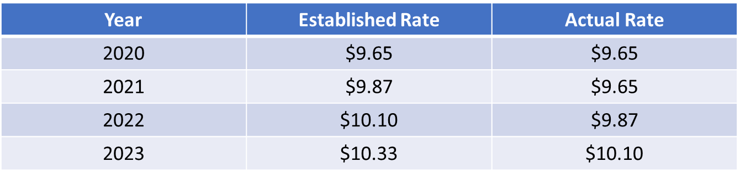
Minimum Wage
How has the high unemployment in Michigan impacted the established minimum wages established in the IWOWA?
If ESTA had taken effect on February 19, 2023, the minimum wage would be $13.03/hour.

Slide 25


