Slide 1




Slide 2


WHO WE ARE
Michigan Humanities is committed to promoting and supporting humanities programming throughout our state that explore, strengthen, and celebrate expansively and inclusively the stories, histories, and cultures of the people in our state. Through our own programming and grant-making we seek to partner with diverse organizations from all sectors.

Slide 3
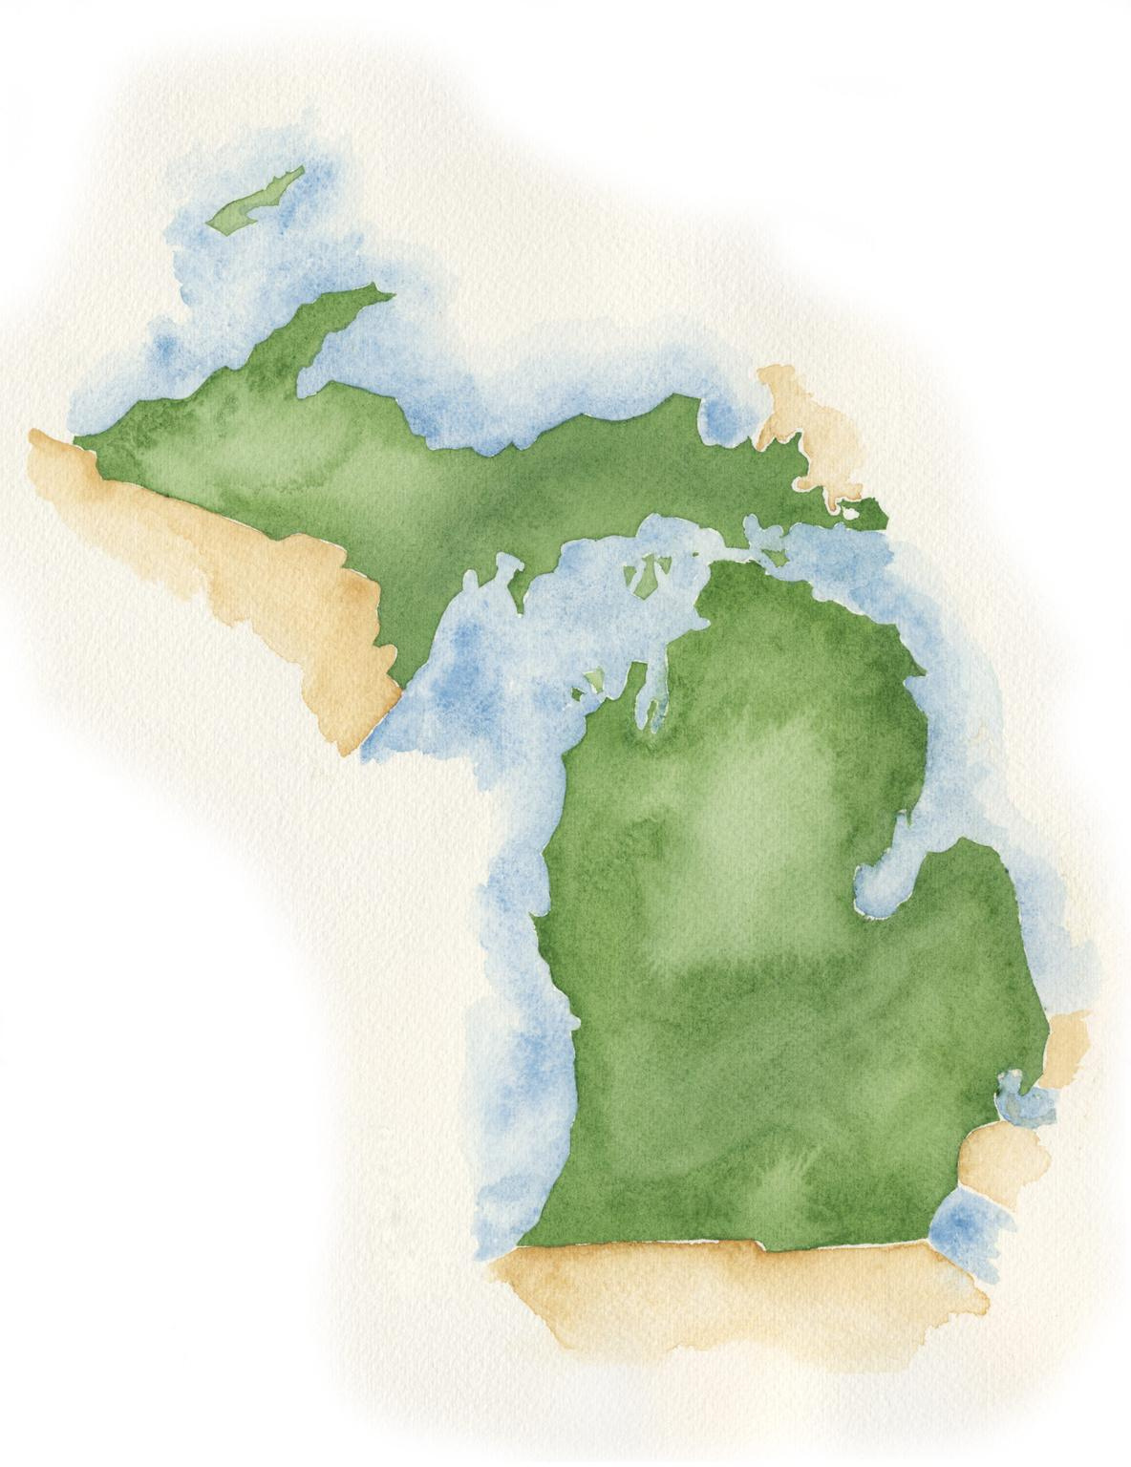

HISTORY
Michigan Humanities is the state affiliate of the National Endowment for the Humanities. Our organization opened its doors in 1974 to begin public humanities programming. Michigan Humanities is one of the 56 state and territorial humanities councils.

Slide 4



Mission
Bringing people together through stories, histories, cultures, and conversations.
Vision
A more thoughtful, connected, engaged, and informed Michigan.

Slide 5


Slide 6

GREAT MICHIGAN READ
Michigan Humanities’ Great Michigan Read creates a statewide discussion around a Michigan themed book. Through partnerships with libraries, schools, book clubs, and a wide range of other non-profit organizations, the Great Michigan Read facilitates statewide reading and programs to bridge communities around a common conversation.

Slide 7

GREAT MICHIGAN READ
2023-24 title is
Firekeeper’s Daughter
by Angeline Boulley

Slide 8
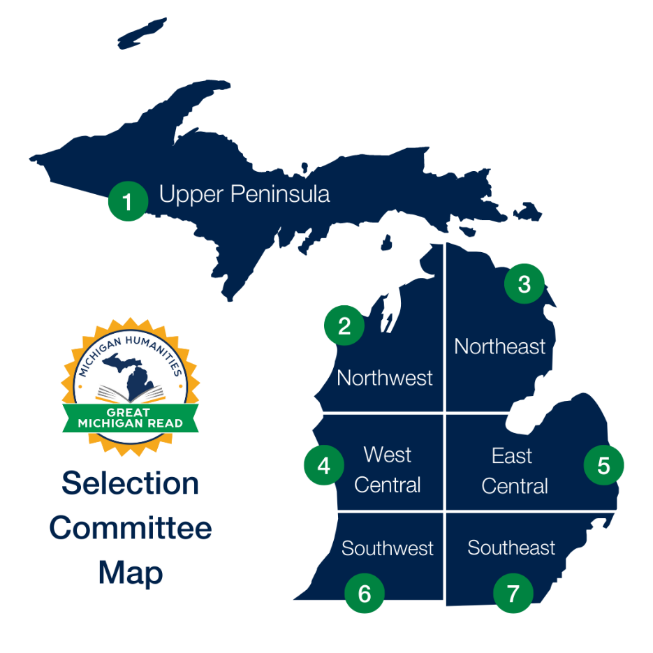
GREAT MICHIGAN READ
  7 regional selection committees select the title bi-annually
  Author Tour opportunities
  Open to Michigan non-profit organizations, libraries, schools, book clubs, and more!
  Partners receive free books, reader’s guides, teacher’s guides, bookmarks, supplemental materials, and audio/e-books
  Action Grants up to $750 are available for additional Great Michigan Read programming needs

Slide 9
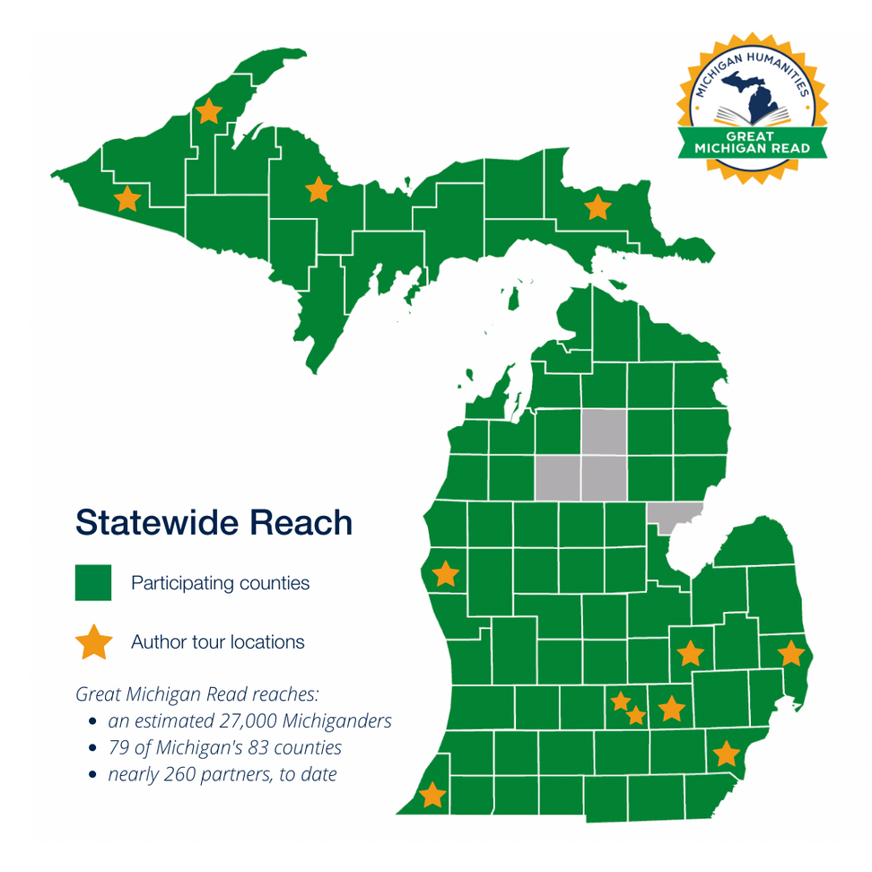
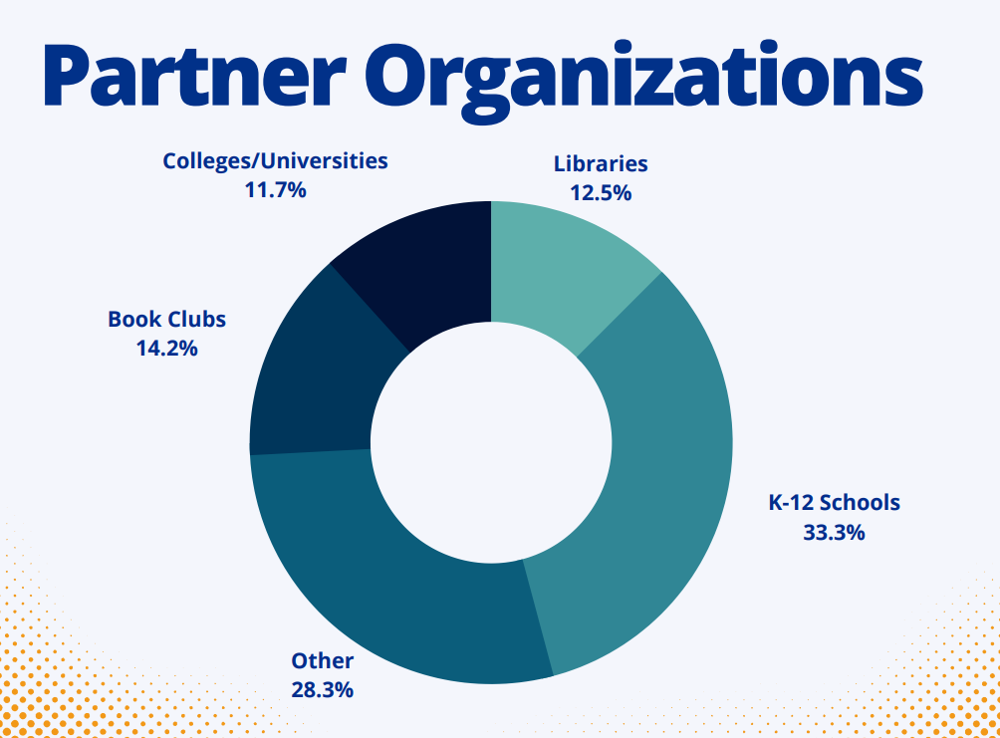
GREAT MICHIGAN READ

Slide 10
GREAT MICHIGAN READ
Action Grants
Up to $750 to support programming that goes along with the book.
  Must be a non-profit organization
  Non-matching
  First come-first served
  Majority of funds should be used for actual program

Slide 11
GREAT MICHIGAN READ
Author Tour
Angeline Boulley will do two author tours, with a total of 10 stops.
Spring dates:
April 25—Ironwood
Date TBD—St. Ignace area
Date TBD—Keweenaw Peninsula

Slide 12


Slide 13

POETRY OUT LOUD
Poetry Out Loud is a national poetry recitation competition for high school students. By encouraging youth to learn about great poetry through memorization and performance, students can master public speaking skills, build self-confidence, and learn about their literary heritage. The program and all materials are provided to each partner at no cost.
Each year, participating partners host their own competitions and select a student to represent their school/organization at the state finals. The state champion advances to the national finals in Washington, D.C. and competes for a $20,000 college scholarship.

Slide 14


Slide 15

ARTS & HUMANITIES TOURING GRANTS
Provide funding opportunities to Michigan non-profit organizations to host arts and humanities programming that feature artists and presenters from both the humanities and performing/visual arts fields.

Slide 16
ARTS & HUMANITIES TOURING GRANTS
Grant Funding
No match required. This is a reimbursement award.
  40% reimbursement for out-of-state artists
  60% reimbursement for in-state artists (proof of residency required)
  75% reimbursement for under-represented in-state artists (proof of residency required)
  Request for a grant may not exceed $3,000 per application, and an organization may not submit more than 4 grant applications or request more than $4,000 during the program period.

Slide 17

ARTS & HUMANITIES TOURING GRANTS
Funding windows:
Performances from December 1 to February 28:
Application window opens November 15 at 9:00am
Performances from March 1 to May 31:
Application window opens February 1 at 9:00am
Performances from June 1 to August 15:
Application window opens May 1 at 9:00am

Slide 18
ARTS & HUMANITIES TOURING GRANTS
Before You Apply
You will need the following to complete the application:
  Contract for performance
  Proof of non-profit status
  Unique Entity Identifier (UEI) number
  Date of performance
  Approximate number of audience members
  Residency for in-state artists

Slide 19
ARTS & HUMANITIES TOURING GRANTS
Frequently Asked Questions
  How/when do I pay my artist?
  When will I get my reimbursement?
  How do I access my final report?
  How do I evaluate my event?
  Do I need to take photos?
  What are legislator thank you letters?

Slide 20


Slide 21

BRIDGING MICHIGAN GRANTS
Bridging Michigan grants provide Michigan nonprofits with up to
$2,500 that can be used to spark in-depth thinking and conversation around the persistent social, economic, and cultural issues of systemic inequity that divide our communities.
Accepted on a rolling basis.

Slide 22


Slide 23
HUMANITIES GRANTS
Humanities Grants currently offer up to $20,000 to support a variety of projects centered around the humanities in Michigan.
These projects entail public-facing programming or produce publicly accessible products, such as exhibitions, theater performances, and more, that enrich Michiganders’ knowledge and understanding of various peoples, cultures, and communities in the state.

Slide 24
HUMANITIES GRANTS
About Humanities Grants
Up to $20,000 to support humanities-based projects
Can support a variety of projects including:
    Exhibitions
    Documentaries
    Oral History Projects
    Theater
    Books
Key Components of a Humanities Grant:
    Humanities Theme
    Public Program/Product

Slide 25
HUMANITIES GRANTS
Spring Grants
Awards made in June
    Applications due in March
    Draft project proposals accepted for feedback
Fall Grants
Awards made in November
    Applications due in September
    Draft project proposals accepted for feedback

Slide 26


Slide 27
MICHIGAN HUMANITIES
AWARDS
  Annual awards program
  Open call for nominations
  Nominations accepted January-March
  Individual and organizational awards
  Recipients receive funds towards a project supporting their work or a community celebration

Slide 28

MICHIGAN HUMANITIES GRANT PORTAL
Notes:
32

Slide 29
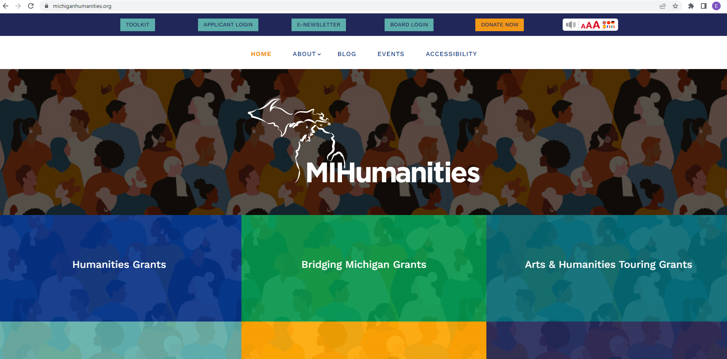
Access our online grant portal (a.k.a Foundant) by going to www.michiganhumanities.org and clicking "Applicant Login" at the top of the page
15

Slide 30
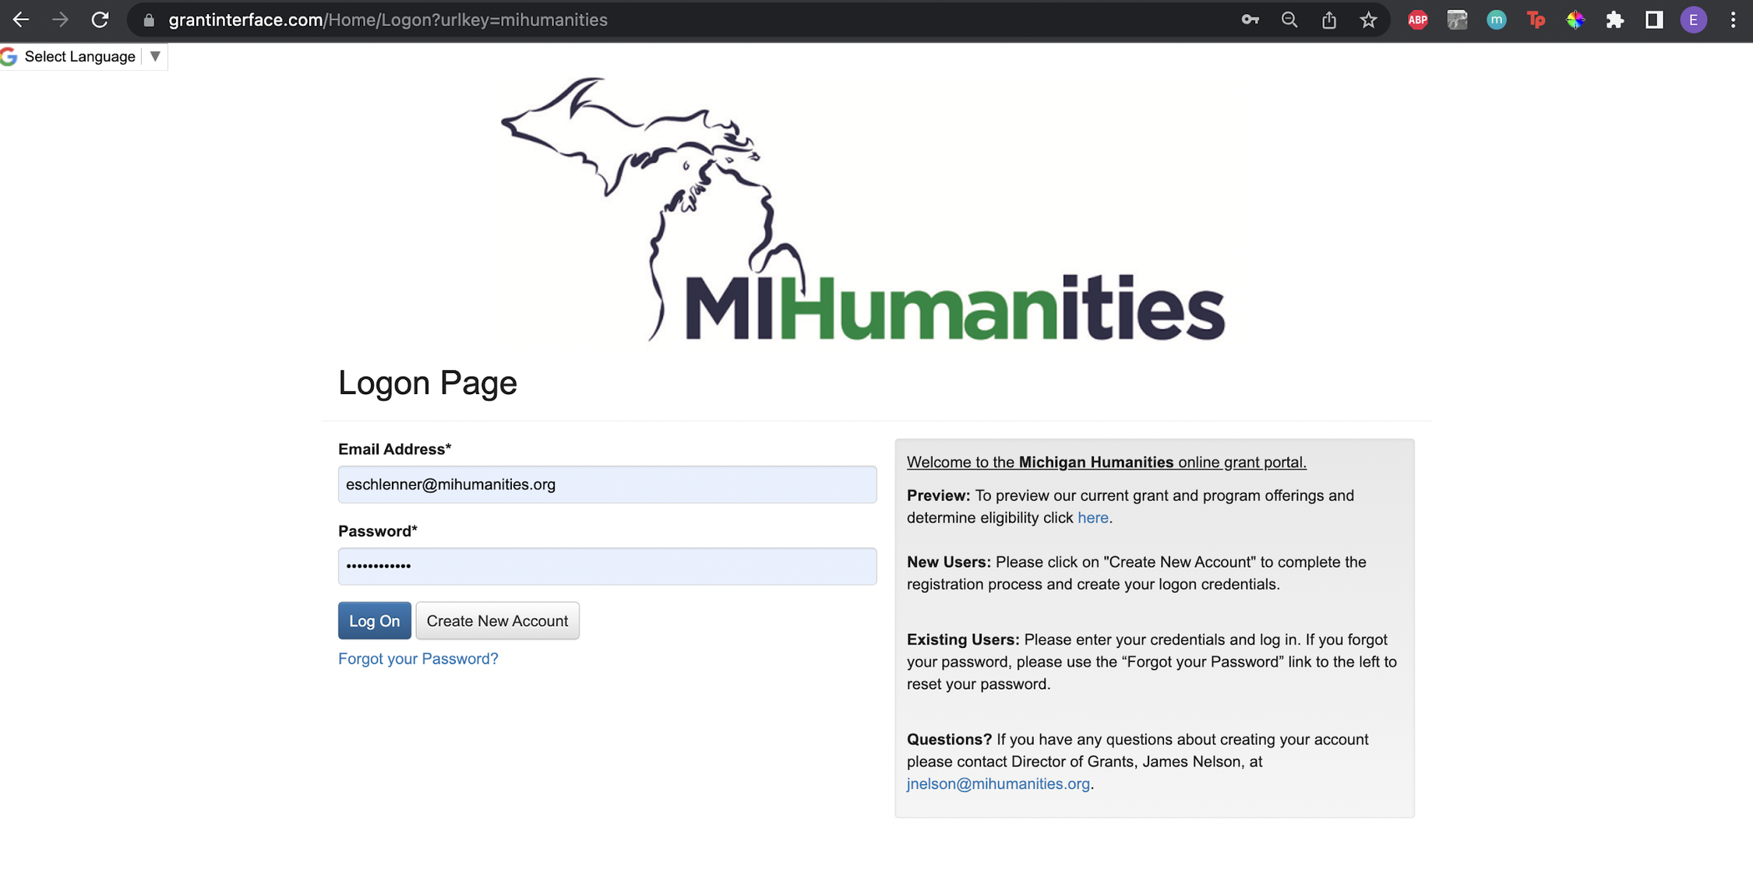
Foundant, where you apply for grants and register for programs
8/05/20XX
34

Slide 31
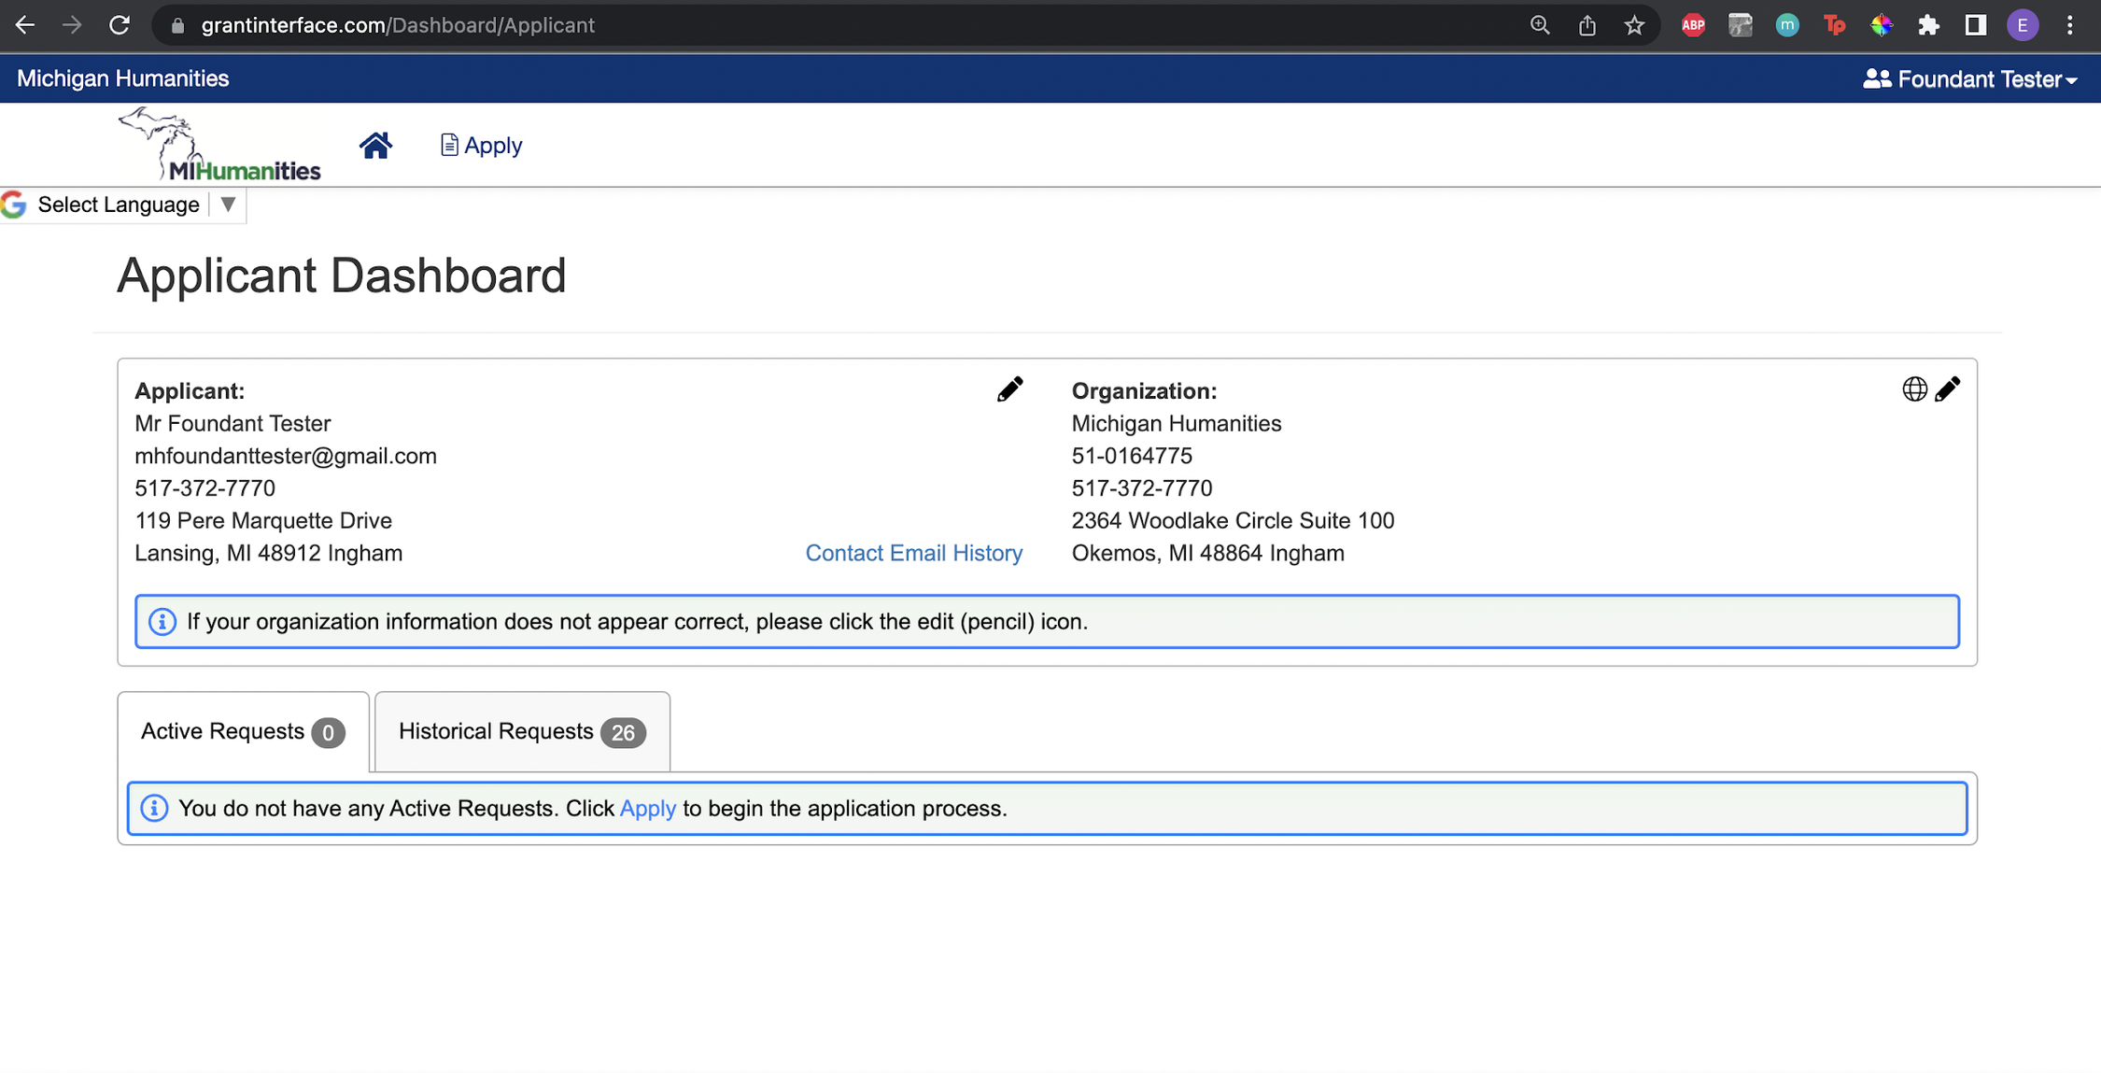
After logging in, you will see this Home screen. Click on "Apply" to see the open grant and program opportunities
8/05/20XX
35

Slide 32
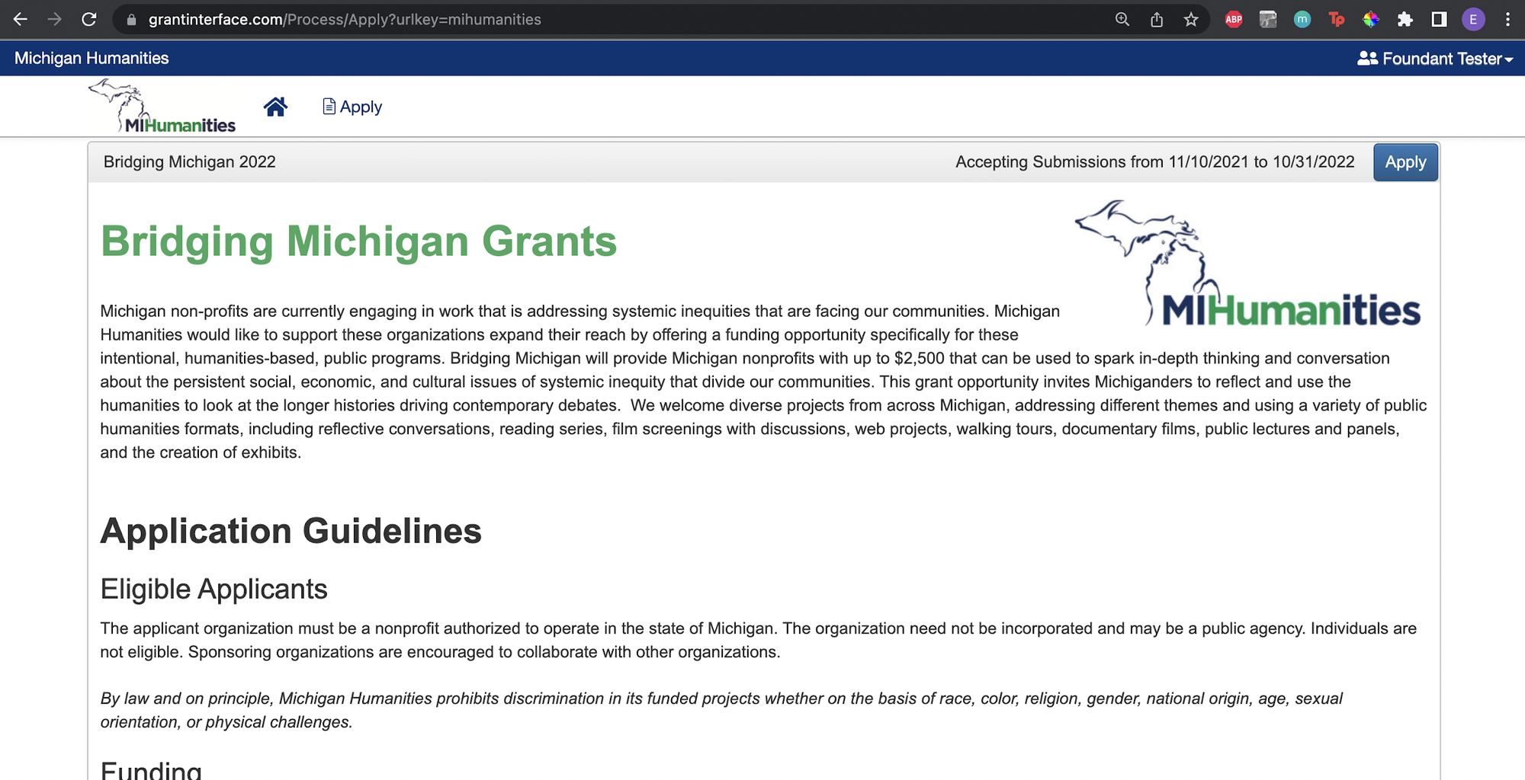
"Apply" page
8/05/20XX
36

Slide 33




KEEP IN TOUCH
info@mihumanities.org
www.michiganhumanities.org
517-372-7770
Feel free to reach out to us about any joint efforts, partnerships, or grant/programming opportunities.
We would love to hear from you!

