Slide 1

ASPIRING ENTREPRENEURS AND YOUR LIBRARY: A PERFECT MATCH!
HILLARY HENTSCHEL, JAN MURPHY, DAVID SILBERMAN, EMILY TOBIN, AND SHERRI VAUGHN

Slide 2



Outcomes
At the end of the session, participants will:
Describe the most crucial and important gaps to address in effectively supporting the entrepreneurial/small business community.
Evaluate small business resources and programs to ensure that library offerings are addressing and serving patrons and the business community in ways that lead to successful, measurable outcomes.
Understand how public libraries and other community organizations can partner to support the small business community and contribute to economic development.

Slide 3
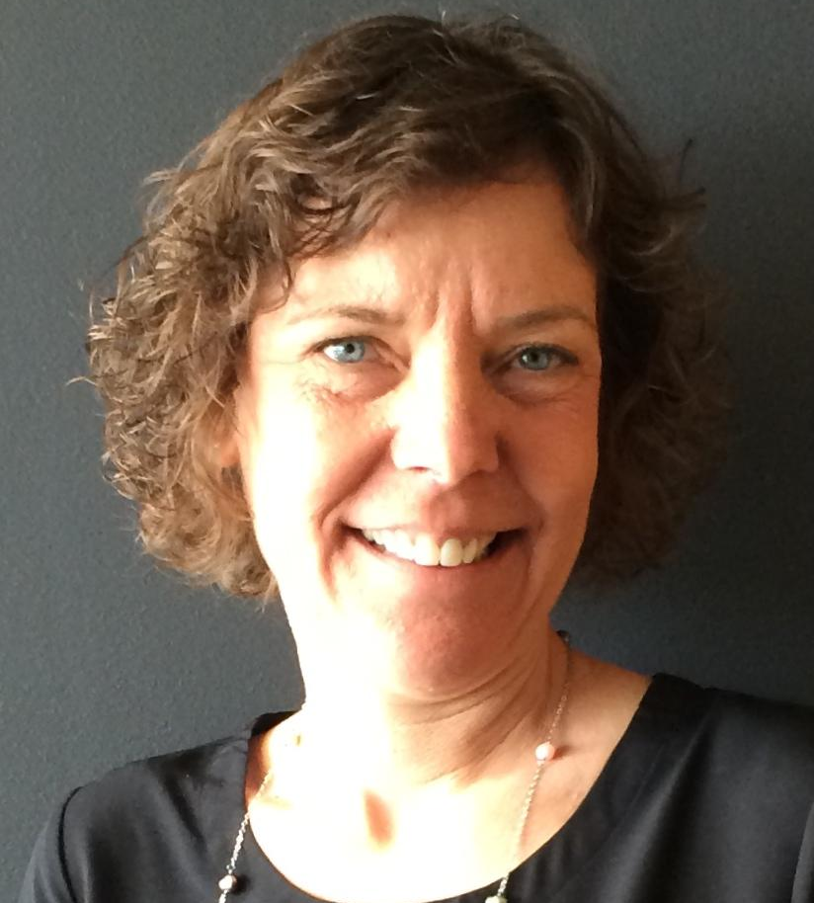
About Us
Jan Murphy
Jan Murphy is a product management director at Gale, where she has spent her entire career, beginning as an assistant editor in 1991 (when there was a typewriter on each desk). She loves making resources that help libraries help others!

Slide 4
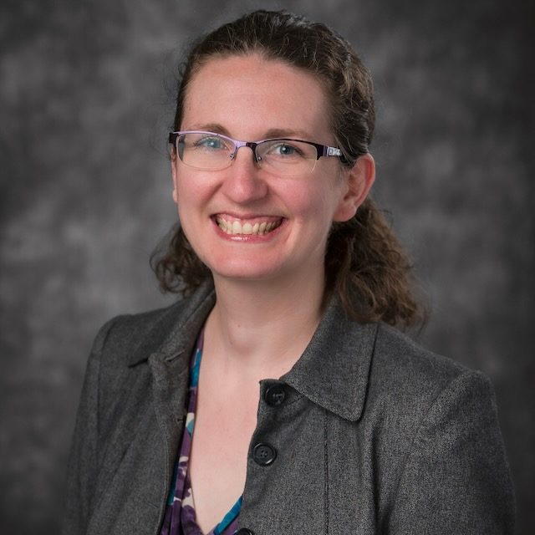
About Us
Hillary Hentschel
Hillary Hentschel is the Head of Information Services at the Novi Public Library (NPL) in Novi, Michigan. She started her career in Business Reference at Gale Cengage Learning before becoming the Business Librarian at NPL, where she specialized in business and career resources and outreach to the small business community. Her favorite part of her job is surprising people with everything the library has to offer!

Slide 5
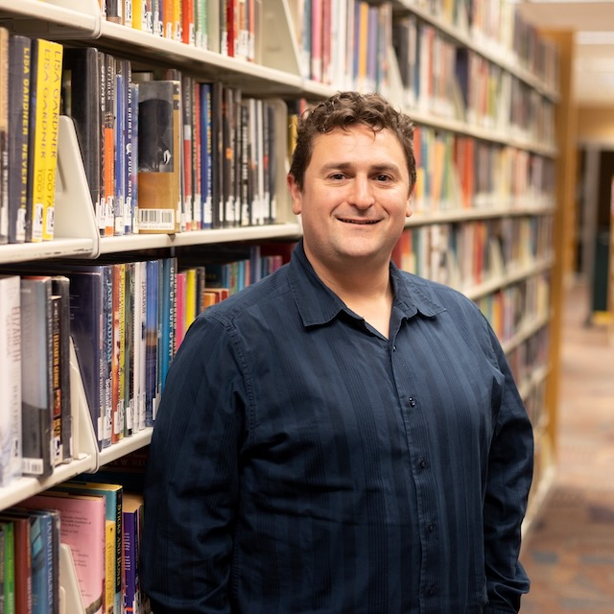
About Us
David Silberman
David Silberman attended Western Michigan University for a bachelors in Public History and Wayne State University for his Masters in Library & Information Science. He worked at Oakland Community College and the Novi Public Library before joining the Clarkston Independence District Library as the Business & Marketing Librarian in 2021. He now serves as the head of Adult Services, along with an ambassador for the Clarkston Area Chamber of Commerce, building connections between CIDL and area businesses and non-profits.

Slide 6
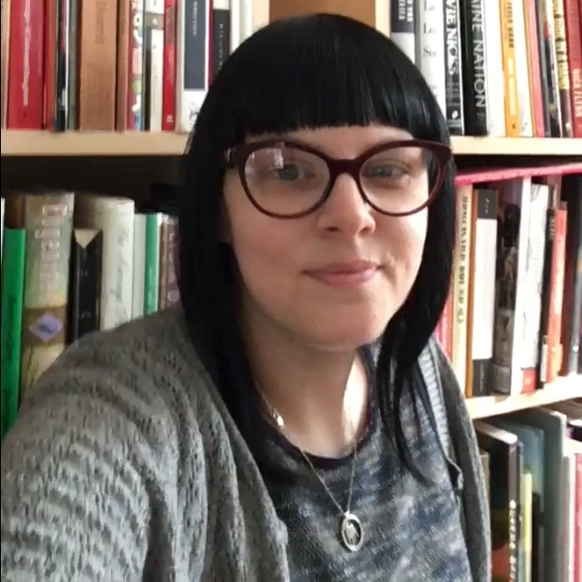
About Us
Emily Tobin
Emily Tobin has been in the library profession for 7 years and before that worked for 13 years in bookstore management. She is passionate about customer service and making community connections. Emily is currently working in community engagement and providing library services for older adults.

Slide 7
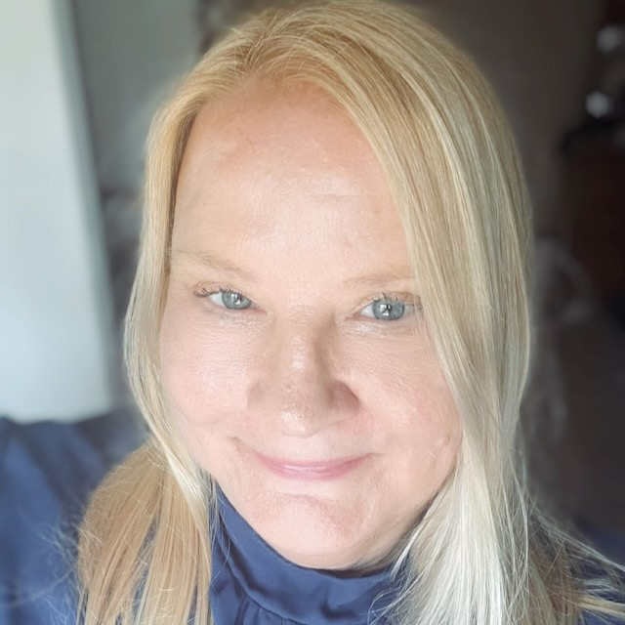
About Us
Sherri Vaughn
Sherri Vaughn is the Nonprofit & Business Outreach Coordinator at the Farmington Community Library where she has spent her entire career which began in 1981. Through her work at FCL she connects users to the business and nonprofit resources they need to succeed. Sherri has also served as an Ambassador for the past seven years with the Greater Farmington Area Chamber of Commerce building connections between FCL and area businesses and nonprofits.

Slide 8
WHY ENTREPRENEURSHIP?

Slide 9
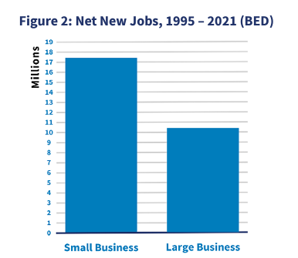
Facts and figures show the need
SMALL BUSINESS IS BIG!
Small businesses comprise:
99.9% of all firms
99.7% of firms with paid employees
46.4% of private sector employees (61.7 million workers)
43.5% of gross domestic product
SOURCE: FREQUENTLY ASKED QUESTIONS. U.S. SMALL BUSINESS ADMINISTRATION OFFICE OF ADVOCACY, MARCH 2023, HTTPS://ADVOCACY.SBA.GOV/WP-CONTENT/UPLOADS/2023/03/FREQUENTLY-ASKED-QUESTIONS-ABOUT-SMALL-BUSINESS-MARCH-2023-508C.PDF

Slide 10

Facts and figures show the need
BUT STARTING A BUSINESS IS HARD (AND RISKY)
The survival rate for small businesses after five years is only 48% and continues to decrease over time.
SOURCE: FREQUENTLY ASKED QUESTIONS. U.S. SMALL BUSINESS ADMINISTRATION OFFICE OF ADVOCACY, MARCH 2023, HTTPS://ADVOCACY.SBA.GOV/WP-CONTENT/UPLOADS/2023/03/FREQUENTLY-ASKED-QUESTIONS-ABOUT-SMALL-BUSINESS-MARCH-2023-508C.PDF

Slide 11
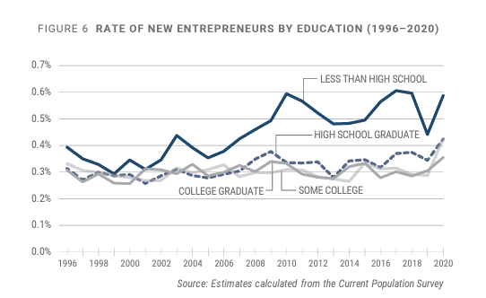
Facts and figures show the need
AND ENTREPRENEURS ARE NOT WHO YOU THINK THEY ARE
According to the 2021 Annual Business Survey (ABS) approximately:
1.15 million or 19.9% of employer businesses in 2020 were minority-owned
320,864 (5.6%) were veteran-owned
1.24 million (21.4%) were owned by women
Source: Census Bureau Releases New Data on Minority-Owned, Veteran-Owned and Women-Owned Businesses, November 10, 2022, https://www.census.gov/newsroom/press-releases/2022/annual-business-survey-characteristics.html.
SOURCE: FAIRLIE, ROBERT AND SAMEEKSHA DESAI (2021) NATIONAL REPORT ON EARLY-STAGE ENTREPRENEURSHIP IN THE UNITED STATES: 2020, KAUFFMAN INDICATORS OF ENTREPRENEURSHIP, EWING MARION KAUFFMAN FOUNDATION: KANSAS CITY.

Slide 12

DISCUSSION:
IDENTIFYING THE GAPS

Slide 13

DISCUSSION:
MAKING AN IMPACT

Slide 14

DISCUSSION:
EXPANDING ON PARTNERSHIPS

Slide 15

Q&A

