Slide 1
Advocacy Basics
Bob DeVries
Governmental Consultant Services, Inc.
Lobbyist for the Michigan Library Association

Slide 2
There are four basic requirements to becoming an effective advocate
Establish
Establish a relationship
Understand
Understand the process and manage your expectations
Be
Be a subject matter expert
Show
Show your passion!

Slide 3
Establish a Relationship
Establishing a relationship is necessary before any effective advocacy can begin. Legislators will listen and remember if they know who you are. Luckily, it’s usually easy to get to know a legislator.
Attend a campaign event or volunteer for a political campaign
Attend a town hall meeting and be sure to introduce yourself afterword
Many legislators hold open “office hours” at a local city hall, library, or coffee shop where constituents can meet with them to discuss issues

Slide 4
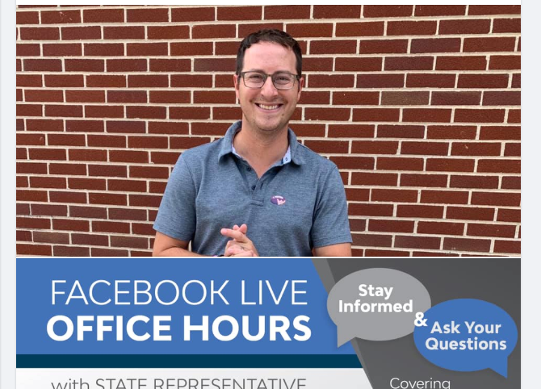
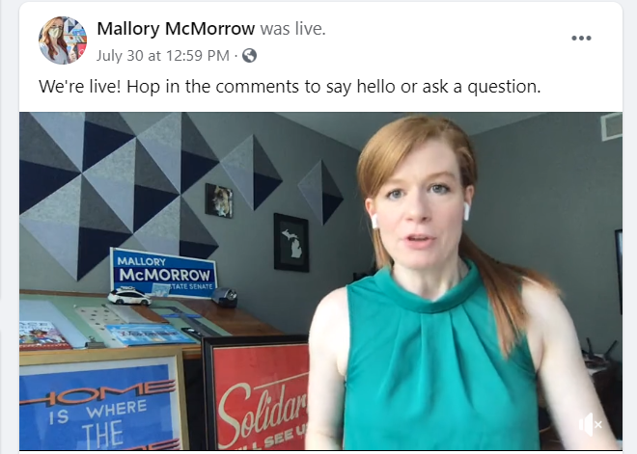
Connecting with Legislators during the pandemic is different but still possible
Many legislators have started to utilize social media and video conferencing to connect with constituents

Slide 5
Understand the Process and Manage your Expectations
The legislative process is complicated. It often takes a long time for an idea to move through the process and become a law. Because of this, there is often a disconnect between what an advocate wants and what is reasonable and/or doable.
To learn more about the process spend some time on the websites for the House and Senate. There, you can read about the rules and procedures, and you can watch legislative sessions and committee meetings.

Slide 6
Be a Subject Matter Expert
Most Legislators will know the basics about a very wide range of issues. But they often only have the time to specialize in one or two areas. They will often look to trusted subject matter experts to help fill in the gaps in their knowledge.
Once you’ve established a relationship, you can talk to a legislator about your area of expertise.
Make sure your legislator has your contact information and ask them to give you a call or email if you can ever help them with your area of expertise.

Slide 7
Show your passion!
You are certainly going to be more excited about Libraries than the legislator you are talking to. That’s ok. Show your passion!
If the legislator you are talking to can’t see why you’re excited about libraries, why would they become excited about libraries?
Once you’ve established a relationship, make a habit of sending them information on a regular basis about new programs, technologies, facilities, etc.

Slide 8
Library Issues in the Legislature
Right to Read
Penal Fines and Civil Fines
Dark Stores
Gun Free Zones
Open Meetings Act

