Slide 1
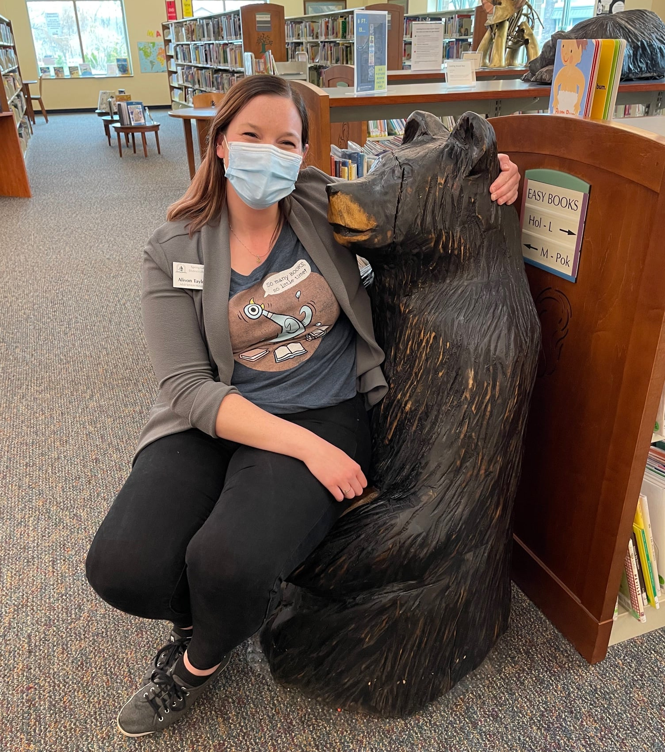
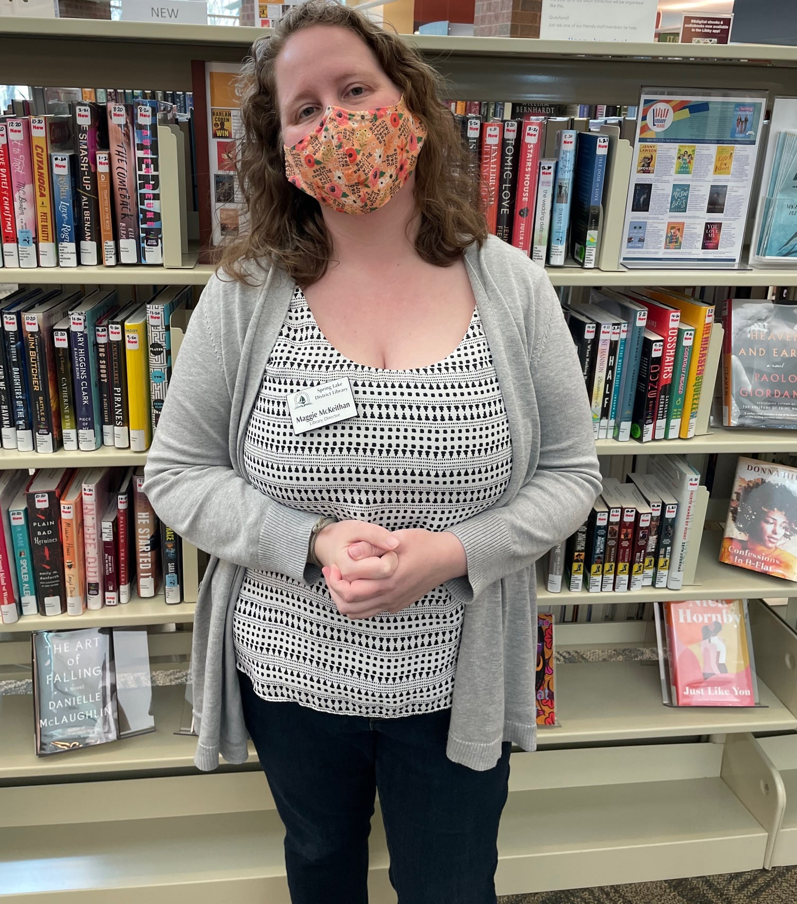

Outreach on Wheels: Book Bikes for Beginners
Alison Taylor, Library Services Manager
Maggie McKeithan, Library Director

Slide 2
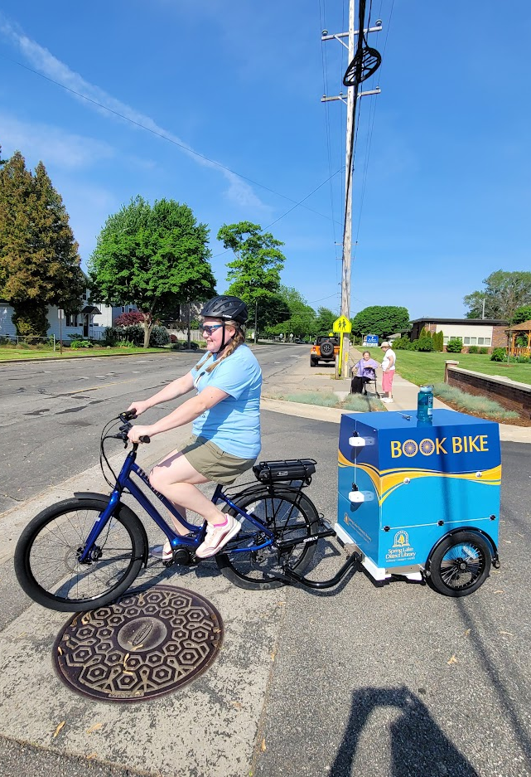
Overview
Construction
Cost to Build
Training and Staffing
Where do we go?
What do we do?
What’s on the bike?
Lessons Learned
Future Plans

Slide 3
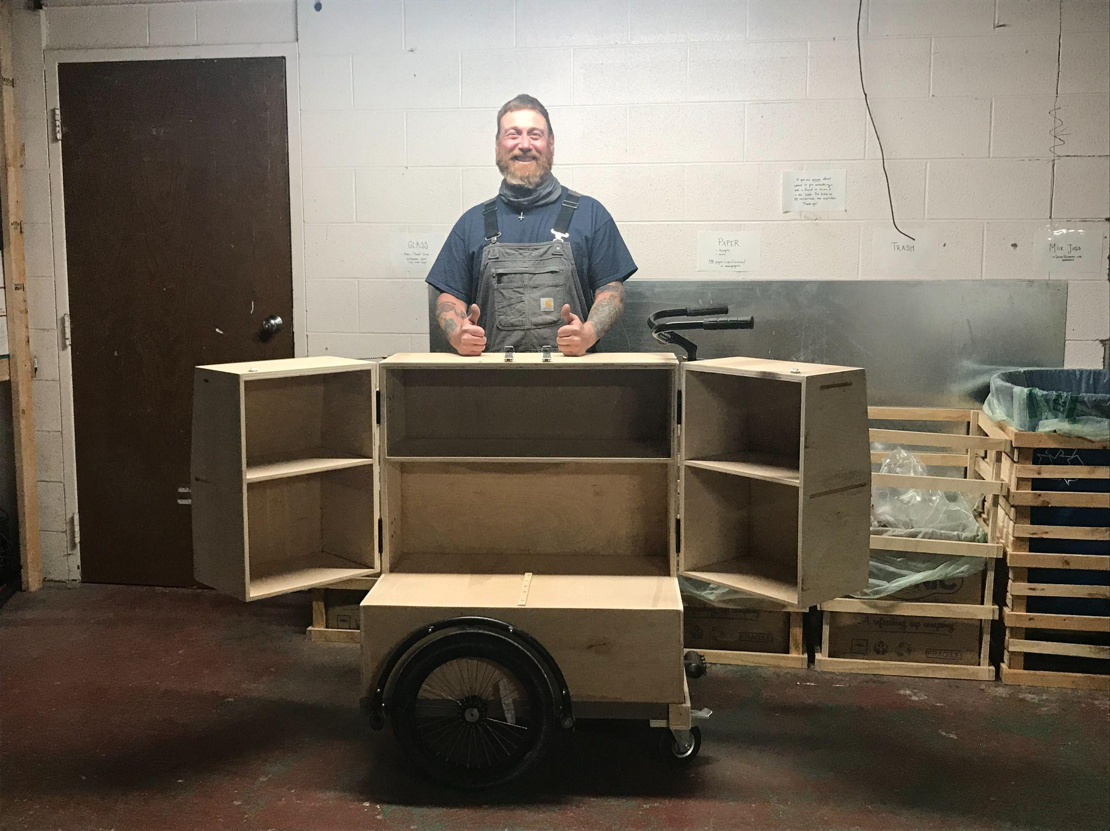
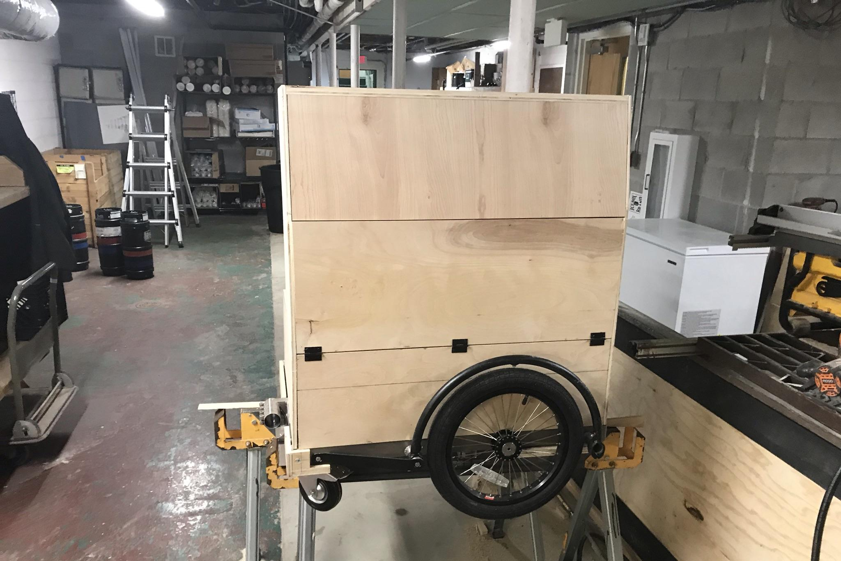
Construction
Pick the design you want:
Tricycle style
Pull-behind trailer style
We wanted:
Easy to ride
Weight in the back vs weight in the front
Separate the bike from the trailer
Street Smart Trailers - Brian Pace
streetsmarttrailers@gmail.com

Slide 4
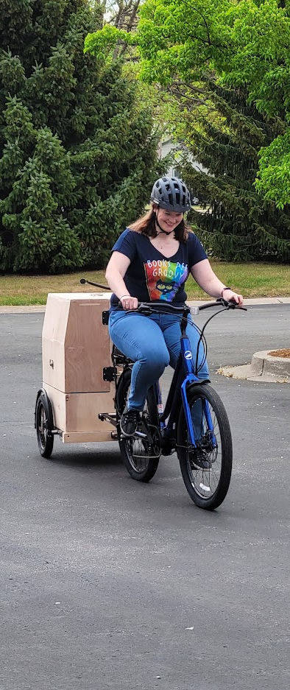
Cost to Build
Paid for the plans - $200
Paid a local carpenter for time and materials - $4,000
Purchased an e-bike to make it easier to pull - $2,000
Purchased trailer frame and hitch - $1,000
Put a wrap on the outside - $1,000
All in - $8,200
Received $2,000 from Library of Michigan Public Library Services Grant
(Thanks, Library of Michigan!)

Slide 5
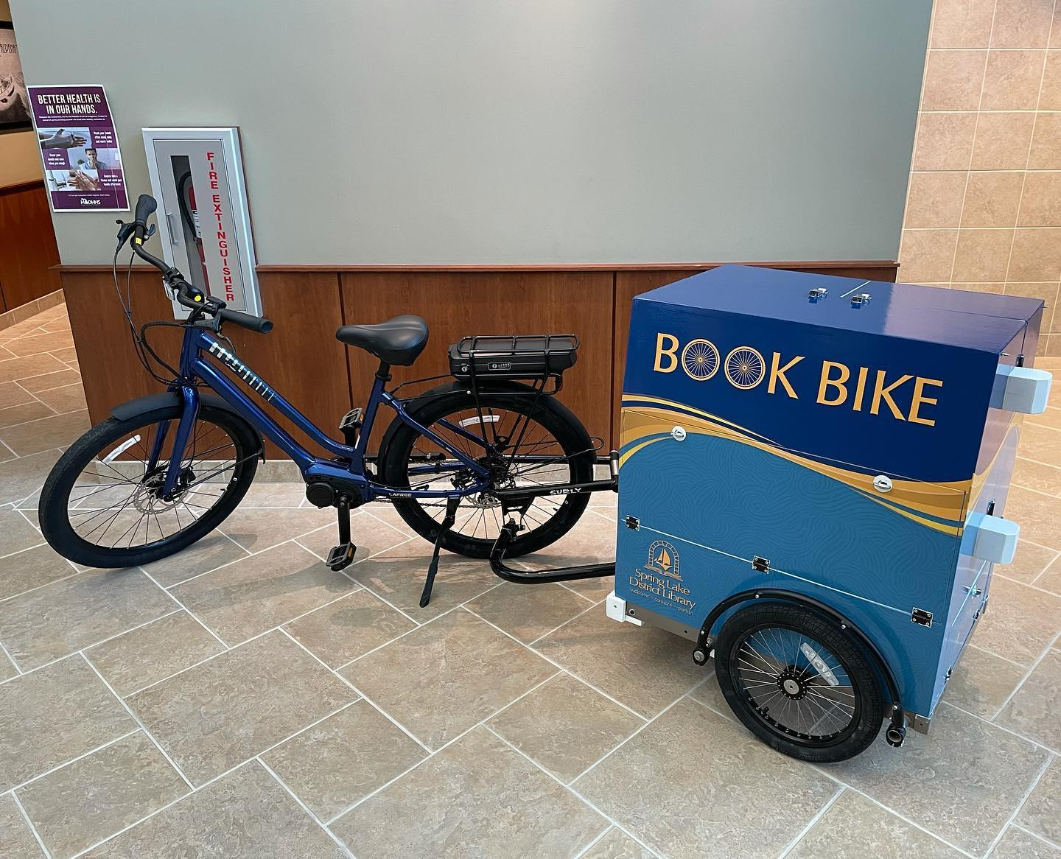

Slide 6
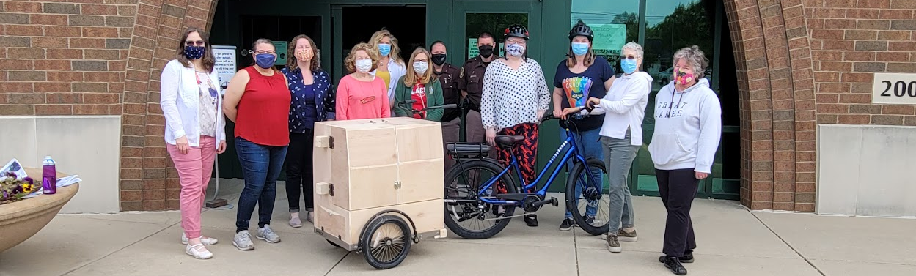
Training and Staffing
Year 1 - hosted a training for anyone interested
Asked for volunteers to take the bike on its adventures
Sheriff’s Department came and talked about bike rules of the road
Year 2 - more targeted training with limited staff
Assigned staff to take the bike out

Slide 7
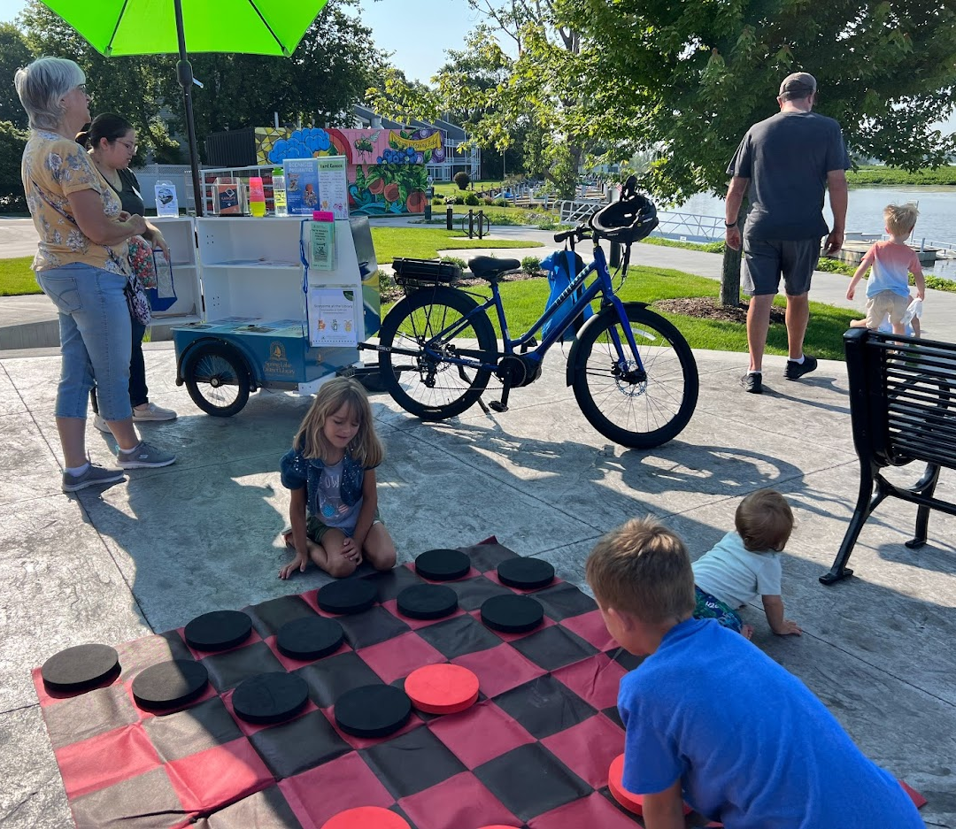
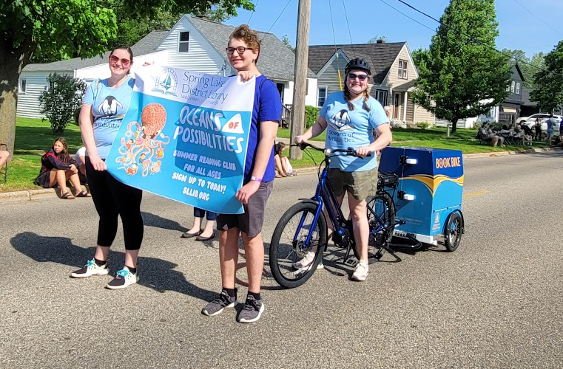
Where do we go?
Farmer’s Market
Park for Storytimes
Memorial Day Parade

Slide 8
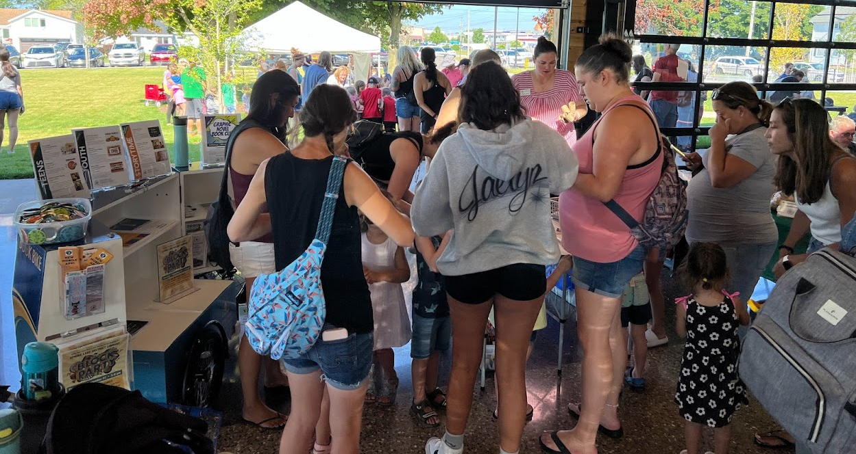
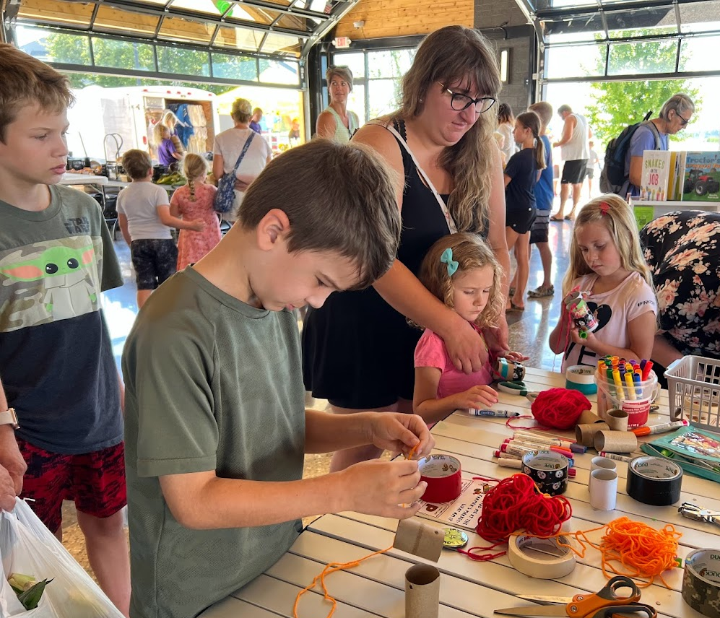
What do we do?
Hand out flyers
Hand out swag
Bring activities
Check out books
Talk to people!

Slide 9
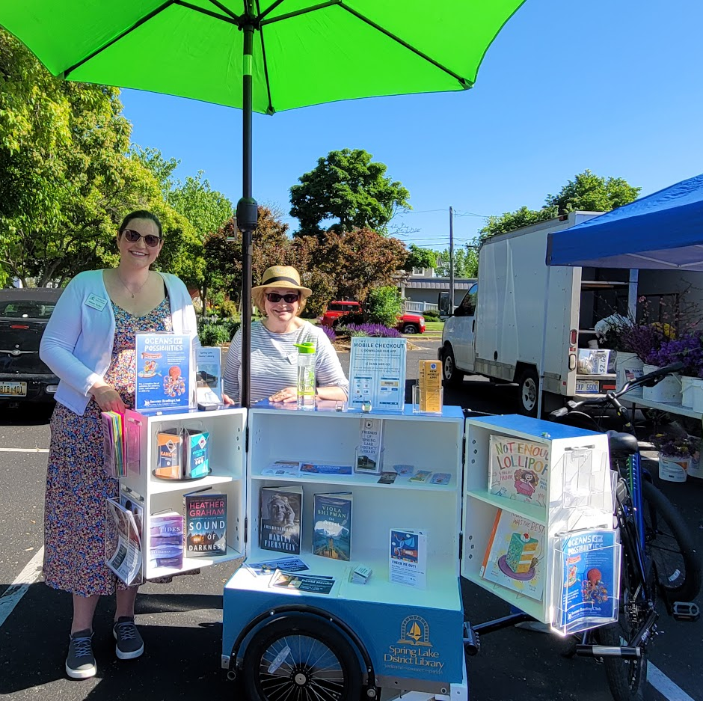
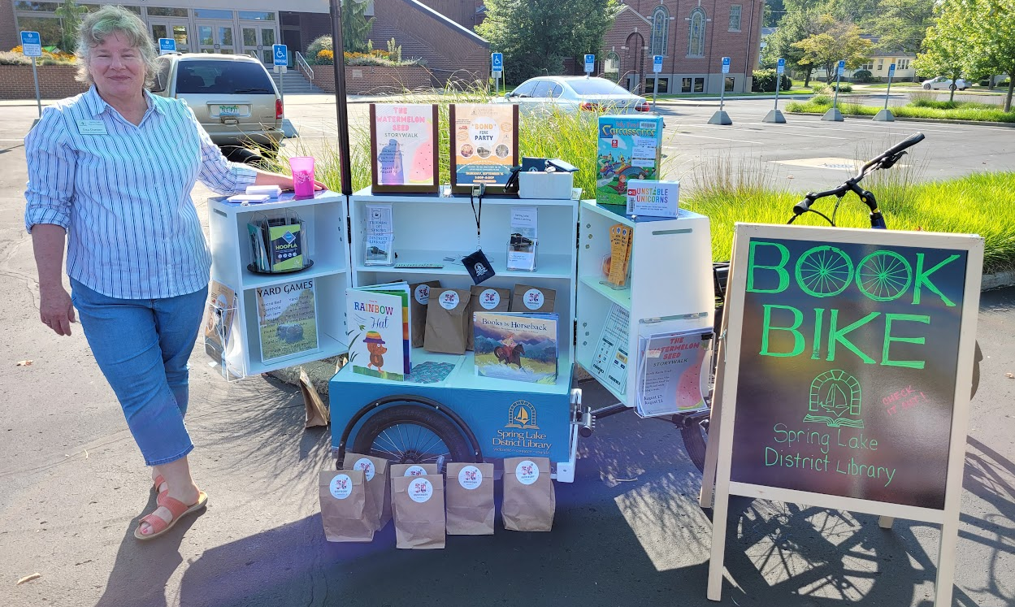
What do we put
on the bike?
Helmet!
Safety Vest
Umbrella
First aid kit
Door stopper
Basic bike stuff

Slide 10
Lessons learned
Requires more staffing than we thought - volunteers are hard to come by
Requires thought to schedule events and the staff to take it out
Easy and fun to ride
Practice with the bike - checking tires, getting trailer on and off, how to use e-bike features
Windy days can be brutal - papers everywhere

Slide 11
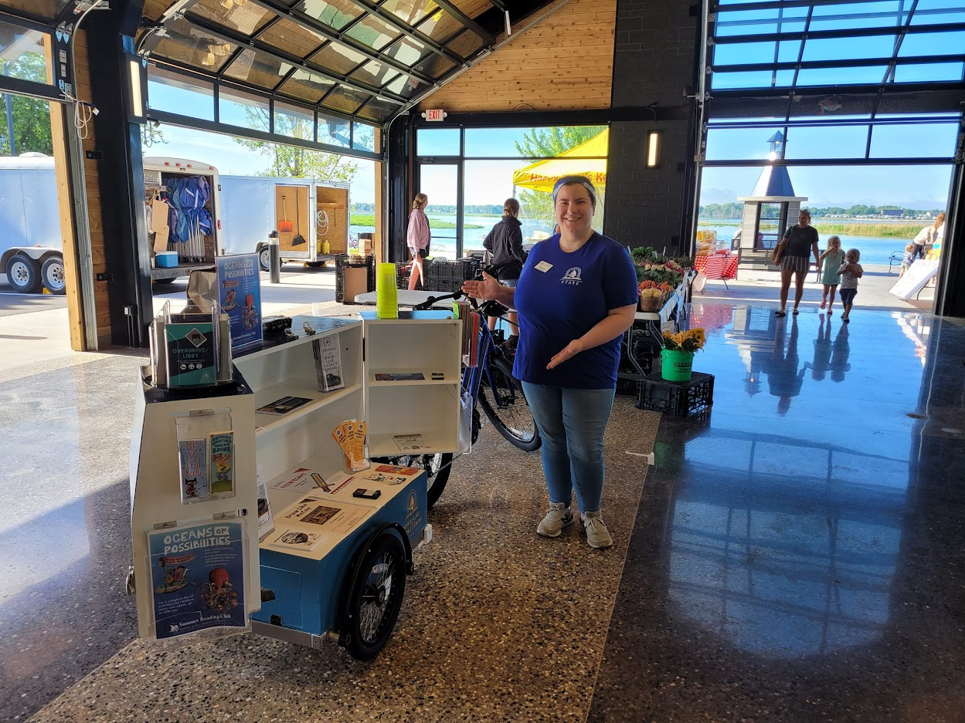
Future Plans
Expand our reach
Schools
Social district
Community events
Hire an intern to focus on taking it to events

