Slide 1


Resources for MI Veterans,
Becoming a veteran connector,
& overview of the MI Governor’s Challenge
Michigan Library Association Annual Conference
October 20, 2022
Priority Group One, MI Governor’s Challenge

Slide 2
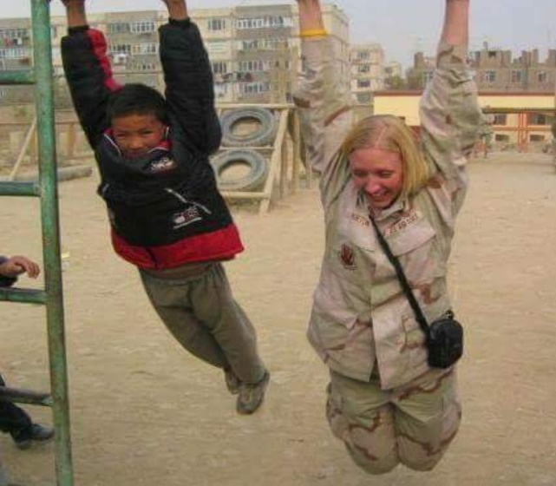
Allow me to introduce myself…
Andrea M. Norton, LMSW
  Community Engagement and Partnership Coordinator (CEPC) with the Saginaw VA
  Air Force Veteran
USAF (1998-2007)
Operation Enduring Freedom
Disclosure Statement: No relevant financial or nonfinancial relationships to disclose

Slide 3
Goals and Objectives
At the conclusion of the presentation, you will have an increased awareness of why and how to screen for military status.
You will have knowledge of resources available including how to make a referral to the Michigan Veterans Affairs Agency and the Veterans Health Administration.
In addition, you will have increased awareness of the VA’s Public Health Model for Suicide Prevention.
Notes:
Gain a better understanding of the veteran population
Why best practice screening for military status is important
Resources to support veterans in your community

Slide 4

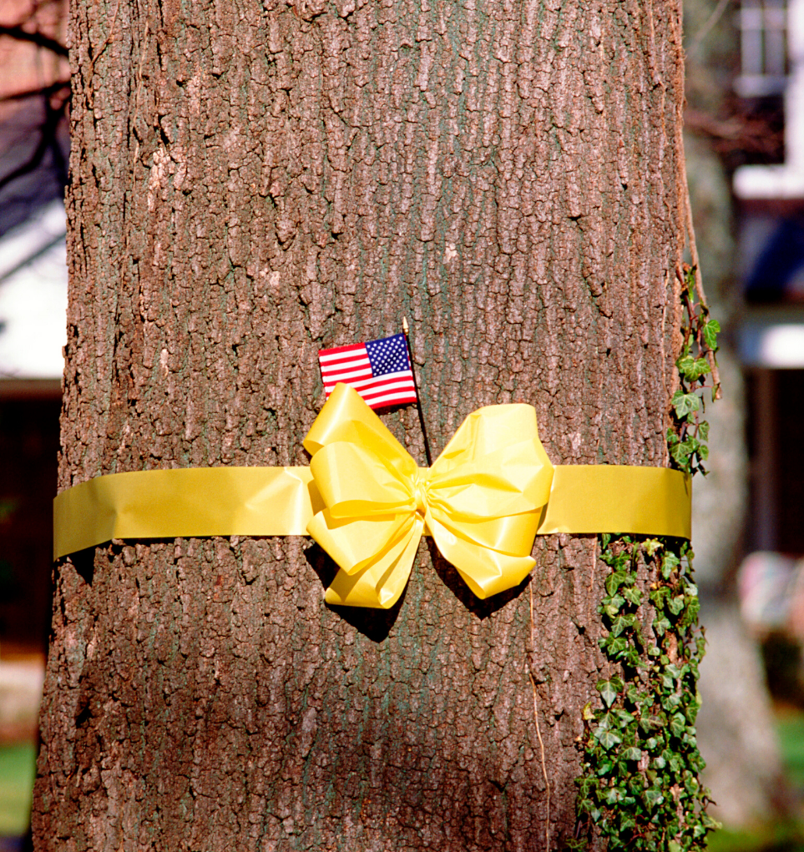
Poll Question
Have you served in the US Armed Forces?
Has someone in your family served?
How many in the room know a veteran or someone who has served?

Slide 5
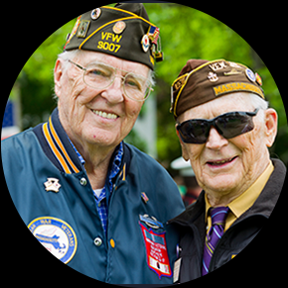
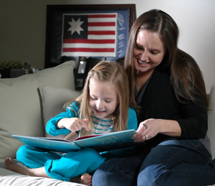
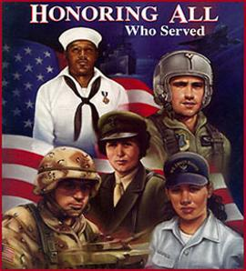
Who is a Veteran?
Title 38 of the Code of Federal Regulations defines a veteran as “a person who served in the active military, naval, or air service and who was discharged or released under conditions other than dishonorable.”

Slide 6
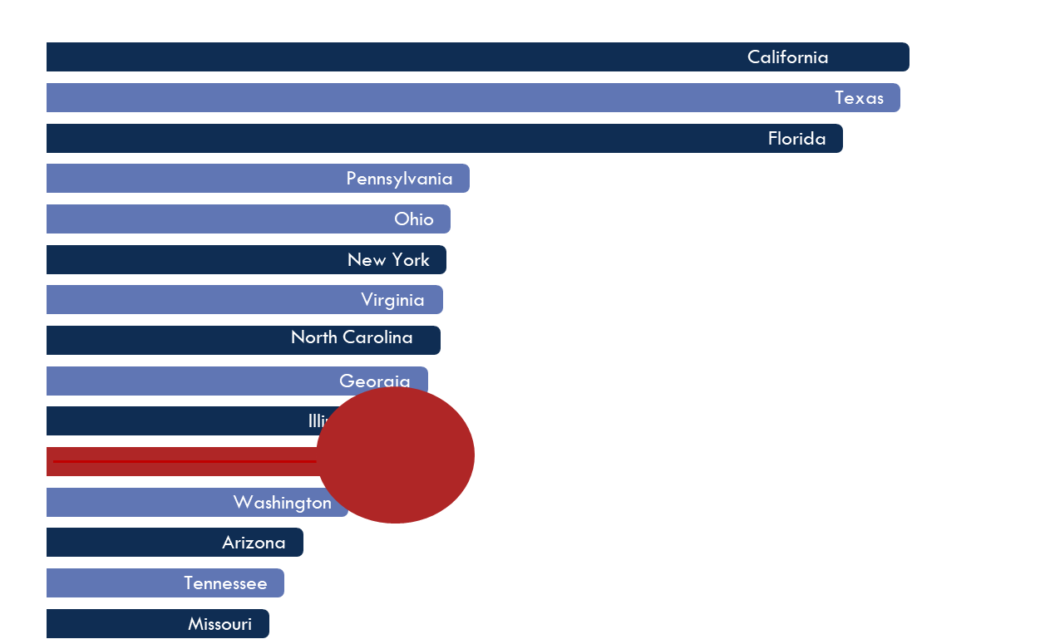
Veteran population in Michigan
Michigan has one of the largest Veteran populations in the country, ranking 11th in 2020 with over 567,000 Veterans
Michigan
Source: U.S. Dept. of Veterans Affairs
251,418 total Michigan VHA enrollees in 2020 (~ 16,729 women Veterans)
  Ann Arbor- 60,260
  Battle Creek- 57,500
  Detroit – 65,534
  Saginaw – 43,387
  Iron Mt – 24,737
~315,000 not connected to VHA
Notes:
Michigan’s Veteran population is one of the largest in the US, ranking 11th in 2020 with over 567,000 Veterans
251,418 total Michigan VHA enrollees in 2020 (~ 16,729 women Veterans)
Ann Arbor- 60,260
Battle Creek- 57,500
Detroit – 65,534
Saginaw – 43,387
Iron Mt – 24,737
~315,000 not connected to VHA

Slide 7
315,000 not connected to VHA?
Organizations are not screening for military service in a uniform/consistent manner.
Some first responders and other agencies report they identify veterans by flags, hats, or other memorabilia.
Some report they can “tell by looking”.

Slide 8
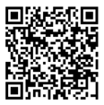
What does a Veteran look like?
Notes:
When I ask the questions, “What does a veteran look like?”, what is the image in your head?
Have audience take their phones and scan the QR code for link to the “She is a Veteran” youtube video page

Slide 9
Why is this important?
Veterans, service members, and their family members do not always self-identify.
“Have you served” versus “are you a veteran” is the preferred method as it enables those who don’t feel comfortable or don’t identify as a veteran to be recognized.
Often the biggest barrier for a veteran and their family is simply being unaware of all eligible benefits.
Notes:
Diversity is not always about the color, gender, age, ability….
The military experience has long been known to be a profound experience for individuals. You probably work next to a veteran and may/may not know it. Over 400 employees at MM have identified as having veteran status (there are probably more)

Slide 10
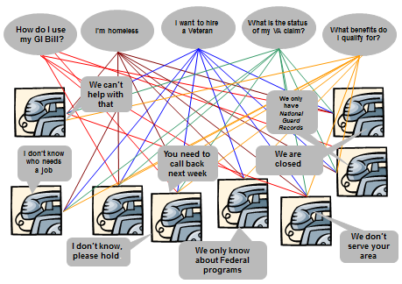
Challenge:
Where do veterans turn for assistance?
Notes:
No single federal or state definition of “veteran” covers all the types of military service nor the variety of benefits eligibility.
State government has 14 different departments and agencies that do something for vets
Over 600 local community organizations that work for vets and several other philanthropic supporters

Slide 11

Solution: MVAA
Am I eligible for benefits?
Where is my DD-214?
Where is my claim?
Federal
I can’t pay my bills!
State
We want to hire vets.
Local
How can I get a job with my skills?
How can I use my GI Bill®?
Notes:
Most times, the challenge isn’t that a solution does not exist, it’s a matter of finding it and properly connecting the veteran and the service provider

Slide 12


Michigan Veterans Affairs Agency
The Michigan Veterans Affairs Agency serves as the central coordinating agency connecting those who have served in the U.S. Armed Forces and their families with the benefits they deserve.

Slide 13
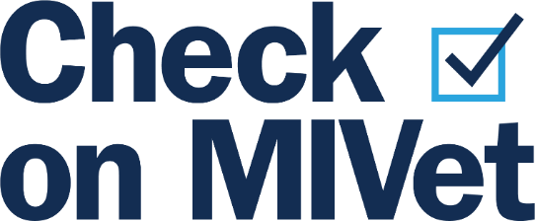
Referral process
The referral process to Michigan Veterans Affairs Agency is quick and user-friendly.
Check on MIVet:
Anyone can request a benefits consultation for military-connected by visiting Michigan.gov/MVAA and clicking the Check on MIVet link at the top of the site.
Provide individual with our 24/7 call center number: 1-800-MICH-VET. We have free business cards, post cards, resource toolkits, and other materials available.

Slide 14

Michigan Veteran
Resource Service Center
The MVAA has a 24/7 call center to help veterans and their families with benefit and resource connectivity, in all areas of life.
We are available 365 days of the year.
  1-800-MICH-VET
  Lean on the MVAA to connect your employees and/or customers to state, local, and federal benefits.

Slide 15
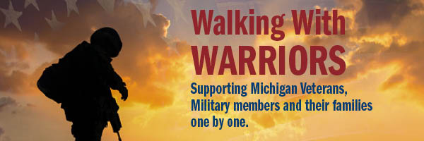
State Benefits: Quality of Life
MDHHS & Veteran Navigators
  Connection to federal, state and local resources
  Mental Health
  Substance Abuse
  Housing and other common issues
Not everyone qualifies for federal VA benefits, but they can qualify for services of a veteran navigator within MDHHS.
Notes:
Veteran Navigators was created to assist Veterans and military families of ALL eras and discharge types. They work to connect Veterans and their families to federal, state and local resources to ease issues regarding mental health, substance abuse, housing and other common issues that impact veterans in order to support healthier lifestyles and provide support.
https://www.michigan.gov/mdhhs/0,5885,7-339-71550_2941_93573---,00.html

Slide 16
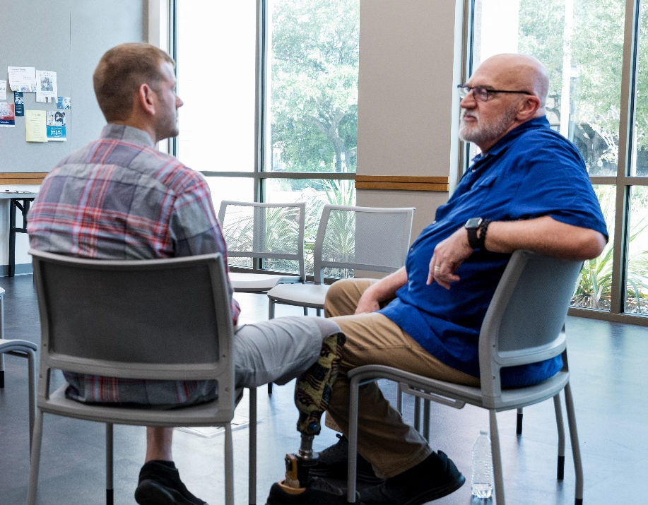
Buddy to Buddy Program
Veterans are never alone.
The MVAA offers a personal, one-on-one veteran mentorship to veterans of all eras and discharge types.
If you have veterans who are lacking familial supports, are having difficulty with transitioning or could just use a friend, consider a referral to the MVAA Buddy to Buddy Program.

Slide 17
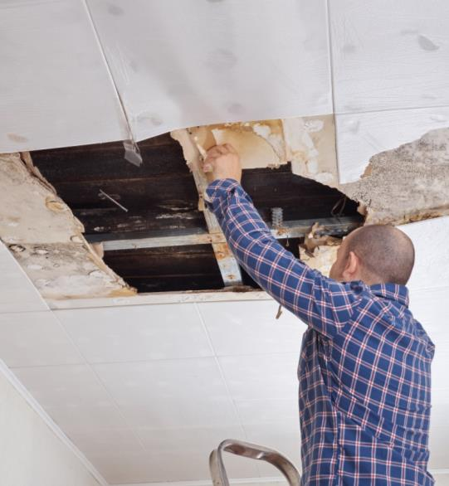
State Benefits: Emergency Assistance
Michigan Veterans Trust Fund
  $50 million trust fund est. after WWII
  For emergent needs
  For war-time era veterans
Special COVID Related Grants
  Food 4 Vets $300,000
  Gleaners of SE Michigan (Veteran Food Program) $52,000
FY 2020 - Present
  Served 2,593 veterans and their families
  Highest identified needs:
    Shelter
    Utilities
    Transportation
New as of December of 2021- Emergency financial assistance is available to veterans 65+ older (wartime and peacetime).
Notes:
MVTF
Emergent need = an unforeseen situation causing a temporary or short term financial emergency or hardship that a grant will resolve and the applicant can demonstrate the ability to meet his or her future expenses.

Slide 18

Collaborative Efforts:
Michigan Governor’s Challenge
Michigan has partnered with SAMHSA and the United States Department of Veterans Affairs (VA) to bring the Governor’s Challenge to Prevent Suicide Among Service Members, Veterans, and their Families to our communities across Michigan.
Michigan Veterans Affairs Agency is lead for Michigan Governor’s Challenge Initiative

Slide 19
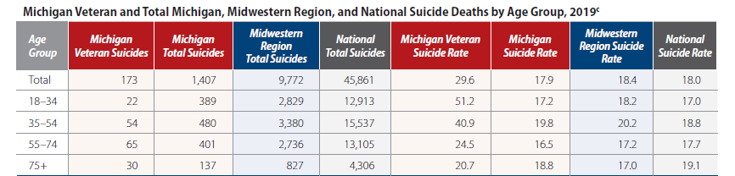
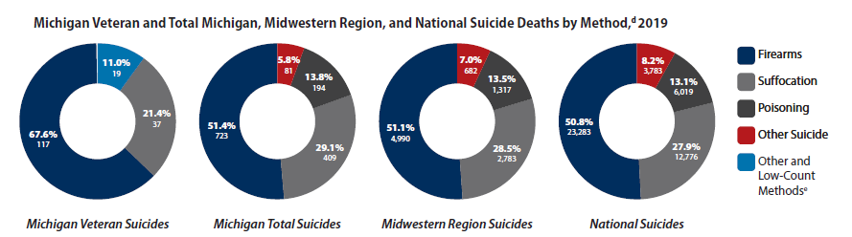
Veteran Specific Risks for Suicide & Statistics
Frequent deployments
Deployments to hostile environments
Exposure to extreme stress
Physical/sexual assault while in the service
Length of deployments
Service-related injury
Normal life stressors
Ramchand, Rajeev, Suicide Among Veterans: Veterans' Issues in Focus. Santa Monica, CA: RAND Corporation, 2021. https://www.rand.org/pubs/perspectives/PEA1363-1.html.
Suicide Prevention is a top clinical priority for the President, the State of MI, and the VA.
Notes:
Ramchand, Rajeev, Suicide Among Veterans: Veterans' Issues in Focus. Santa Monica, CA: RAND Corporation, 2021. https://www.rand.org/pubs/perspectives/PEA1363-1.html.
U.S. Department of Veterans Affairs, Office of Mental Health and Suicide Prevention. 2021 National Veteran Suicide Prevention Annual Report. 2021.

Slide 20
Methods of suicide
Firearms are the most lethal method of suicide.
Firearms are 85-90% lethal when used during a suicide attempt. It is very important to address firearms with every situation/every time to ensure that access is address.
All other methods combined are 5% lethal when used during a suicide attempt.
Veterans are trained to handle/use weapons.
Veterans usually have access to firearms; some have a collection of firearms.
Notes:
Source: CDC WISQARS and US Dept. of Veterans Affairs
https://www.mirecc.va.gov/lethalmeanssafety/facts/

Slide 21
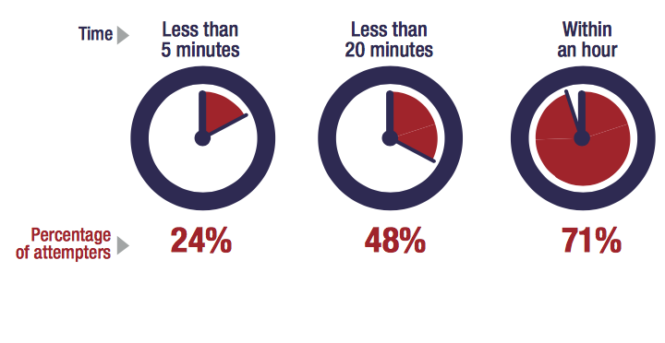
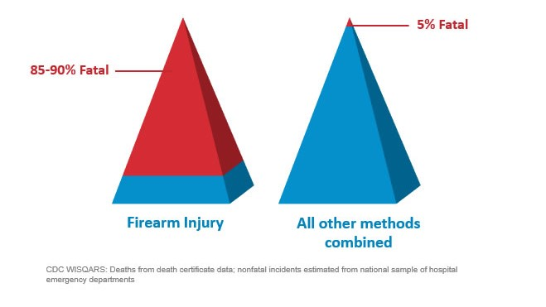

Time From Decision to Action < 1 Hour
Source: Simon, T.R., Swann, A.C., Powell, K.E., Potter, L.B., Kresnow, M., and O’Carroll, P.W. Characteristics of Impulsive Suicide Attempts and Attempters. SLTB. 2001; 32(supp):49-59.
Source: CDC WISQARS and US Dept. of Veterans Affairs
https://www.mirecc.va.gov/lethalmeanssafety/facts/
Notes:
Source: CDC WISQARS and US Dept. of Veterans Affairs
https://www.mirecc.va.gov/lethalmeanssafety/facts/
The time between when a person decides to die by suicide and they act on the decision is often very short. A 2005 study found that 71% of attempters estimating that the process took less than an hour. This reality underscores the importance of reducing access to means for those who are at elevated risk for suicide, until the risk period passes.
Access to lethal means increases suicide risk for everyone living in the home
Acute phase of a suicidal crisis is often brief.
Building in time and space—even 30-60 minutes—between impulse to act and the means to harm one’s self saves lives
We know that people rarely “substitute” one means for another. So, it is important to restrict whichever means they have in mind to use.
Means matter—how a person attempts suicide impacts how fatal the injury will be.
About 90% of firearm-related suicide attempts are fatal, as compared to approximately 5% of suicide attempts by all other mechanisms combined
Most who survive a nonfatal suicide attempt do not go on to die by suicide

Slide 22
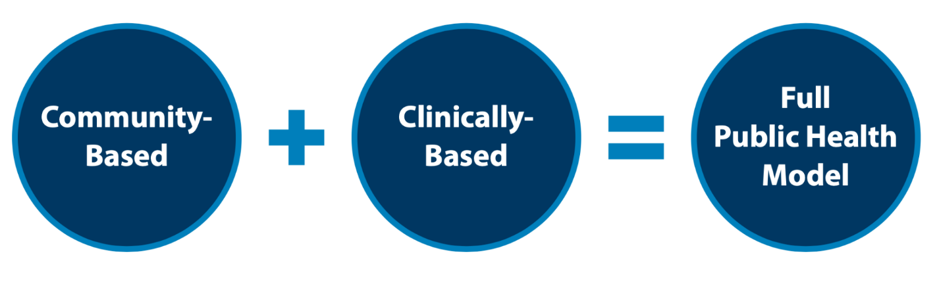
The Public Health Strategy
The VA's public health strategy combines partnerships with communities to implement tailored, local prevention plans while also focusing on evidence based clinical strategies for intervention. Our approach focuses on both what we can do now, in the short term, and over the long term, to implement VA’s National Strategy for Preventing Veteran Suicide.
Notes:
Suicide is a public health challenge that causes far-reaching pain among individuals, families, and communities across the country. Suicide is also preventable. Veteran suicide is an urgent issue that the U.S. Department of Veterans Affairs (VA), along with its stakeholders, partners, and communities nationwide, must address. VA supports the national goal of reducing the annual suicide rate in the U.S. by 20 percent by the year 2025 and is implementing a public health approach to achieve this mission.
In 2020, VA translated the vision offered by the 10-year National Strategy and its four major domains into operational plans of actions through the Suicide Prevention 2.0 initiative (SP 2.0). SP 2.0 focuses on nationally implementing and operationalizing across a 6-year period new and bundled community-based and clinically based services and programs reflective of the National Strategy to expand VA’s approach to prevent Veteran suicide nationwide. SP 2.0 aligns suicide prevention, intervention, and postvention goals across clinical and community settings to reach and serve Veterans both within and outside VHA clinical care at national, state, and local levels.

Slide 23



Focused Priority Areas Across Federal, State, and Local Levels:
Identify Service Members, Veterans, and their Families and Screen for Suicide Risk
Promote Connectedness and Improve Care Transitions
Increase Lethal Means Safety and Safety Planning
Notes:
The National Strategy for Preventing Veteran Suicide 2018-2028 provides a framework for identifying priorities, organizing efforts, and contributing to the national focus on Veteran suicide prevention. The 14 goals and 43 objectives in the National Strategy work together in a synergistic way to promote wellness, increase protection, reduce risk, and promote effective treatment and recovery. Evidence suggests that the three priority areas highlighted here can help in reducing suicide rates.
SP 2.0 Community Based Intervention (CBI-SP) promotes these priority areas and emphasizes their critical sub-elements (six goals in total) in alignment with the National Strategy and therefore State, regional, and local teams are encouraged to use these priorities as key elements in their suicide prevention strategic plans.
1) Identify Service Members, Veterans, and their Families and Screen for Suicide Risk
Identifying Veterans — "Ask the Question" — enables culturally competent care and access to resources; allows community members, families, and community service providers to connect individuals to appropriate care
Suicide risk screening in healthcare settings allows providers to recognize and prevent self-harm
2) Promote Connectedness and Improve Care Transitions
Connectedness to others (including family members, co-workers, community organizations, and social institutions) is an important protective factor
Providing caring contacts upon discharge from one setting to another can reduce suicide attempts and increase compliance with treatment recommendations
3) Increase Lethal Means Safety and Safety Planning
Limiting access to lethal means during periods of crisis can make it more likely that the person will delay or survive a suicide
Completing a personal safety plan is a clinical intervention that can help individuals manage and decrease suicidal feelings and help them stay safe when these feelings reoccur

Slide 24
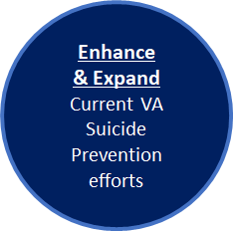
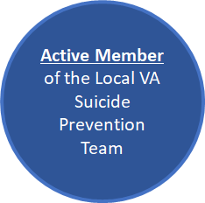
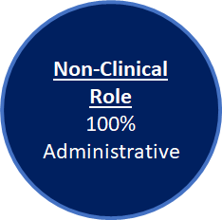
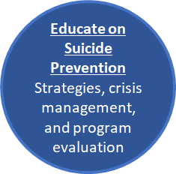
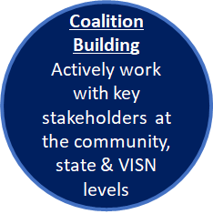
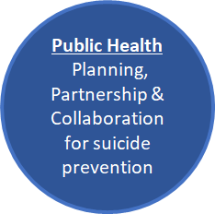
Community Engagement and Partnership Coordinator (CEPC) Overview
New Positions within the VA
Notes:
New Slide and notes added
CEPCs serve as subject matter experts in public health approaches, coalition leadership and management, and other community-based models for suicide prevention regarding Veterans. Here, they collaboratively work with key stakeholders to develop, facilitate, and strengthen CBI-SP at community, state, and VISN levels. This program emphasizes public health planning, partnered and collaborative action and effective community practice for suicide prevention.
The CEPC role is intended to enhance and expand current VA suicide prevention efforts that are facilitated by over 450 suicide prevention team members nationwide. CEPCs are 100% administrative and a non-clinical position, to fully collaborate & implement evidence-informed community-based suicide prevention strategies. Here, CEPCs are an active member of their local VA Suicide Prevention Team(s) and collaborate closely with the team and key community stake holders to bring a new emphasis on public health planning, partnered and collaborative action, and effective community practice for suicide prevention.

Slide 25
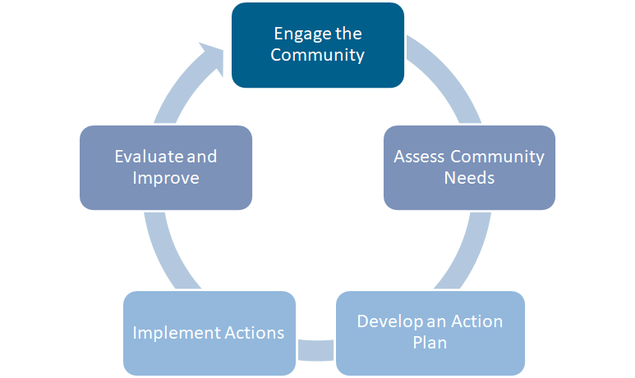
Effective Community-Based Suicide Prevention
For successful coalition building, it is important that all members actively participate in:
Developing Shared Vision
Needs Assessment
Organizational Capacity
Planning
Implementation
Evaluation
Sustainability
Notes:
Updated and changed (removed the competencies & gave ownership to all parties to set up for success).
Effective community based and public health suicide prevention practices include community engagement, coalition and team building, needs assessment and action planning, implementation of best practices in community systems, program evaluation, and sustainment of community efforts (Kania et al., 2011; Wantersman et al., 2000; Chinman et al., 2004).
The goal of CBI-SP is to establish a national comprehensive program for community-based efforts for suicide prevention (Frieden, 2014; Lai et al., 2019). This will be accomplished through a three-year phased implementation of effective CBIs across national, state, tribal, and community levels with the objective of reducing Veteran suicide nationwide. The VA’s chosen CBIs (Governor’s Challenge, CEP-SP, and Together With Veterans) are all grounded in effective practice of community-based prevention and community implementation science paired with a focus on disseminating suicide prevention strategies within communities across the country (Frieden, 2014; Lai et al., 2019).
Forming and supporting coalitions entails specific strategies to engage community stakeholders, develop a shared vision, assess the community, develop an action plan for the coalition, and implement, evaluate, improve and sustain the efforts of the coalition. The CEPCs and CEP-PMs look forward to collaboratively working on this together with you, our community partners, and we seek to eliminate Veteran suicides.

Slide 26
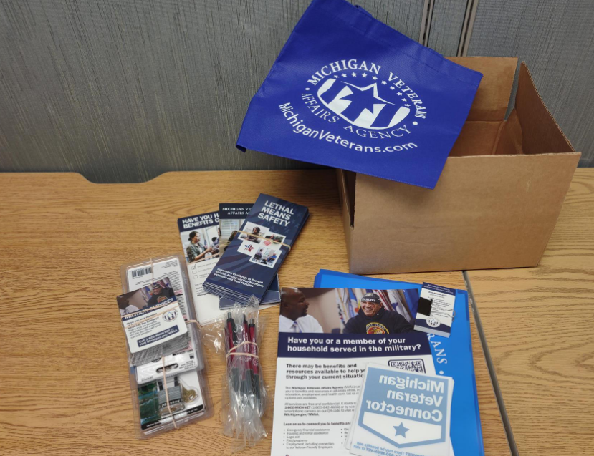
How can a community help?
Consider incorporating a military screening question:
  “Have you or a member of your household served in the military?”
If yes, can I share resources of benefits available in MI? (We offer free toolkit folders).
Consider ordering free toolkits that can be used in high trafficked areas of your business and/or within the break rooms of your company.

Slide 27

Key Efforts and Focus-
Michigan Governor’s Challenge
Engaging community partners, business, and employers to consider implementing innovative best practices (e.g., Screening and Asking the Question – (have you or a member of your household ever served in the military?)
To encourage organizations to “Ask the Question” the MI Governor’s Challenge team developed the MI Veteran Connector designation.

Slide 28
Benefits of Becoming a
MI Veteran Connector
“Michigan Veteran Connector” designation that shows your company as an ally in the veteran community.
Free veteran centric materials including VA and Gov. Challenge toolkits (printed and electronic).
Access to the Michigan Governor’s Challenge Psych Armor Portal which contains free veteran centric training and resources.
Introductions to key veteran service providers (MVAA Veteran Service Officers, VA Homeless Coordinators, DHHS Veteran Navigators, and more!)

Slide 29
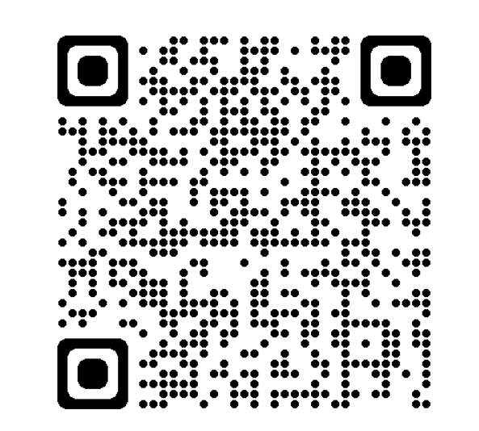
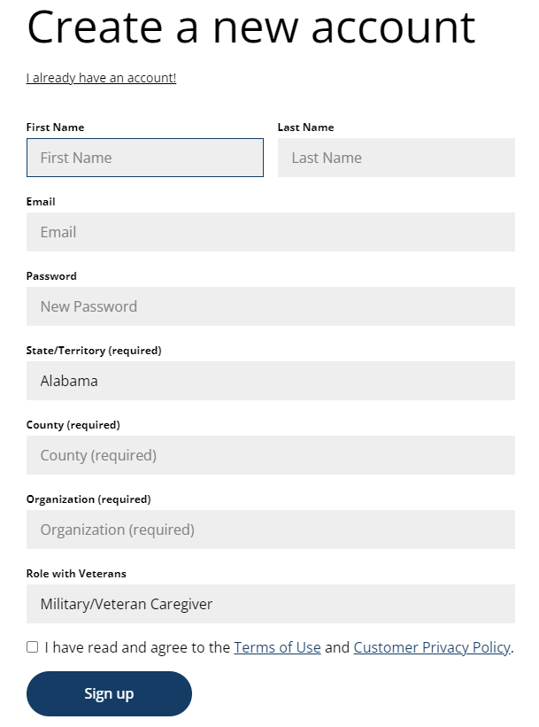
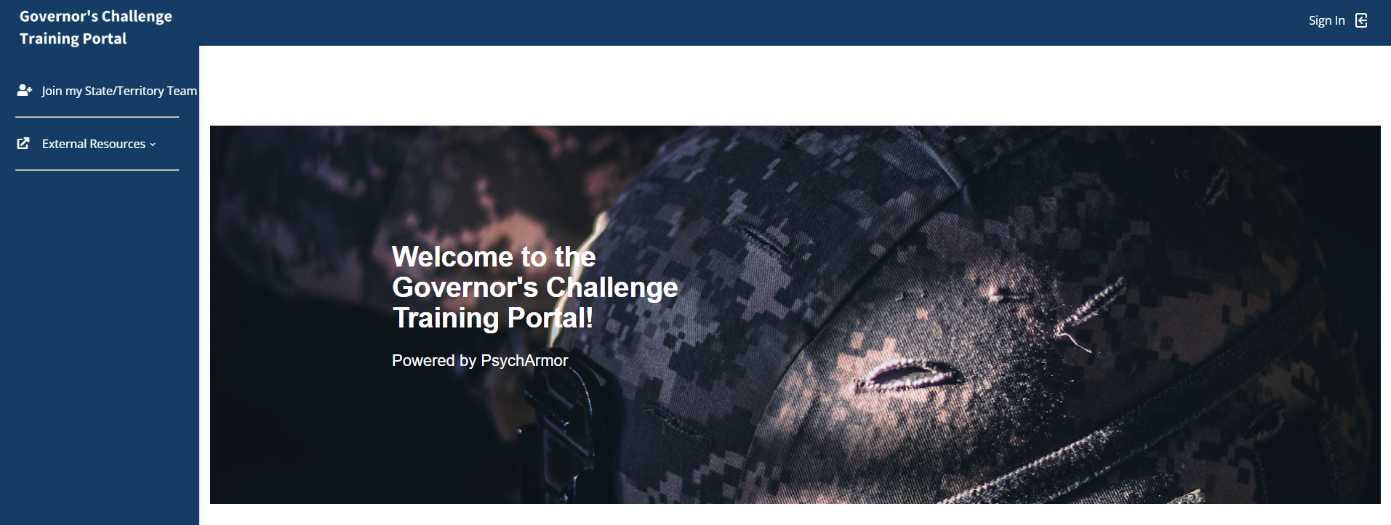
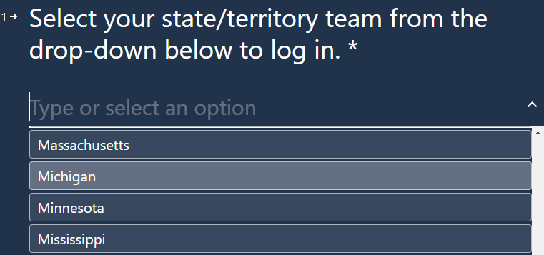

Michigan Governor’s Challenge: Training Portal
Michigan now has a Psych Armor Institute Governor’s Challenge Training Portal.
Link: Governor’s Challenge Portal – PsychArmor
Step 1: log in to Governor’s Challenge Training Portal https://governorschallenge.psycharmor.org/ and click join my State/Territory Team
Step 2: Find and select “Michigan” from the drop-down menu
Step 3: Create a new account by filling in form

Slide 30

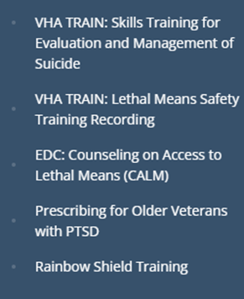
Current Training Menu
15 Trainings Available
VA S.A.V.E* | VA S.A.V.E.: Preventing Caregiver Suicide
Women Who Serve* | Finding Stability After Suicide Loss
15 Things Veterans Want You to Know* | 15 Things Veterans Want You to Know for Health Care Providers
Communication Skills with Veterans* | Postvention
Myths & Facts of Wounded Warriors* | Substance Use Disorder in Military and Veteran Populations
Connecting with the VA | Crisis Response Plan for Health Care Providers – Introduction and Assessment
Suicide in Military Members and Veterans | Crisis Response Plan for Health Care Providers – Intervention
Inner Conflict and Survivor’s Guilt | *These 5 trainings can be completed to earn a “Veteran Ready Organization” certificate.
External Resources

Slide 31
Best practice recommendation-
We encourage everyone to consider the following:
Review your organization’s military connected screening question (if you don’t have one, reach out to leadership to see if it can be added). If someone is identifying as military connected, “Can I share information on veteran resources within MI?”.
Utilize our toolkits and folders (all items are free). The biggest barrier is often the veteran or family is unaware of all benefits they are entitled.
To obtain more information or become a MI Veteran Connector; email mvaastrategy@michigan.gov.

Slide 32
Suicide Prevention Resources

Slide 33
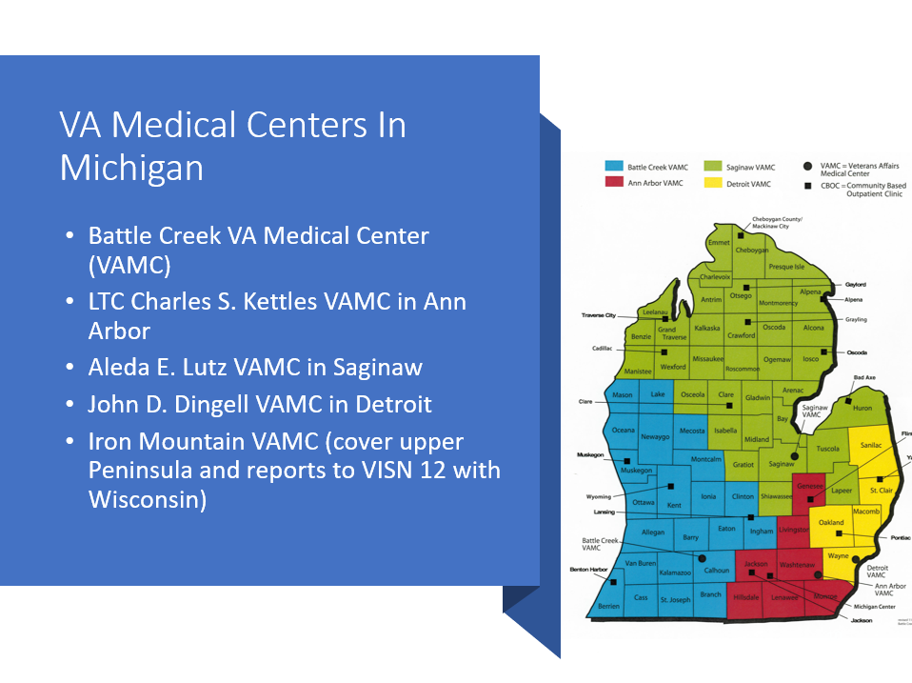

Slide 34
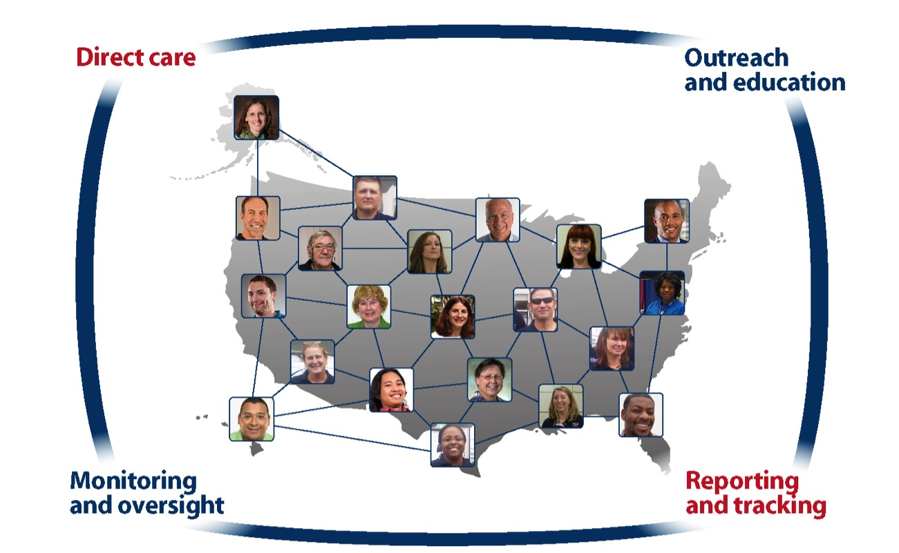
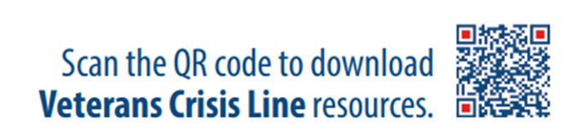
National Network of Suicide Prevention Teams
More than 400 SPCs
Notes:
Discuss Data change

Slide 35
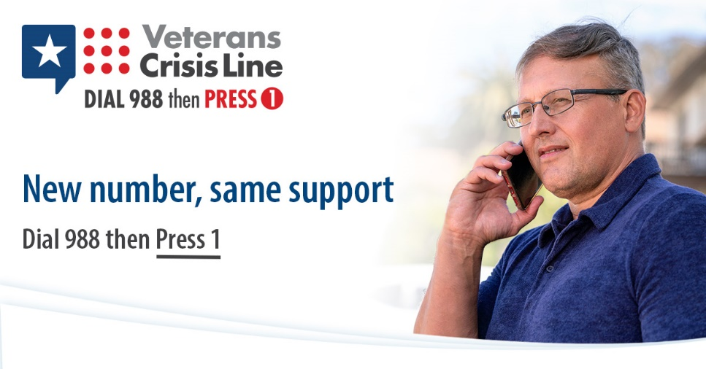
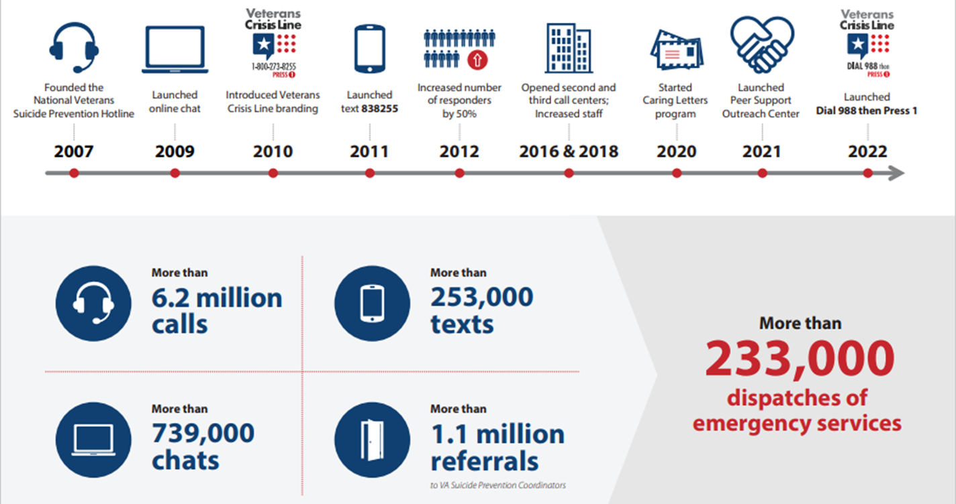
Veterans Crisis Line
Access free, confidential support 24/7, 365 days a year
You do not have to be enrolled in VA benefits or healthcare to connect
Serves Veterans, Service Members, NG, Reserves, and those who support them

Slide 36
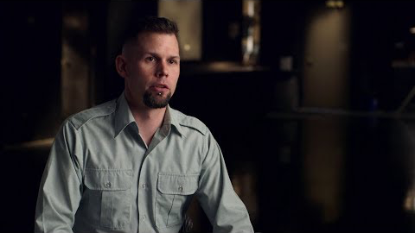
Make the Connection
Online resource featuring hundreds of Veterans telling their stories about overcoming mental health challenges
MakeTheConnection.net/conditions/suicide
Notes:
Make the Connection: This online resource connects Veterans, their family members and friends, and other supporters with information and solutions to issues affecting their lives. More information is available at https://maketheconnection.net/.

Slide 37

Coaching into Care
National VA telephone service which aims to educate, support, and empower family members and friends who are seeking care or services for a Veteran
CALL 888-823-7458
Notes:
Coaching into Care (1-888-823-7458): A national telephone service of the VA, Coaching into Care aims to educate, support, and empower family members and friends who are seeking care or services for a Veteran. More information is available at https://www.mirecc.va.gov/coaching/.

Slide 38
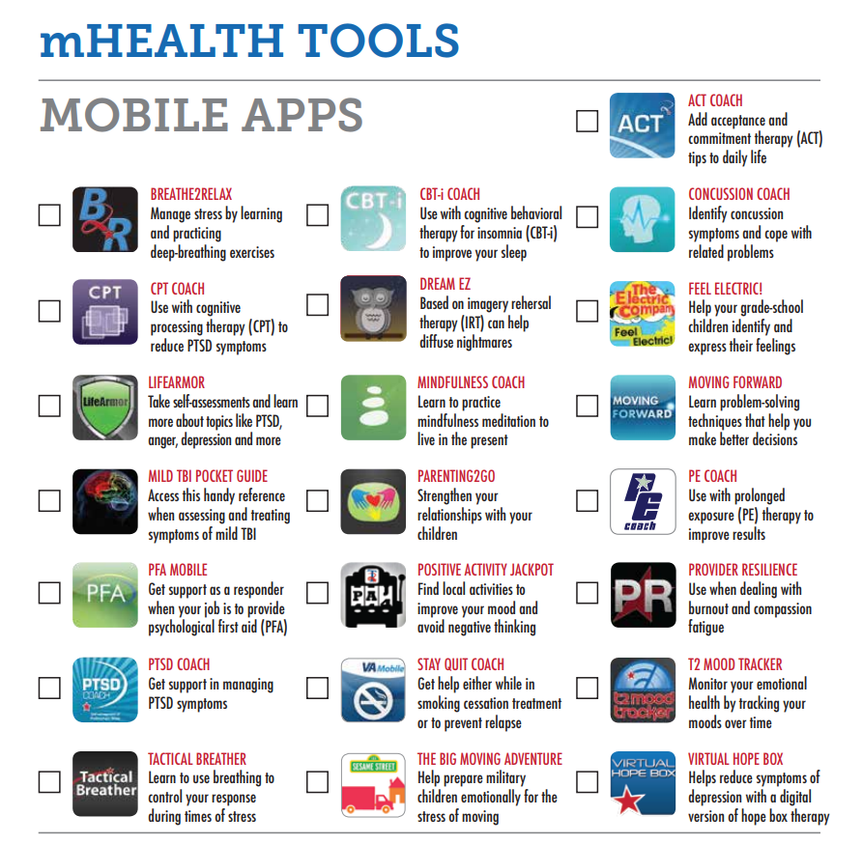

Slide 39
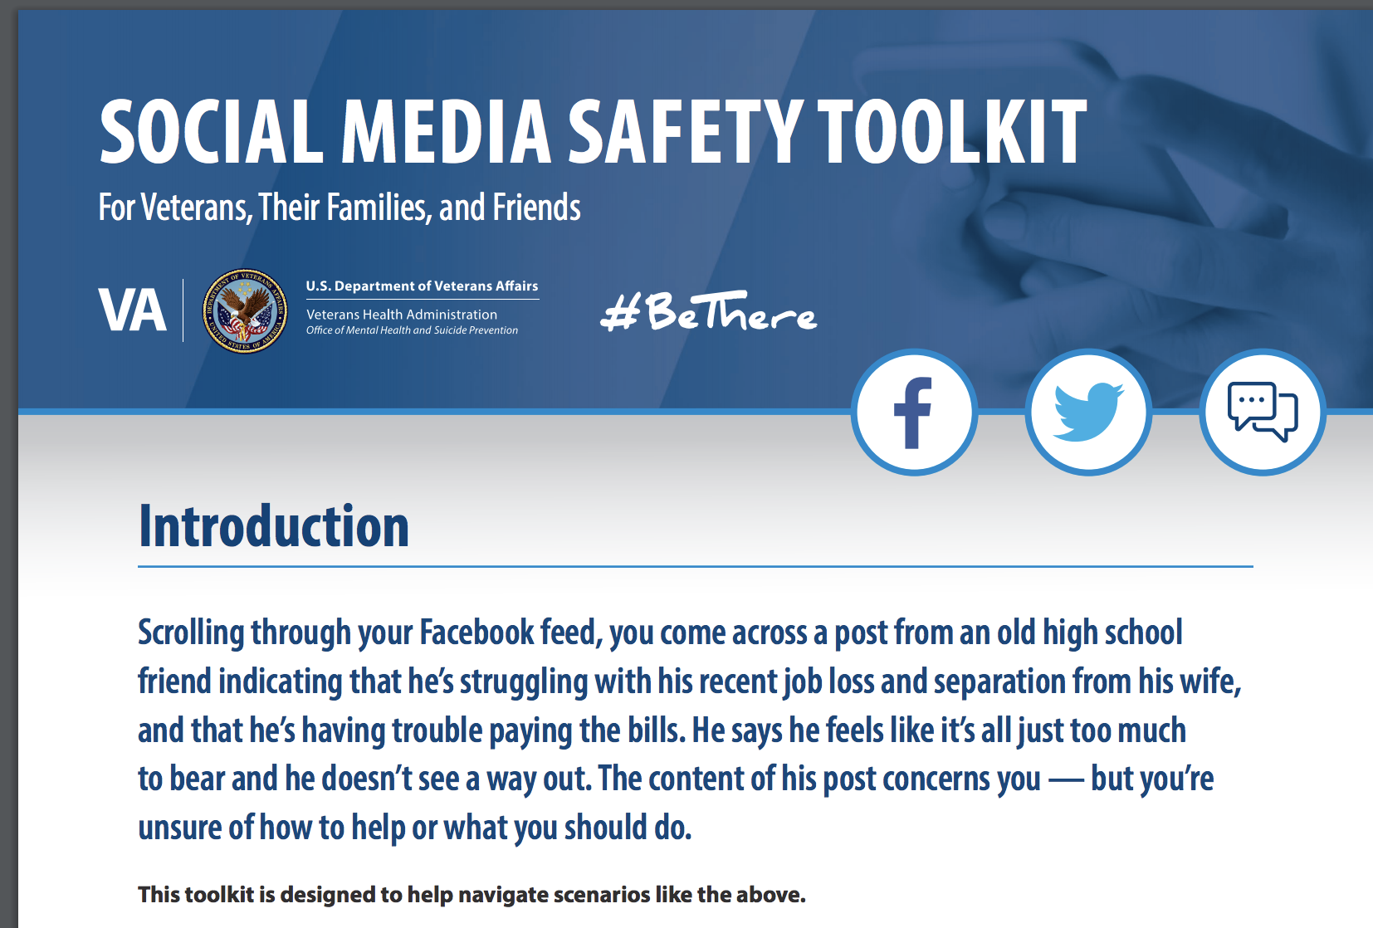

Social Media Safety Toolkit
As discussed in the National Strategy for Preventing Veteran Suicide, social media is an important intervention channel and a key piece of VA’s comprehensive, community-based suicide prevention strategy.
The Social Media Safety Toolkit for Veterans, their families, and friends equips everyone with the knowledge needed to respond to social media posts that indicate a Veteran may be having thoughts of suicide.
The toolkit includes best practices, resources, and sample responses.
Download at https://www.mentalhealth.va.gov/suicide_prevention/docs/OMH-074-Suicide-Prevention-Social-Media-Toolkit-1-8_508.pdf
Notes:
The Social Media Safety Toolkit for Veterans, Their Families, and Friends equips everyone with the knowledge needed to respond to social media posts that indicate a Veteran may be having thoughts of suicide. The toolkit includes best practices, resources, and sample responses.
As discussed in the National Strategy for Preventing Veteran Suicide, social media is an important intervention channel and a key piece of VA’s comprehensive, community-based suicide prevention strategy.
Many service members and Veterans are active on social media platforms, and some have posted to express emotional distress or thoughts of suicide. Social media has become a critical channel for VA and partners like you to reach Veterans in crisis with safe messaging and resources.
VA is sharing the Social Media Safety Toolkit among VA employees, with partner organizations, and throughout communities nationwide to help ensure that people who live and work with Veterans every day are equipped to reach Veterans with safe messaging and lifesaving resources.
Download the Social Media Safety Toolkit at https://www.mentalhealth.va.gov/suicide_prevention/docs/OMH-074-Suicide-Prevention-Social-Media-Toolkit-1-8_508.pdf.

Slide 40
Lethal Means Safety Toolkit
Developed in partnership with the American Foundation for Suicide Prevention (AFSP) and the National Shooting Sports Foundation (NSSF), the trade association for the firearms industry.
Toolkit guides communities through the process of building coalitions to raise awareness about safe storage and its connection to suicide prevention.
Safe storage can put time and space between an individual and a firearm during suicidal crisis and shows promise for reducing rates of suicide.
VA respects the important role firearms play in many Veterans’ lives and is dedicated to providing safe storage options that are consistent with each Veteran’s values and priorities. Help Veterans and their loved ones make their homes safer and share these resources with your network.
Access the toolkit online:
Safe Firearm Storage Toolkit

Slide 41
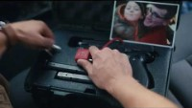
National VA Suicide Prevention Lethal Means Safety (LMS):
Public Service Announcement (PSA)
Notes:
With nearly 70% of Veteran suicides being by firearm and approximately 1/3 of Veterans storing their firearms loaded and unlocked, we know that increasing time and space between individuals facing a suicidal crisis and a firearm prevents suicide.
A call to action, to “Learn how securing your guns can help prevent suicide”. Viewers are then directed to www.keepitsecure.net, a landing page that will connect to additional Lethal Means Safety content.

Slide 42
Veteran resources available right now:
Michigan Veterans Affairs Agency is home to 1-800-MICH-VET (1-800-642-4838) that serves as a 24/7 call center connecting veterans to state programs, federal benefits, and local resources. MVAA houses the emergency financial assistance program, Food4Vets food voucher program along with the Buddy-to-Buddy Program. All services offered are free of charge, https://www.michigan.gov/mvaa .
Veterans Crisis Line. If you are having thoughts of suicide, call 988 then PRESS 1 or visit veteranscrisisline.net/. For emergency mental health care, you can also go directly to your local VA medical center 24/7 regardless of your discharge status or enrollment in other VA health care.
Vet Centers. Discuss how you feel with other veterans in these community-based counseling centers. 70 percent of Vet Center staff are veterans. Call 1-877-927-8387 or find one near you.
VA Mental Health Services Guide. This guide will help you sign up and access mental health services.
MakeTheConnection.net. Visit for information, resources, and veteran to veteran videos for challenging life events and experiences with mental health issues.
Notes:
With nearly 70% of Veteran suicides being by firearm and approximately 1/3 of Veterans storing their firearms loaded and unlocked, we know that increasing time and space between individuals facing a suicidal crisis and a firearm prevents suicide.
A call to action, to “Learn how securing your guns can help prevent suicide”. Viewers are then directed to www.keepitsecure.net, a landing page that will connect to additional Lethal Means Safety content.

Slide 43
Veteran resources available right now:
RallyPoint. Talk to other veterans online. Discuss: What are your feelings as the Taliban reclaim Afghanistan after 20 years of U.S. involvement?
Tragedy Assistance Program for Survivors (TAPS). Request a Peer Mentor.
VA Women Veterans Call Center. Call or text 1-855-829-6636 (M-F 8 a.m. to 10 p.m. and Saturday 8 a.m. to 6:30 p.m. Eastern).
VA Caregiver Support Line. Call 1-855-260-3274 (M-F 8 a.m. to 10 p.m. and Saturday 8 a.m. to 5 p.m. Eastern).
Together We Served. Find your battle buddies through unit pages.
George W. Bush Institute. Need help or want to talk? Check In or call 1-630-522-4904 or email checkin@veteranwellnessalliance.org.
Elizabeth Dole Foundation Hidden Heroes. Join the Community
American Red Cross Military Veteran Caregiver Network. Peer Support and Mentoring
Team Red, White & Blue. Hundreds of events weekly. Find a chapter in your area.
Student Veterans of America. Find a campus chapter to connect with.
Team Rubicon. Find a local support squad.
Michigan Veteran Navigator Program, MDHHS - Veteran Navigators (michigan.gov).
Notes:
With nearly 70% of Veteran suicides being by firearm and approximately 1/3 of Veterans storing their firearms loaded and unlocked, we know that increasing time and space between individuals facing a suicidal crisis and a firearm prevents suicide.
A call to action, to “Learn how securing your guns can help prevent suicide”. Viewers are then directed to www.keepitsecure.net, a landing page that will connect to additional Lethal Means Safety content.

Slide 44
If you take NOTHING else away…
Know….
  …that there’s active collaborative efforts toward preventing veteran suicide.
    …that your organization can be part of it.
  …that there’s resources and benefits available to vets and their loved ones.
Know….
  …that often the biggest barrier to connection, is veterans merely not knowing what they’ve earned.
  …that MVAA and the VA stands ready to serve those who’ve served us, and their loved ones. Use 1-800-MICH-VET.
Notes:
With nearly 70% of Veteran suicides being by firearm and approximately 1/3 of Veterans storing their firearms loaded and unlocked, we know that increasing time and space between individuals facing a suicidal crisis and a firearm prevents suicide.
A call to action, to “Learn how securing your guns can help prevent suicide”. Viewers are then directed to www.keepitsecure.net, a landing page that will connect to additional Lethal Means Safety content.

Slide 45

Questions?
Notes:
With nearly 70% of Veteran suicides being by firearm and approximately 1/3 of Veterans storing their firearms loaded and unlocked, we know that increasing time and space between individuals facing a suicidal crisis and a firearm prevents suicide.
A call to action, to “Learn how securing your guns can help prevent suicide”. Viewers are then directed to www.keepitsecure.net, a landing page that will connect to additional Lethal Means Safety content.

