Slide 1
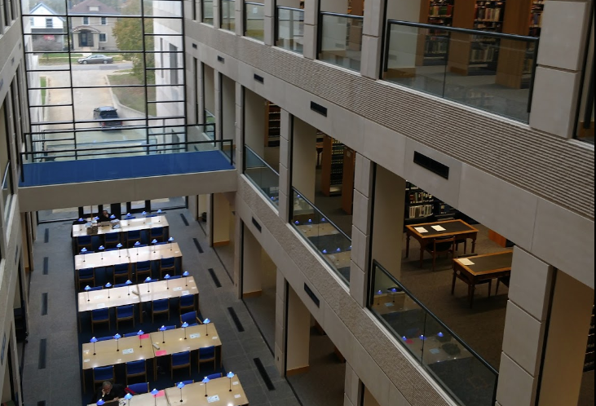
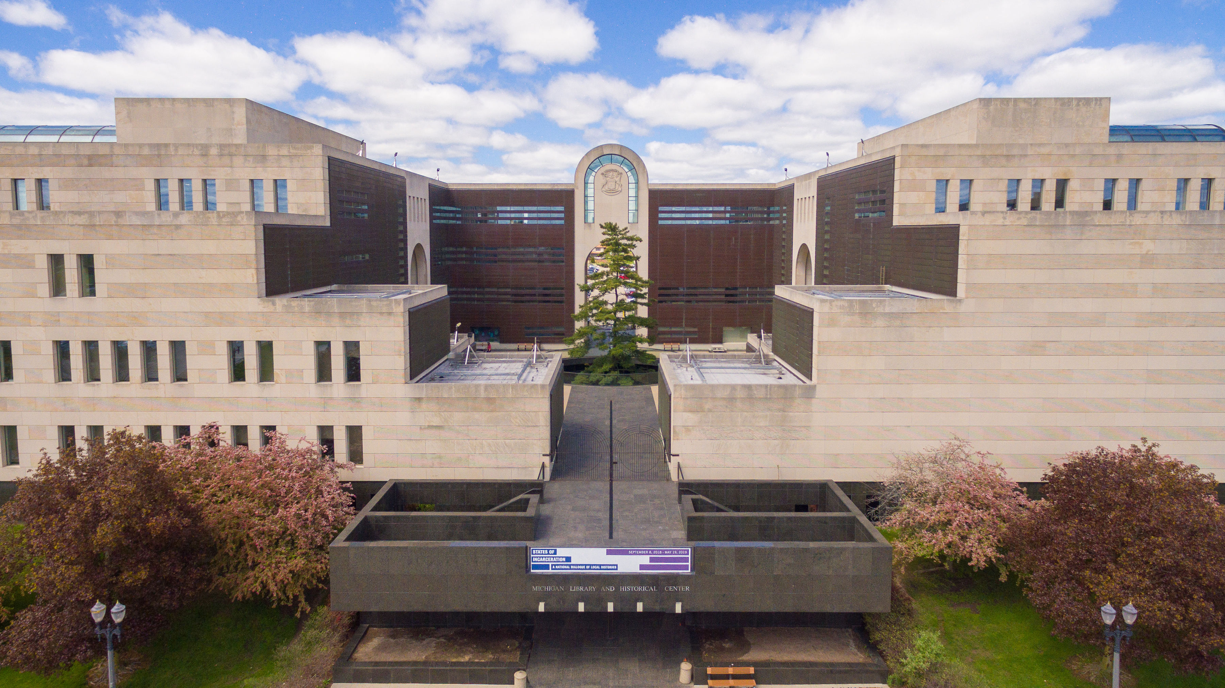
Cents and Census-Ability: A guide to the 2020 census for Michigan Libraries

Slide 2
Your Speakers – and what we will discuss
Joe Hamlin Library Data Coordinator What is the census and what does it collect?
Kathy Webb State Aid & Penal Fines Coordinator How does the Census help Michigan libraries?
Clare Membiela Library Law Consultant What are the Legal implications of the Census?
Evette Atkin Continuing Education Consultant How all this info comes together for your library

Slide 3
What is the Decennial Census?
What is it?
A count of the population taken every 10 years since 1790
A tool that provides valuable data about our population
A Simple Survey that will now be available electronically
Why do we do it
To calculate the number of seats that each state will have in the U.S. House of Representatives
To Learn about our population
The Data is used in several ways

Slide 4
Participating in the Decennial Census
Why Participate?
Being counted = Money
Being Counted = Political Representation
Collects useful, usable data
Allows us to get a broader sense of our population

Slide 5
Census Data Sets
American Community Survey (ACS)
https://www.census.gov/programs-surveys/acs/data.html
Population, age, education, business, race and ethnicity, income, housing, poverty
Quick Facts
https://www.census.gov/quickfacts
Same as above plus, Computer and Internet use, Economy, Transportation, Geography, Easy to use dropdown menus to navigate.
Geography
https://www.census.gov/programs-surveys/geography/data/interactive-maps.html
Interactive Maps, Infographics,
My Congressional District
https://www.census.gov/mycd/
ACS Data by Congressional District

Slide 6
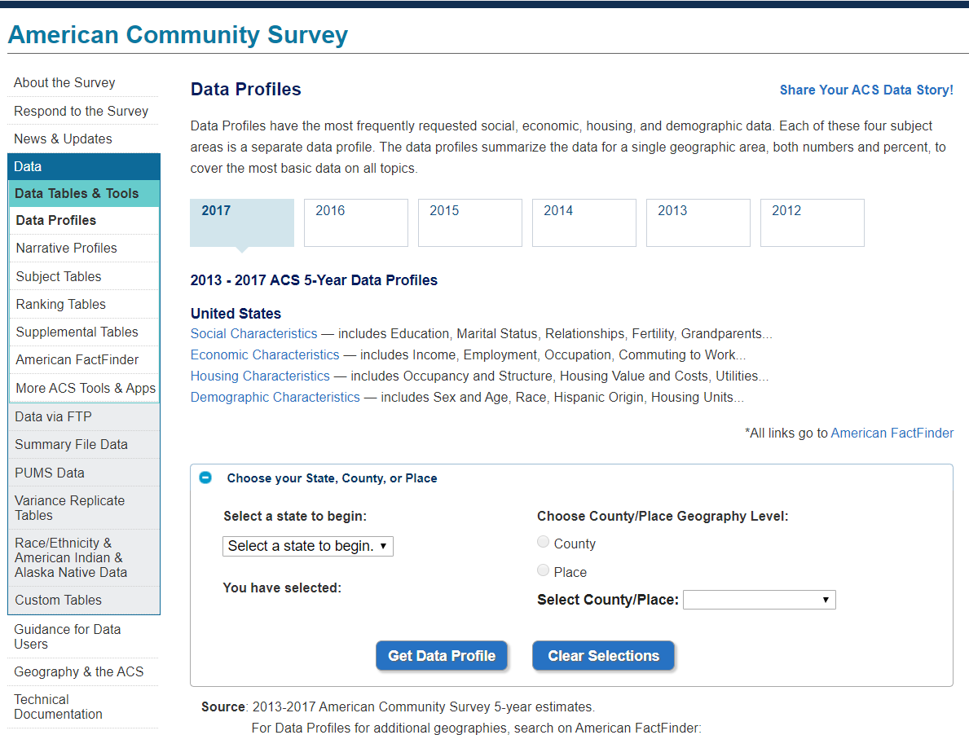
American Community Survey
Data Profiles for specific areas
Subject, Ranking Tables
Narrative Profiles
Custom Tabulations

Slide 7
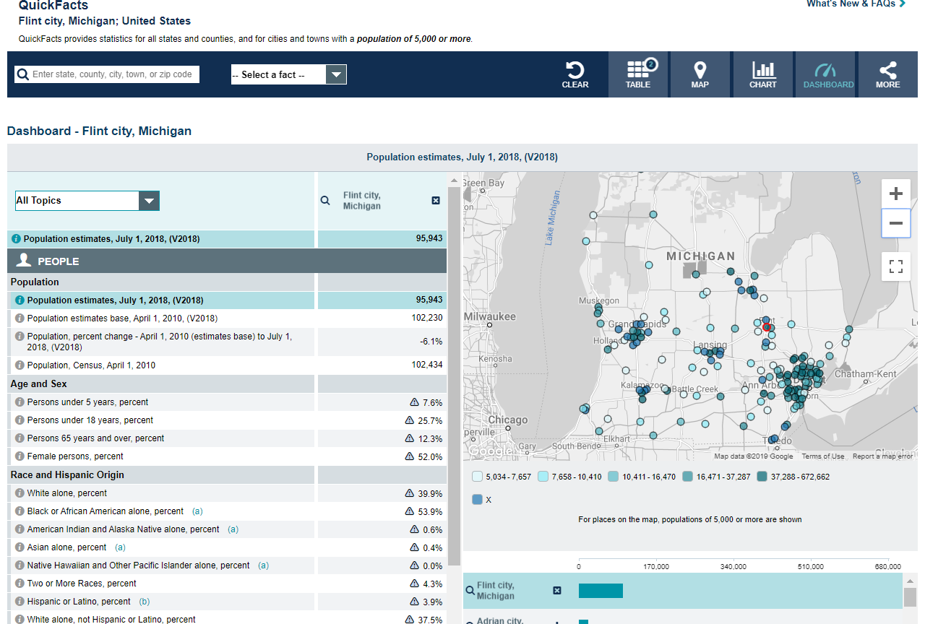
Census QuickFacts
Easy to Use
Tables, Maps and Charts
Search by Locale
Multiple Facts to Search By
Easy to Export, Embed, Share to Social Media

Slide 8
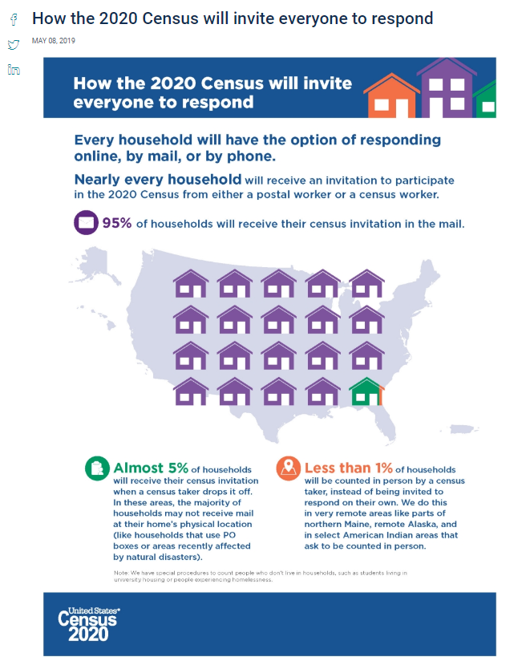
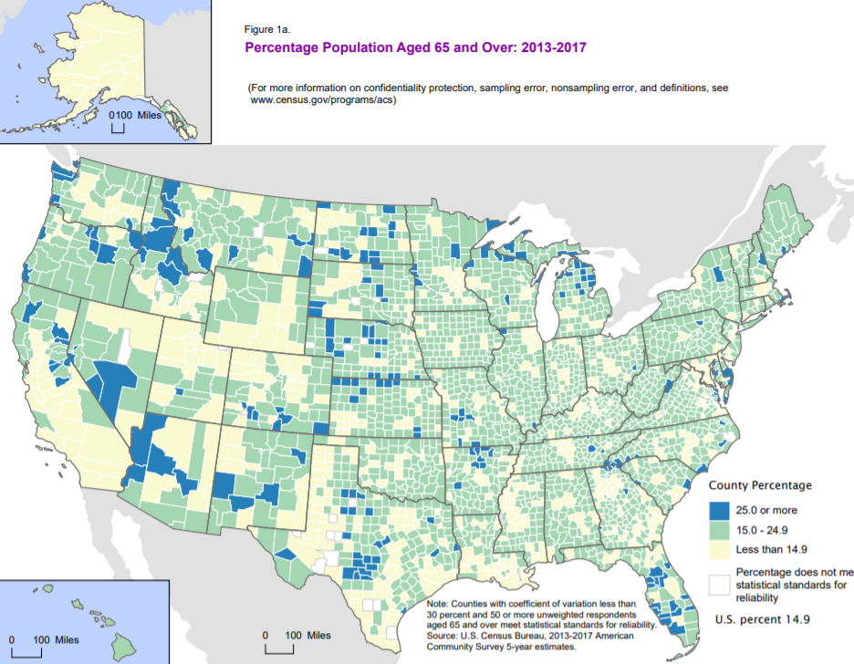
Geography
Interactive Maps
Infographics
Fact Sheets

Slide 9
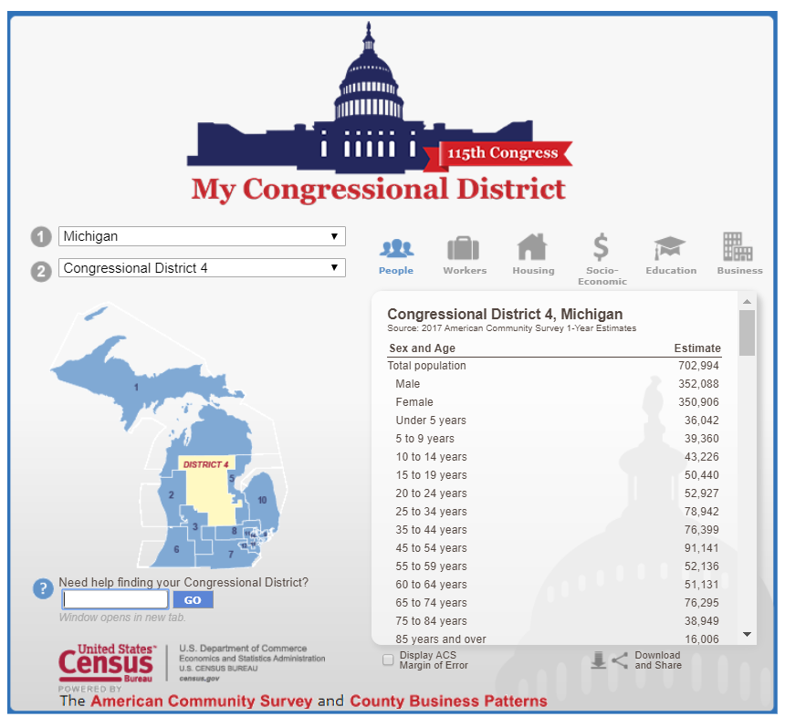
My Congressional District
Data by Congressional District
Informed by the ACS & CBP
Multiple Data Tables
Easy to Use

Slide 10
Why the Census is Important to Your Library

Slide 11
Additional state Funding
State Aid to Public Libraries
State Aid is paid on a per capita system
As the number of people served goes up, state aid funds go up
Penal fines to Public Libraries
Penal Fines to Public Libraries are paid from the county treasurer
Paid to established public libraries on a per capita basis
Population increases the service area population increases.
This Photo by Unknown Author is licensed under CC BY-SA-NC

Slide 12
Important Fact: Personnel Requirements for Public Libraries
A public library that does not comply with personnel requirements due to a change in class level following the application of a decennial census may receive state aid if the personnel continue to present valid certificates and were employed before the library received notification of the change in class level. When a person employed before the change in class level leaves the position, the position shall be filled in accordance with the personnel requirements in order for the library to receive state aid.

Slide 13
Changes in Legal Service Area
A public library that shifts to a higher class level because of a change in its legal service area population shall meet the higher level of requirements for personnel not later than the beginning of its next reporting year after the library has received notice from the department (Library of Michigan) of the change in library class size.
Note: After a notice of change in library service area the Library of Michigan will notify in writing to the library that a change in population has been received.

Slide 14
Public Library Class Levels
A class 1 public library serves a population of 3,999 or less
A class 2 public library serves a population of 4,000 to 6,999
A class 3 public library serves a population of 7,000 to 11,999
A class 4 public library serves a population of 12,000 to 25,999
A class 5 public library serves a population of 26,000 to 49,999
A class 6 public library serves a population of 50,000 or more

Slide 15
When will new numbers be released
March 31, 2021 Redistricting Counts to states
Please note that these dates are strictly tentative from information from the U.S. Census Bureau is giving individuals who attended the Census Solution workshops.
The State of Michigan has not released any tie frames for release of 2020 Census populations at this time.
Updates as more information becomes available.

Slide 16
For more information on the state Aid to Public Libraries Application Process : Please visit https://www.michigan.gov/documents/libraryofmichigan/State_Aid_to_Public_Libraries_Application_Process_544008_7.pdf
Visit U.S. Census Bureau at census.gov
This Photo by Unknown Author is licensed under CC BY-SA

Slide 17
Legal Census-abilities
Completion
Privacy
Accommodation

Slide 18
Completion
Article I, Section 2, U.S. Constitution:
Representatives and direct taxes shall be apportioned among the several states which may be included within this union, according to their respective numbers, … The actual Enumeration shall be made within three years after the first meeting of the Congress of the United States, and within every subsequent term of ten years, in such manner as they shall by law direct.

Slide 19
Title 13, United States Code

Slide 20
13 U.S. Code § 221.Refusal or neglect to answer questions; false answers
(a)Whoever, being over eighteen years of age, refuses or willfully neglects, when requested by the Secretary, or by any other authorized officer or employee of the Department of Commerce or bureau or agency thereof acting under the instructions of the Secretary or authorized officer, to answer, to the best of his knowledge, any of the questions on any schedule submitted to him in connection with any census or survey provided for by subchapters I, II, IV, and V of chapter 5 of this title, applying to himself or to the family to which he belongs or is related, or to the farm or farms of which he or his family is the occupant, shall be fined not more than $100.
(b)Whoever, when answering questions described in subsection (a) of this section, and under the conditions or circumstances described in such subsection, willfully gives any answer that is false, shall be fined not more than $500.
(c)Notwithstanding any other provision of this title, no person shall be compelled to disclose information relative to his religious beliefs or to membership in a religious body.

Slide 21
13 U.S. Code § 222.Giving suggestions or information with intent to cause inaccurate enumeration of population
Whoever, either directly or indirectly, offers or renders to any officer or employee of the Department of Commerce or bureau or agency thereof engaged in making an enumeration of population under subchapter II, IV, or V of chapter 5 of this title, any suggestion, advice, information or assistance of any kind, with the intent or purpose of causing an inaccurate enumeration of population to be made, shall be fined not more than $1,000 or imprisoned not more than one year, or both.

Slide 22
Privacy
The Census Bureau,the Secretary of Commerce, and the employees MAY NOT share, release, disclose or otherwise provide census information that is identifiably attached to a particular respondent
§9. Information as confidential; exception
(a) Neither the Secretary, nor any other officer or employee of the Department of Commerce or bureau or agency thereof, or local government census liaison, may, except as provided in section 8 or 16 or chapter 10 of this title or section 210 of the Departments of Commerce, Justice, and State, the Judiciary, and Related Agencies Appropriations Act, 1998 or section 2(f) of the Census of Agriculture Act of 1997-
(1) use the information furnished under the provisions of this title for any purpose other than the statistical purposes for which it is supplied; or
(2) make any publication whereby the data furnished by any particular establishment or individual under this title can be identified; or
(3) permit anyone other than the sworn officers and employees of the Department or bureau or agency thereof to examine the individual reports.

Slide 23
§8. Authenticated transcripts or copies of certain returns; other data; restriction on use; disposition of fees received
(a) The Secretary may, upon written request, furnish to any respondent, or to the heir, successor, or authorized agent of such respondent, authenticated transcripts or copies of reports (or portions thereof) containing information furnished by, or on behalf of, such respondent in connection with the surveys and census provided for in this title, upon payment of the actual or estimated cost of searching the records and furnishing such transcripts or copies.
(b) Subject to the limitations contained in sections 6(c) and 9 of this title, the Secretary may furnish copies of tabulations and other statistical materials which do not disclose the information reported by, or on behalf of, any particular respondent, and may make special statistical compilations and surveys, for departments, agencies, and establishments of the Federal Government, the government of the District of Columbia, the government of any possession or area (including political subdivisions thereof) referred to in section 191(a) of this title, State or local agencies, or other public and private persons and agencies, upon payment of the actual or estimated cost of such work. In the case of nonprofit agencies or organizations, the Secretary may engage in joint statistical projects, the purpose of which are otherwise authorized by law, but only if the cost of such projects are shared equitably, as determined by the Secretary.
(c) In no case shall information furnished under this section be used to the detriment of any respondent or other person to whom such information relates, except in the prosecution of alleged violations of this title.
(d) All moneys received in payment for work or services enumerated under this section shall be deposited in a separate account which may be used to pay directly the costs of such work or services, to repay appropriations which initially bore all or part of such costs, or to refund excess sums when necessary.

Slide 24
§214. Wrongful disclosure of information
Whoever, being or having been an employee or staff member referred to in subchapter II of chapter 1 of this title, having taken and subscribed the oath of office, or having sworn to observe the limitations imposed by section 9 of this title, or whoever, being or having been a census liaison within the meaning of section 16 of this title, publishes or communicates any information, the disclosure of which is prohibited under the provisions of section 9 of this title, and which comes into his possession by reason of his being employed (or otherwise providing services) under the provisions of this title, shall be fined not more than $5,000 or imprisoned not more than 5 years, or both.

Slide 25
Elephant in the Room
Most Federal Employees in the Bureau of the Census are NOT political appointees
Current Statutes prohibit disclosure of information connected to particular individuals to governmental and non-governmental entities
Only Congress can amend the US Code.

Slide 26
Library Privacy Act
Providing assistance to patrons in completing the Census is not a violation of the Library Privacy Act- as long as the assistance is desired and /or requested.
Do NOT tell patrons how to answer – simply facilitate completion or connect to resources.
Make sure that no copies of an individual’s submission is saved on the computer

Slide 27
ADA Requirements
Disabled populations are one of the most undercounted groups.
Not enough information/follow-up
Fear of interference with Government programs (distrust of government)
Lack of transportation/assistance
Disability makes completing survey difficult
The ADA regulations (Parts II & III - 35 CFR 101 et., seq & 36 CFR 101 et.,seq) not only requires that the Census be accommodating to Americans and residents with Disabilities, it also requires that public libraries assist patrons with disabilities in obtaining the information/services they seek in the library- including assistance and information on completing the census.
ADA Accommodations are available via Census.gov and via several disabilities rights organizations. If your library has accessible technology (such as TDD phones, voice to text technology , or computers with the ability to read text,) let your disabled patrons and community know. If your community has a large demographic of disabled residents, perhaps work with community partners to reach out to this group.
Contact Census.gov or local disabilities rights organizations to obtain information and/or training on assisting disabled patrons with census completion.

Slide 28
The Census Survey is available in 3 formats. They are:
Online
Phone
Paper

Slide 29
The Census Survey is available in 3 formats. They are:
2020 is the first time the decennial census form is available online. However, it is still possible to complete the census via phone or paper form

Slide 30
What do I need to do to ensure that I am not counted multiple times?
Nothing!

Slide 31
What do I need to do to ensure that I am not counted multiple times?
The United States Census Bureau uses numerous tools, not to mention a complex algorithm in place to week out duplicate data.

Slide 32
True or False: The Census is voluntary.
FALSE

Slide 33
True or False: The Census is voluntary.
Refusing or willfully neglecting to complete the census can result in a $100 fine!

Slide 34
If I ____________ my Census form, I could be subjected to a $500 fine.
Falsify

Slide 35
The old or “long” form of the Census is now called the __________.
American Correspondence Survey
American Financial Survey
American Community Survey
Community Family Survey

Slide 36
The old or “long” form of the Census is now called the __________.
America Community Survey

Slide 37
The old or “long” form of the Census is now called the __________.
The American Community Survey (ACS) is conducted every year to provide up-to-date information about the social and economic needs of your community. The ACS shows how people live--our education, housing, jobs and more. For example, results may be used to decide where new schools, hospitals, and emergency services are needed.
The census is conducted once every 10 years to provide an official count of the entire U.S. population to Congress.

Slide 38
Why should libraries help with the 2020 Census?
America’s libraries are ideal partners to help address these challenges. Libraries are trusted institutions and experienced collaborators—providing information, technology, and training resources to enable Americans to connect with government for many purposes. With a convenient presence in communities across the country, from inner-city neighborhoods to remote tribal lands, libraries can help Census stakeholders reach the full range of audiences.
-American Library Association

Slide 39
Questions?

Slide 40
We Are Here To Help
Evette Atkin atkine@michigan.gov 517-335-1495 Continuing Education Coordinator
Joseph Hamlin hamlinj2@michigan.gov 517-335-1501 Library Data Coordinator Public Library Staff Certification
Kathy Webb webbk1@michigan.gov 517-335-1514 State Aid and Penal Fines Coordinator
Clare Membiela membielac@michigan.gov 517-335-8132 Library Law Consultant

